Slide 1

Central Alabama Aging Consortium Area Agency on Aging
Connecting the Community to Services

Slide 2
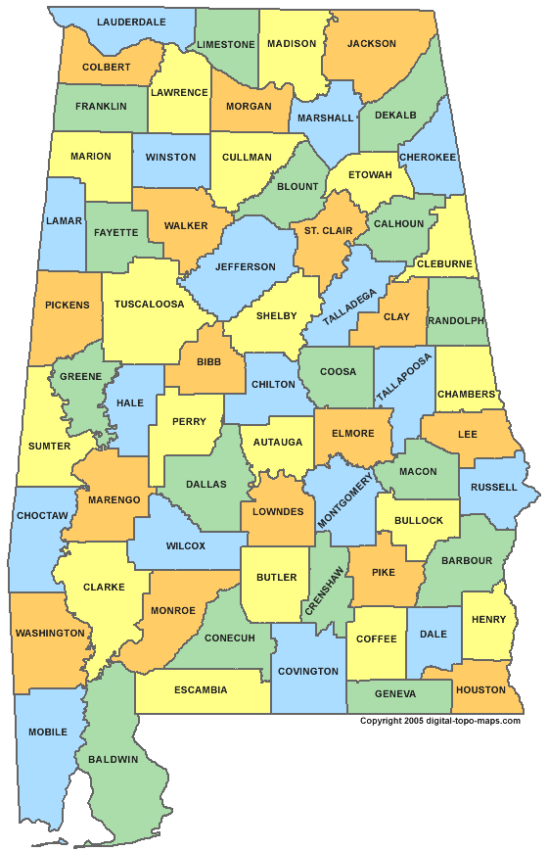
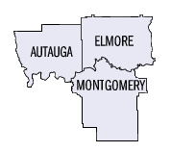
CAAC’s service area
State Unit on Aging
  Alabama Department of Senior Services
  Commissioner Appointed by the Governor
  Commissioner Jean Brown
  Provides over-sight and distributes federal and state funds
  13 Area Agencies on Aging which cover all of Alabama’s 67 counties

Slide 3

CAAC – connecting you to services
ADVOCACY
  Elder Justice
    Empower, Protect, and Advocate
    Education and Awareness
    Elder Justice Protection Tool Kit
  Legal
    No cost legal assistance
    Advance Directives
    Housing, Benefit programs, Debt collection, Consumer issues
    Defense of Guardianship

Slide 4
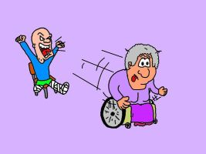

CAAC – connecting you to services
  Ombudsman
    Skilled Nursing Facilities and Assisted Living Facilities
    Work to improve quality of life
    Complaint Resolution, Staff In-Services, Education, Family and Resident Councils
    Annual Conference and Annual Inter-Agency Meeting
  SMP
    Prevent, Detect, Report Medicare and Medicaid Fraud

Slide 5


CAAC – connecting you to services
Community Based Services
  Aging and Disability Resource Center
    Intake – Place to start
    Eligibility Screening and Application Assistance
    Information and Referrals

Slide 6



CAAC – connecting you to services
  Dementia Friendly Communities
    Dementia Friendly Alabama
    Partnerships
    Education – Community, Schools, Business
    Resources – website and face book page
    Training

Slide 7

CAAC – connecting you to services
  Elderly Nutrition Program
    19 Senior Centers/Meal Sites; 1 Pick-up Center
    Total hot meals per day-1050
      410 Senior Centers; 640 Homebound (Meals on Wheels)
    Frozen Door to Door Meals – 120 5 pack meals =600 per week
    Must be 60 and older or spouse of 60 & older
    Nutrition Counseling provided by licensed dietician

Slide 8

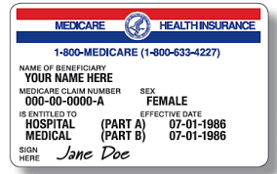
CAAC – connecting you to services
SenioRx
  Assists uninsured and underinsured individuals with obtaining low or no cost medications
  Pharmaceutical Company Patient Assistance Programs
  55 and older with one or more chronic medical conditions that require daily medication, no insurance. Must meet income limits; OR
  Deemed disabled by the SSA or have applied and are awaiting a decision or have a doctor’s declaration of disability; OR
  In 24 month Medicare Waiting Period or are in the Medicare Coverage Gap
SHIP
  Insurance Counseling – Medicare and related programs or coverages
  Medicare, Medicaid, Long-Term Care Insurance
  Part D Assistance and Comparisons
  Just turning 65 or going on Medicare

Slide 9

CAAC – connecting you to services
In-Home Services
  Gateway to the Community Transition Assistance
    Assistance in transitioning from a Skilled Nursing Facility to the Community
  ACT Waiver
    Individuals who meet Medicaid’s criteria for institutional Medicaid who have transitioned from a Skilled Nursing Facility into the community
    Medical, Income, and Asset criteria
    Services include Case Management, Homemaker, Personal Care, Meals, Companion, Skilled and Unskilled Respite
    Person-Centered Care Planning; Life Planning

Slide 10
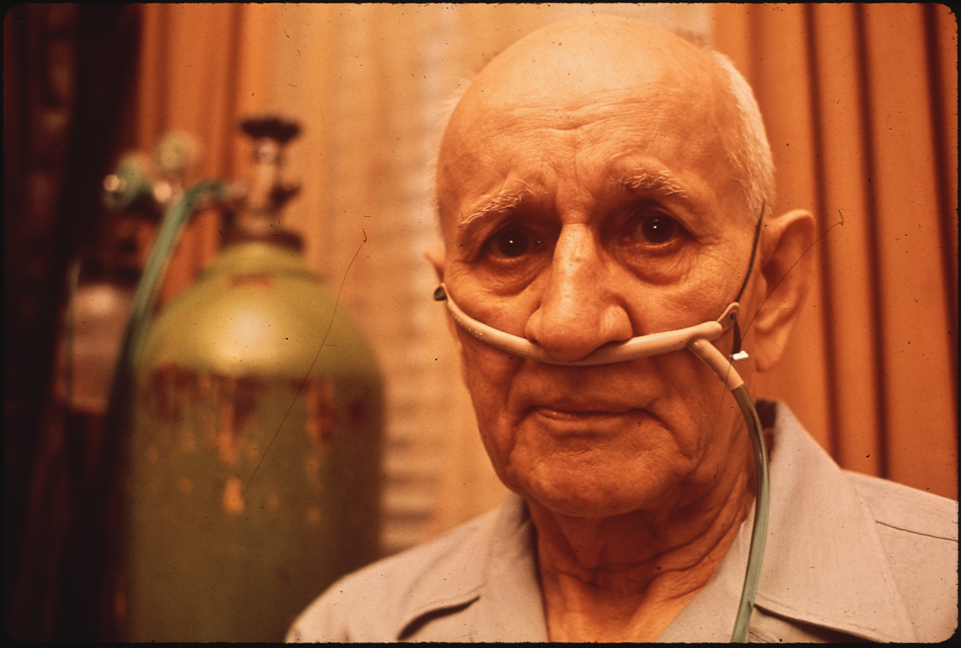
CAAC – connecting you to services
Elderly and Disabled Waiver
  Individuals who meet Medicaid’s Institutional Medicaid guidelines who want to remain in the community rather than going to a Skilled Nursing Facility
  Medical, Income, Asset Criteria
  Case Management, Homemaker, Personal Care, Adult Day Care, Meals, Skilled and Unskilled Respite
  Person-Centered Care Planning; Life Planning

Slide 11
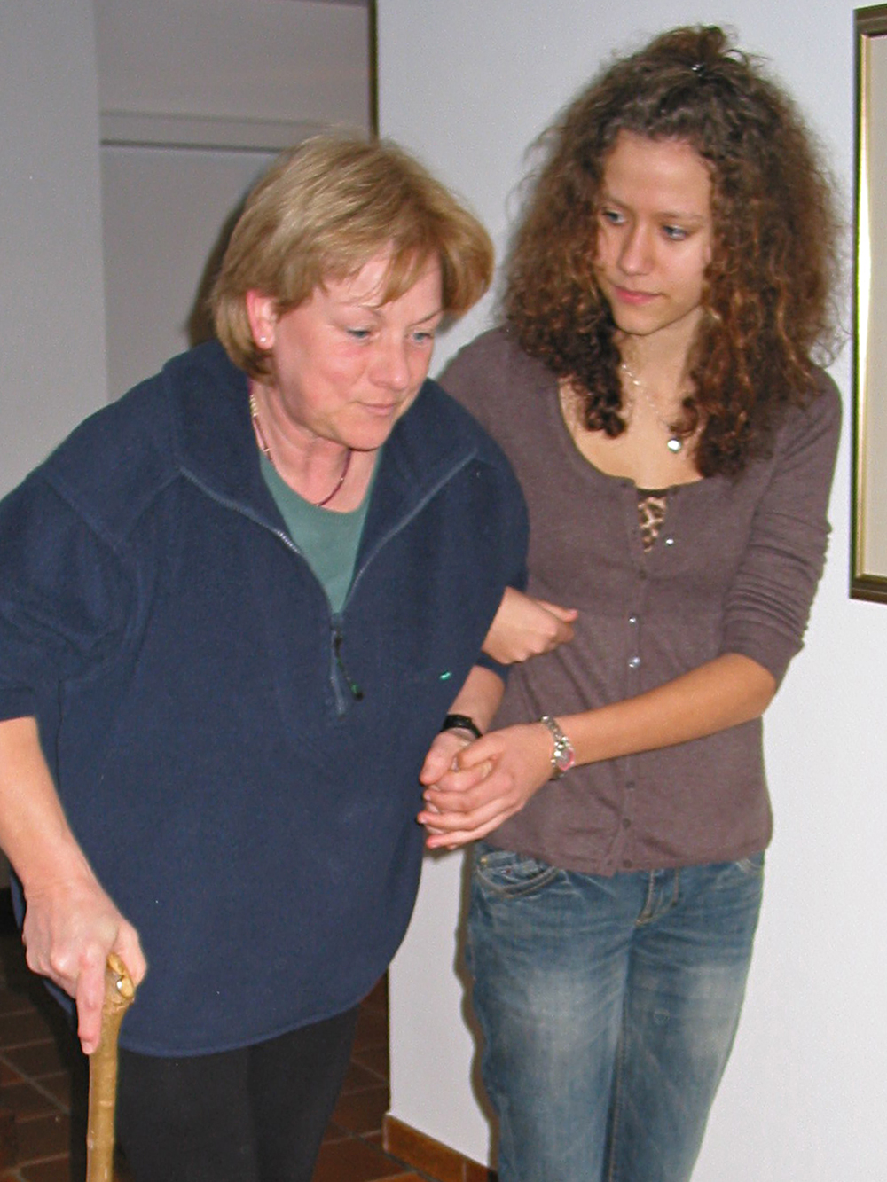
CAAC – connecting you to services
Personal Choices
  Self-Directed Home and Community-Based Services
  Must be on one of the Medicaid Waiver Programs
  Choice and Flexibility
  PC Counselor in addition to Case Manager

Slide 12
CAAC – connecting you to services
Alabama Cares – Family Caregiver Program
  Primary Caregiver for someone 60+ or any age if the person has Alzheimer’s Disease or other Dementia Diagnosis
  A grandparent or relative caregiver 55+ (who is not the parent) for a child age 18 or younger or an adult age 19-59 with a severe disability
  Services include:
    Information
    Assistance to access to services
    Education, individual counseling, support groups, and caregiver training
    Respite for temporary relief from caregiving responsibilities
    Supplemental Services – incontinent supplies, emergency response systems

Slide 13

CAAC – connecting you to services
Homemaker
  60+ (Limited enrollment)
  Assistance with 2 ADL’s or IADL’s
  Limited assistance with general household activities such as changing bed linens, cleaning, laundry

Slide 14
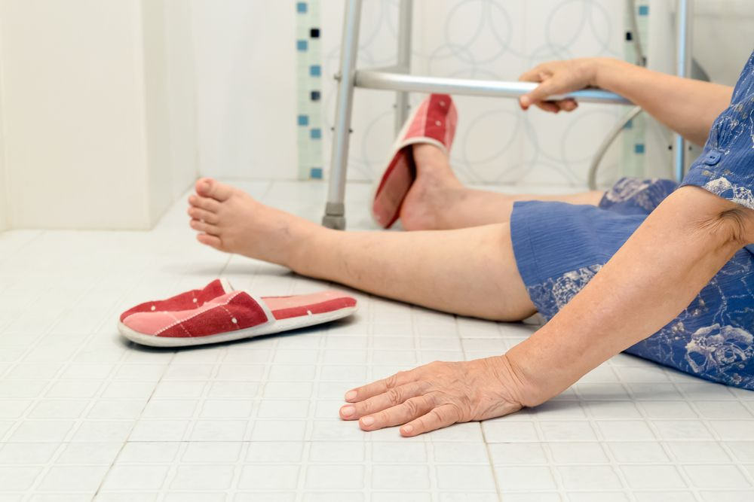
CAAC – connecting you to services
Preventative Services
  CDSMP- Chronic Disease Self-Management
    Contracted
    Classes to assist with managing chronic diseases
  DSMP – Diabetes Self-Management Program
    Contracted
    Classes to assist with managing Diabetes
  MOB – Matter of Balance
    Program designed to reduce the fear of falling and improve activity levels
    Reduce the number of falls and injuries from falls

Slide 15

CAAC – connecting you to services
Public Education Events
Health/Senior Fairs
Partnership Development
Older Americans Month Event – May
Master’s Games

Slide 16
CAAC – connecting you to services
Central Alabama Aging Consortium Area Agency on Aging
  2500 Fairlane Drive Montgomery, AL 36116
  ADRC – 334-240-4670 Main Line – 334-2404680 Toll Free – 800-264-4680
  1-800-AGE-LINE (243-5463) State-Wide Number
  Susan Segrest, Executive Director
  CAAC - Serving the elderly and disabled in our service area

