Slide 1


Leveraging USF Funding to Increase Broadband Access for Rural Healthcare
Presented by:
Reid Freeman– Regional Sales Manager
TeleQuality Communications
Notes:
Thank for the introduction (when applicable) and welcome everyone to the session.

Slide 2
Today Topics
  • The Telehealth Framework
  • The Universal Service Fund and the Rural Health Care Program:
    How the USF is financed and distributed
    Eligibility criteria for the program
    How this funding could impact your organization
    How this program has changed in recent years
Notes:
Today’s topics include
(click)
The Telehealth Framework and how this plays into the everyday function of healthcar
(click)
We will also review The Universal Service fund and will specifically dive into the Rural Health Care Program
(click)
We will discuss how the funding is actually financed and how it is distributed
(click)
We will review the eligibility requirements in order to participate in the program, as well as what service can be funded
(click)
We will go into how the funding can impact your organization and will talk about how this can help pay for existing services you have, or maybe you have been delaying the expansion of telecommunication services to be the products you actually need because of cost. So we will discuss how you can now do that while still maintaining an affordable solution for your organization.
(click)
Last but not least, we will discuss the changes the program has experienced in recent years and what you need to know, when you do decide to take advantage of this funding program.

Slide 3

TeleQuality Communications & ENA
Since 1999, TeleQuality Communications has delivered high-quality Internet access, data networking, and communication solutions, supported with a high-touch customer service experience, to healthcare organizations nationwide.
In 2018, we joined forces with Education Networks of America, a leading provider of transformative technology solutions to education and library communities, to bring critical connectivity and communication services to America’s community anchor institutions.
Notes:
Those are some big topics we will be covering, so you are probably wondering how or why I am able to review this information with you today.
(click)
TQ has focused on becoming the expert in the healthcare telecommunications world. We started servicing healthcare facilities in 1999 and have continued to educate our customers on various funding programs they may be eligible for that can help them off-set the costs of implementing a data network that is needed in today’s healthcare world. Because of that focus I am able to communicate to you about the things we have seen that have assisted our customers over the last 19 years.
(click)
In addition to TQ’s years of experience in the healthcare industry we have even more good news. In January 2018 TQ joined forces with an organization called ENA. ENA, similar to TQ has been involved with the federal funding program. The difference between the two organizations is TQ focuses on healthcare and ENA focuses in the schools and libraries division. With the joint expertise in these industries we are confident this joining of forces will help benefit anchor institutions through the US.

Slide 4

The Telehealth Framework
The three vital components to successfully care for long distance patients
Notes:
So let’s jump into the TeleHealth Framework…..

Slide 5
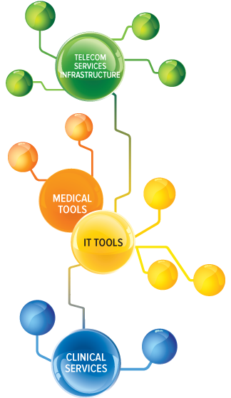
Three Vital Components
1
Telecom Services Infrastructure
  Telecom services specs
  Uniquely designed networks
IT & Medical Tools
  Manage, monitor, support, and secure
  Equipment
  Interoperability
Clinical Services
  The “health” in telehealth
2
3
Image: c 2019 TeleQuality Communications
Notes:
What exactly is the Telehealth framework?? Well, it’s actually a term TQ coined after years of working with healthcare provides. We at TQ feel strongly that a good telehealth program cannot be successful without 3 vital pieces. Those 3 pieces are what we will be discussing in the telehealth framework.
(click)
One vital component of the framework is the Telecom Services Infrastructure. These are the hard wires, or even wireless components your facility uses to talk to the outside world. These are also the services that are fundable through the Universal Service Fund, which is probably the reason you joined this call today.
(click)
The next vital piece contains the IT & Medical Tools. These are the items that manage, monitor, support and secure the services used in the green bubble….the telecom infrastructure….and make it easier for the group in the blue bubble…..the clinical services.
(click)
The last vital piece of the framework is the clinical services. This is what we, at TQ, refer to as the “health” in telehealth. These are the people, the partners, and the patients that use the telehealth products each day.

Slide 6
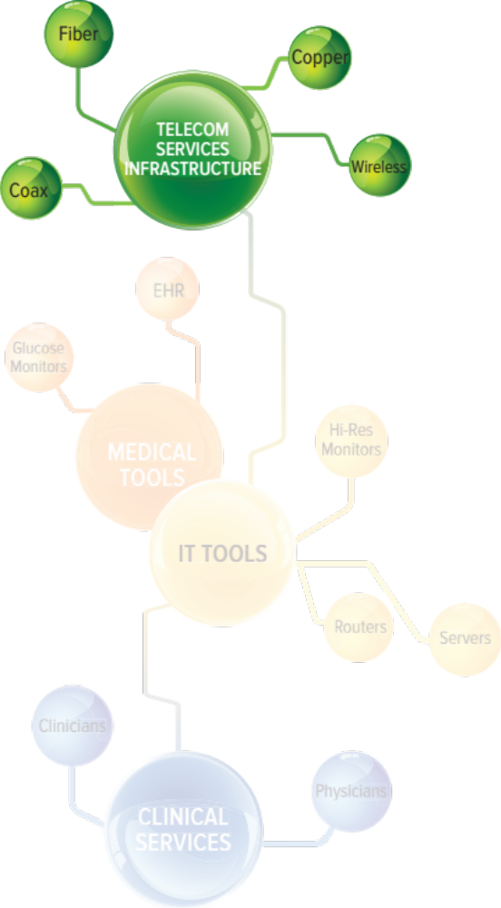
Telecom Services Infrastructure
Minimum required speeds- 10 Mbps
Uniquely designed networks for rural markets
- Ethernet over copper (EoC)
- Redundant networks over different routes/channels
- Creative designs to maximize funding
Image: c 2019 TeleQuality Communications
Notes:
First things first. In order to have a telehealth program run, you must have a way for your facility, and the people in it, to talk to the outside world. How do you do that in today’s world?
(click)
One of the things we learned, in working with healthcare partners is most facilities need a minimum of 10 megabits per second to run a successful network. Please keep in mind, these are minimum numbers recommended by some EMR/EHR companies to successfully use their products/services. Depending on the EMR/EHR platform your organization uses, the minimum speed needed could exceed this. Also, depending on the telemedicine projects you have implemented these speed requirements could also change. Service speed is not the only thing to consider though…..
(click)
The way your network is designed can also play a large role in the functionality of the service. Right now you may be using a dedicated internet line at every facility with VPN tunnels, where as a private cloud connection may be a more efficient and cost effective solution. Each organizations needs can be very unique, and choosing a design that works best for you is an important piece in helping your telehealth products run the way you expect.
So we’ve talked about why you need this, but the good news is, this is the part of the telehealth framework that can be funded under the universal service fund. Although this bandwidth discussion and possible change can be scary the good news is there is funding available to relieve some of the burden.

Slide 7
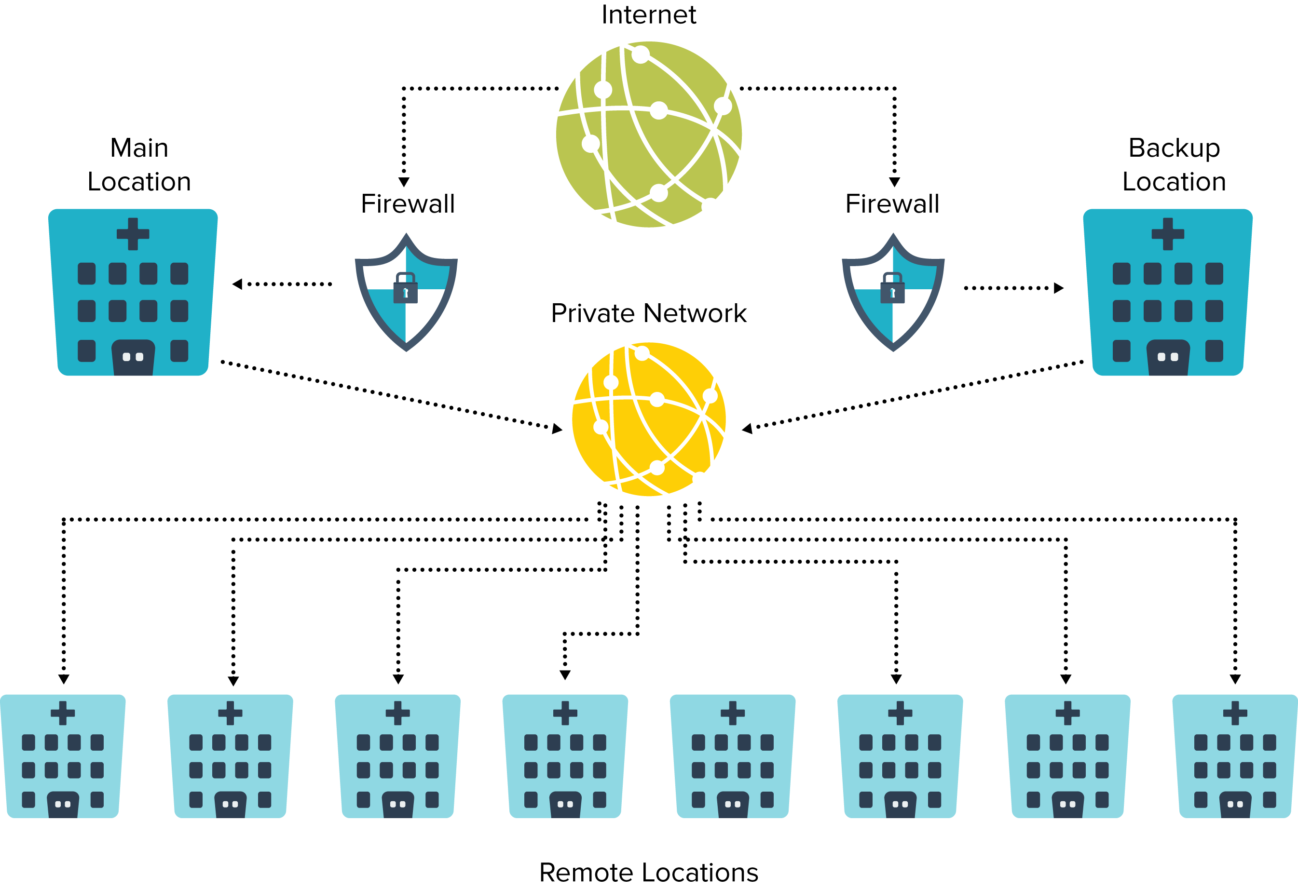
Example: Unique Network Design
Image: c 2019 TeleQuality Communications
Notes:
Because of the funding available and because of the individualized designs available, one of our goals is to ensure you have the right design for your specific needs.
This page gives you an example of a network we have seen some customers utilize. As you can see, the smaller facilities, depicted at the bottom, are remote clinics with either a limited or even non-existent IT support staff. In this case, the IT staff resides at the 2 main locations shown towards the top of the diagram. This customer had previously been using internet services at all locations. This was a heavy burden on their staff. Because there was internet at each site there was equipment located at these remote locations. When something would go wrong on that equipment the IT staff at main site would need to spend their time driving from one site to the other to correct the equipment. With this new design less equipment is needed, minimizing the amount of time the IT staff is on the road. Less equipment is now needed because the firewalls are housed and maintained at the host locations. Each remote site still has access to the internet, their traffic just flows through the host to get to it. This type of network also provides additional security on the network as a whole. Overall this design has saved the customer both time and money.
Once the network is set up to maximize utilization and minimize issues the next thing you want to jump into, to maximize your telehealth projects, are the IT and Medical Tools.

Slide 8
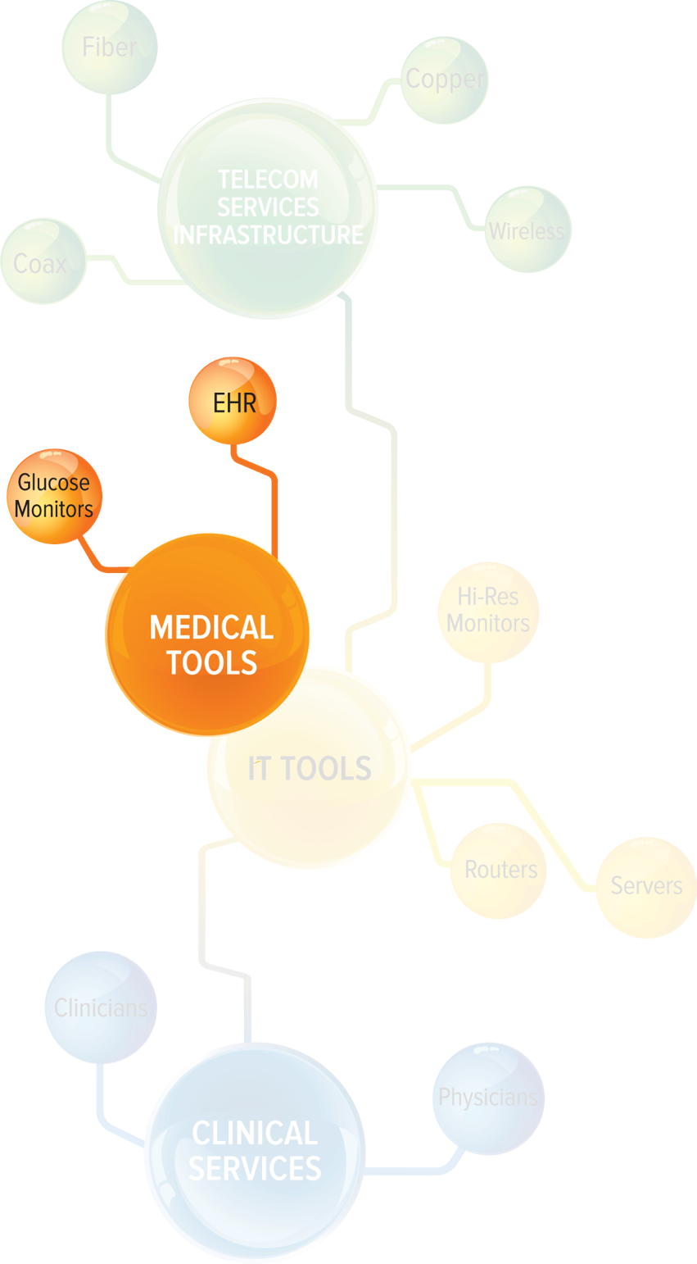
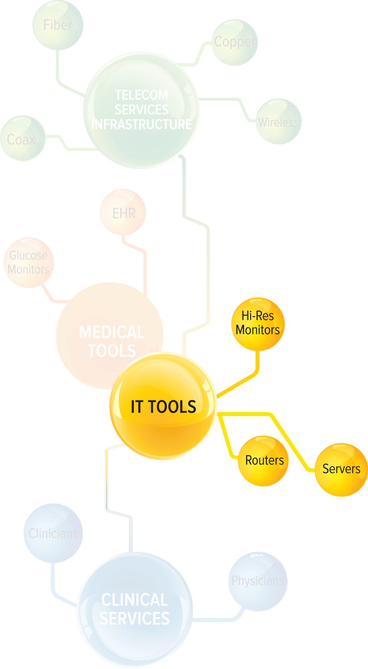
IT and Medical Tools
IT Tools
- Manage
- Monitor
- Support
- Secure
Medical Tools
- Equipment and plans
- Interoperability
Image: c 2019 TeleQuality Communications
Notes:
The IT and medical tools are the pieces of equipment that reside on your organizations Local Area Network, also known as the LAN.
(click)
These tools can include equipment that will manage, monitor support and secure your services, such as routers, switches and firewalls, but also
(click)
The medical tools necessary to perform the functions of your telehealth programs. Including, but not limited to your EMR/EHR system that might be housed in your facility, or even located in the cloud, glucose monitors, X ray machines, hi-resolution monitors used for video telehealth and so many more tools. There are many factors at play with these tools to ensure facilities meet the guidelines for being able to provide telehealth services, and these can be complex. But our goal today is to focus on the network needed to run these tools.

Slide 9
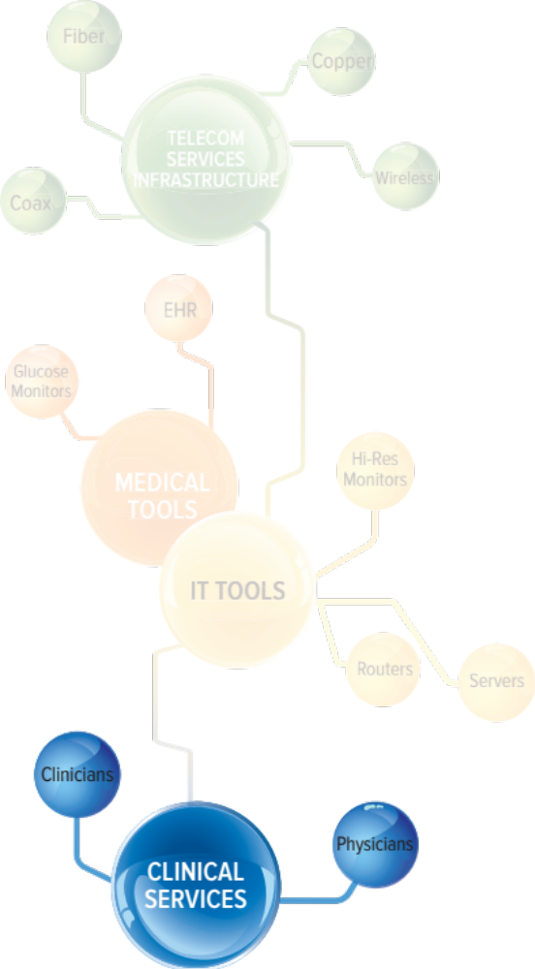
Clinical Services
Telehealth services provided by:
- Radiologists
- Cardiologists
- Skilled healthcare workers
Workflow patterns
- Learning to incorporate technology
into exams and processes
Image: c 2019 TeleQuality Communications
Notes:
The last piece of the telehealth framework is the clinical services piece
(click)
This section refers to the people that will actually be using the tools within your LAN to ensure your team is able to provide the best care possible to the communities you serve.
(click)
Training the team and incorporating this technology into your practice can be an ever changing processes and so it is an important piece to be included in the telehealth framework.

Slide 10

The USF and RHC Program
Understanding The Universal Service Fund and the Rural Health Care Program
Notes:
We’ve spent the whole presentation thus far talking about why you need these services and what they can help you accomplish for your telehealth products…..now let’s talk about the fun stuff….how do you get help from the Universal Service Fund to actually off-set the cost of implementing the network you need to run your telehealth? That green bubble we reviewed earlier.

Slide 11
Some Important Notes
The Universal Service Fund and the Rural Healthcare Program can be confusing for new-timers. We are here to educate.
TeleQuality Communications and its parent company, ENA, are:
  not affiliated with the Universal Service Administrative Company (USAC) which collects and distributes the Universal Service Fund
  not involved in any review or approval processes conducted by USAC
  not involved in the filing process for individual healthcare providers
Notes:
Some quick notes though before I jump into specifics…..
(click)
This funding programing can be confusing, and might even have a bad rap out there from previous users of the program, but don’t worry. My goal today is to educate you on the program and to provide you with resources that can help you truly maximize the funding available to your organization.
(click)
Another important note!! TQ and its parent company ENA are NOT affiliated with the funding program or USAC. We are NOT involved in the review or approval process of the forms and are NOT involved in the actual filing process the Healthcare provider will need to go through.
Okay…now that I’ve made my PSA let’s jump into the details

Slide 12
What is the Universal Service Fund?
Based on the principle of universal service
Communications Act of 1934
  Established universal service in legislation
  Created the Federal Communications Commission (FCC)
  Universal service helped make telephone lines ubiquitous
Telecommunications Act of 1996
  Updated the Communications Act of 1934
  Expanded USF to include advanced services such as high-speed Internet broadband
Source: https://www.fcc.gov/general/universal-service
Notes:
What is the Universal Service Fund??
Click
Universal service is the principle that all Americans should have access to telecommunications services.
Click
This principle is the cornerstone of the Communications Act of 1934,
which established universal service in legislation
and created the Federal Communications Commission (FCC) as the governing body to regulate the communications industry
These policies helped make telephone lines ubiquitous across America throughout the 1930s to today
Click
With the passing of the Telecommunications Act of 1996, Congress expanded the USF to include advanced services such as high-speed Internet broadband.
These universal service policies have helped make telephone and data services widely available throughout the U.S., including rural areas.

Slide 13
How is the USF Financed?
The FCC requires all telecommunications carriers to contribute, including:
  Wireline and wireless companies
  VoIP providers
  Cable companies that provide voice
Contributions are based on a percentage of revenues
Contribution factor changes each quarter based on demand
Contributions are often passed along to consumers via their phone bill
Source: https://www.fcc.gov/general/universal-service
Notes:
One important question I get, when customers are new to the funding program is….How is this fund actually paid for and how long will it last?
(click)
Well the good news is, this fund is housed with the FCC. The FCC requires all carriers to contribute to the fund, so it is it’s own fund and does not seem to be going anywhere anytime soon. This fund helps pay for telecommunication services for many different types of customers, and we will touch on that a little later in the presentation.
(click)
The contributions required are actually based on a percent of the revenue with the service provider and
(click)
That contribution factor is updated quarterly, by the FCC, based on the demand of the program
(click)
In most cases these contributions are passed to consumers via your phone or telecommunications bill. When you review your invoice you will probably notice a FUSF or USF fee. Those fees are then submitted to the FCC and pay for this funding program.

Slide 14
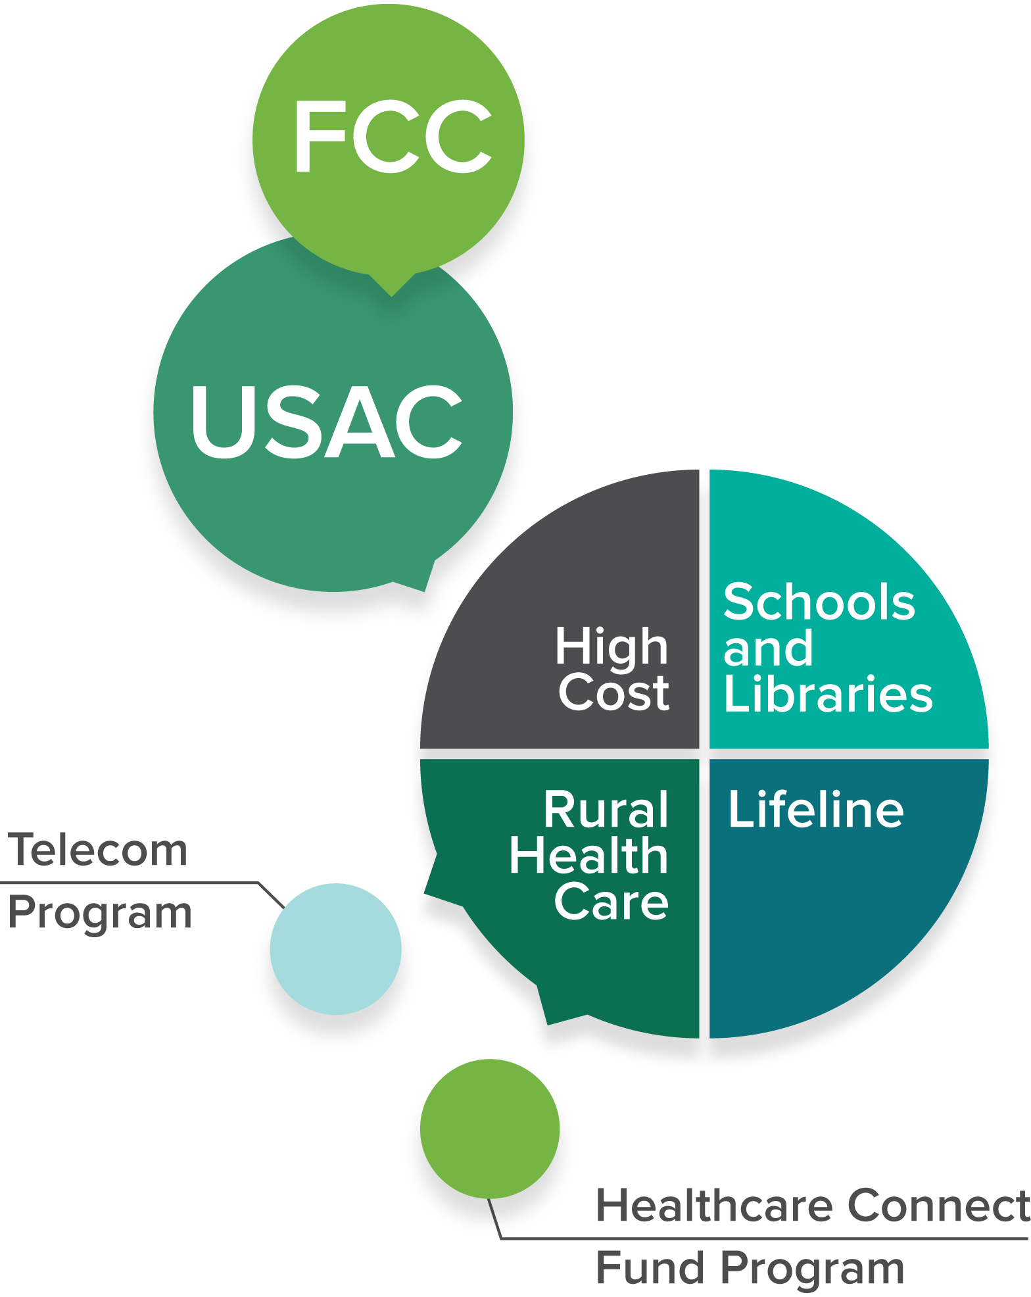
Who Distributes the USF?
The Universal Service Administrative Company (USAC) collects and distributes the Universal Service Fund.
USAC was created in 1997 as a subsidiary of the National Exchange Carrier Association.
USAC is an independent, not-for-profit corporation designated by the FCC as the administrator of all four support programs.
Image: c 2019 TeleQuality Communications
Notes:
Now you know where the money comes from, but another important piece is understanding who is responsible for managing and distributing the funds.
That is where USAC comes into play
(click)
The Universal Service Administrative Company (USAC)* is an independent, not-for-profit corporation designated by the Federal Communications Commission (FCC) as the administrator of all four universal service support programs.
(click)
USAC* was created in 1997 as a subsidiary of the National Exchange Carrier Association (NECA).
(click)
USAC is also an independent, not-for-profit corporation that is managed by the FCC as the administrator for all 4 programs.
As I mentioned earlier, the RHC program is not the only program receiving universal service funds. There are 3 other programs receiving funding as well. Those programs include:
The High Cost Fund
This fund is also referred to as the connect America fund. The funds in this program help ensure voice and broadband services, both fixed and mobile are available to Americans throughout the nation at comparable rates.
Another program is Lifeline
This fund helps families in need obtain voice and broadband connectivity services.
Then there is the Schools and Libraries program, also known as Erate. This program helps ensure schools and libraries can obtain high-speed internet access and telecommunication services at affordable rates. This is the program our partners at ENA have the most experience with.
But the program we are going to focus on today is the Rural Health Care Program.

Slide 15
The Rural Health Care Program
1
Ensures rural health care providers (HCPs) can obtain telecom and Internet services at rates comparable to urban providers
2
Helps HCPs connect physicians, staff, and patients
3
Houses two programs
Healthcare Connect Fund
Telecommunications Program
Source: http://www.usac.org/rhc
Notes:
The rural health care program
(click)
supports health care facilities in bringing world class medical care to rural areas through increased connectivity. In these rural communities the program was designed to ensure the costs of these services would be comparable to the urban providers within the same state.
(click)
By funding facilities in this fashion the goal was to help health care providers better connect to physicians, staff and patients in a way that would allow for the organization to provide the best care possible to the communities they serve
(click)
There are now actually 2 ways to receive funding in this program, by either using the Telecom Program, or the Healthcare Connect Fund Program, but both sub-programs support reduced rates for broadband and telecom services. We will discuss a little later the differences between these programs so you can determine what would work best for your organization.

Slide 16
Eligibility Criteria
1
HCPs must be one of the following entities
  Community health centers or health centers providing healthcare to migrants
  Local health departments or agencies
  Community mental health centers
  Rural health clinics
  Not-for-profit hospitals
  Teaching hospitals, medical schools, or post-secondary educational institutions offering healthcare instruction
  Skilled nursing facilities
HCP must be a non-for-profit entity or public entity
Location
  HCP must be located on an FCC-approved rural location, based on census tract population
  Urban consortiums with rural locations are eligible
2
3
Source: http://www.usac.org/rhc/telecommunications/health-care-providers/eligibility.aspx
Notes:
But before we jump into the different programs, it’s important to first know if your organization would qualify for the funding
(click)
1st it’s important your facility be one of the following entities. As you can see at the bottom of this list, most recently, skilled nursing facilities were also added. So if your organization partners with these types of facilities the services you use to communicate from one location to the next could be funded.
(click)
Next up, your organization must be a non-for-profit or public entity. If you are able to check both of these boxes the final box is
(click)
Based on your location. It is important, that in order to participate in either of the sub-programs, at least some of your facilities must be located in designated rural areas. We have heard, from many providers that they are not deemed rural, in other funding programs, but they are in this one. So, it is important that you review this programs rural designations to ensure you are a fit. So please don’t rule this out until you verify on USAC’s website. And don’t worry, at the end of the presentation we will provide you a link to the website that will help you determine if your site is, in fact, eligible based on location.

Slide 17
Any telecommunications service which is used primarily for the provision of healthcare, including but not limited to:
What Services Are Eligible for Funding?
  ATM (Asynchronous Transfer Mode)
  Centrex
  DSL
  Ethernet
  Fiber
  Fractional T1
  Frame Relay
  ISDN
  Mileage-Related Charges
MPLS
NRS- Network Reconfiguration Services
OC-1
OC-3
Redundant Circuit
Satellite Service
Telephone Service
T1
T3 or DS3
Source: http://usac.org/rhc/telecommunications/health-care-providers/step01/eligible-services.aspx
Notes:
Now you have determined your organization would qualify for funding, let’s next look at the services that are fundable.
(click)
This program is set to fund any telecommunications services used for the provision of healthcare
(click)(click)
This includes, but is not limited to the list included here.
Keep in mind, technology is always evolving, so if you have services not listed here, it’s okay, they could still be fundable as this list is not all inclusive.

Slide 18
Program Comparison
Telecommunications Program
Healthcare Connect Fund
Savings
  Funds the difference between rural and urban connectivity costs
Eligible Expenses
  Telecommunications service
Savings
  Funds a flat rate of 65% for requested services
Eligible Expenses
  Telecommunications service
  Broadband service
  Network equipment
  HCP-constructed and owned network facilities (consortia only)
  Fiber builds
Notes:
Okay, so we’ve gone over what facilities are eligible and what services specifically can get funding, the next step in the process is to determine what sub-program is right for your organization
Let’s 1st talk about the Telecom program.
(click)
This sub-program helps by funding the difference between the rural and urban locations. You may be thinking….what the heck does that mean? A good example here would be……(find a location in the state you are presenting to)
A site in Heflin AL, this is a town of less than 5K people, they may have a clinic in this town that needs those minimum speeds we discussed before, so let’s say a 10 mega bit per second service. That cost, in this rural town, may be $4,000 a month, but a clinic in Birmingham, AL may only be paying $500 a month for that same 10 megabit per second service. The telecommunications fund would fund $3500 a month towards the telecommunications bill so that particular healthcare provider would be responsible for only $500 a month.
If you are sitting there wondering, how do I obtain the urban rate in AL, then you have a few options. The USAC website has information on urban rates, referred to as “safe harbor” and that can help, or you can work with your service provider on obtaining this comparison.
The telecom program has been around since the beginning of the rural health care program, and can be complicated to understand, but very beneficial for organizations that have the right resources available to work through the complex piece. But, because of the complexity, a few years ago the FCC added another program, referred to as the Healthcare Connect Fund, or HCF.
(click)
This fund can be an easier process, in determining savings, as the fund provides a flat 65% savings on your invoice. So if I was to use the same example as above, the customer in Heflin would be funded 65% of the $4,000/month invoice, a $2,600 savings. As you can see, in this case the customer would then be responsible for $1,400/month, as opposed to using the telecom program and paying $500/month. It is definitely a balancing act and something to consider when reviewing which program works best for your organization.
The other benefit to the HCF, is urban locations CAN participate as well, where as the telecom program would only fund services needed to communicate to the rural sites. The HCF, depending on how you file, can also pay for some of the network equipment used, where as the telecom program does not.
Let’s jump into another example of how these two programs compare…..

Slide 19
Program Examples
Services for a 100 Mb circuit funded through the RHC Telecommunications Program
Services for a 100 Mb circuit funded through the RHC Healthcare Connect Fund
Rural Rate = $6,000/month
Urban Rate = $260/month
USF Funds = $5,740/month
Rural Rate = $6,000/month
USF Funds = $3,900/month
$6,000/mo. - $5,740/mo. = $260/month
$6,000/mo. - $3,900/mo. = $2,100/month
Rural Rate
Monthly Recurring Cost for Services
Monthly Cost to HCP After Funding
Rural Rate
Monthly Recurring Cost for Services
Monthly Cost to HCP After Funding
Notes:
(click)
Here is another example of a customers funding based on the 2 programs
(click)
Please note, because an urban rate must be obtained for the telecom program, the rate listed for the savings could fluctuate for this organization.
But again, this breaks out why it is important for each organization to analyze their options and determine which program would be best for you.

Slide 20

Funding Flow Chart
1
2
3
4
5
HCP initiates competitive bidding process to allow for assessing most
cost-effective solutions.
HCP submits paperwork to USAC requesting funding for telecom and/or Internet services.
USAC reviews paperwork and sends approved funding commitment letter to HCP. HCP accepts funding by submitting
the appropriate form
to USAC.
Service provider
then reimburses healthcare provider with funding amount.
USAC administers funds to service provider.
Notes:
Once you determine which program fits best the next step is understanding how to actually get the funding
(click)
1st you would start with the initial paperwork. This first piece of paperwork initiates the competitive bidding and let’s USAC know you are INTERESTED in looking for fundable services. This form in no way commits you to purchasing any services, it only informs USAC and vendors you are interested in pursuing options. Once this form is submitted, you, as a healthcare provider, would need to go out to bid for a minimum of 28 days. This 28 day bidding period is a requirement to receive funding. The form is public, so vendors will know you are interested and will reach out to you to provide a bid for service. At the end of 28 days you are allowed to then select the most cost-effective service. This selection could mean you stay with your existing service, or that you upgrade or change your service to a new provider.
(click)
Once you select the service you want for your organization you, as the healthcare provider then
(click)
File the next piece of paperwork. This form notifies USAC you have selected a service. It also notifies them of the cost and term associated with that service, and if participating in the Telecom program you will also let USAC know what the urban rate comparison would be.
(click)
Once that form is submitted USAC will review the information. Once they finish their review, if approved, you would then receive a funding commitment letter. This funding commitment letter would go to both you, the HCP and the service provider you selected. If you agree with the commitment provided you, the HCP would then go in and file your final piece of paperwork letting USAC know you agree, and that you want your funding.
(click)
Once you submit that form your service provider will then go in and collect the funds on your behalf. Keep in mind, the funds go directly to your service provider, not to your bank. This is an important piece when selecting your service provider. Make sure you ask them their policy on reimbursement of USF and how that will work.
(click)
Once the service provider collects the funds, they will then be required to reimburse you as the HCP.
You may be asking…..why does the funding go to the service provider and not me? Well, the reason is USAC wants to ensure the funding is going to pay for the services they are funding. So if you are behind on your invoice the service provider is able to apply the funds towards those past due balances. However, if you are up to date on your payments, the service provider is required to provide the funds back to your organization.

Slide 21
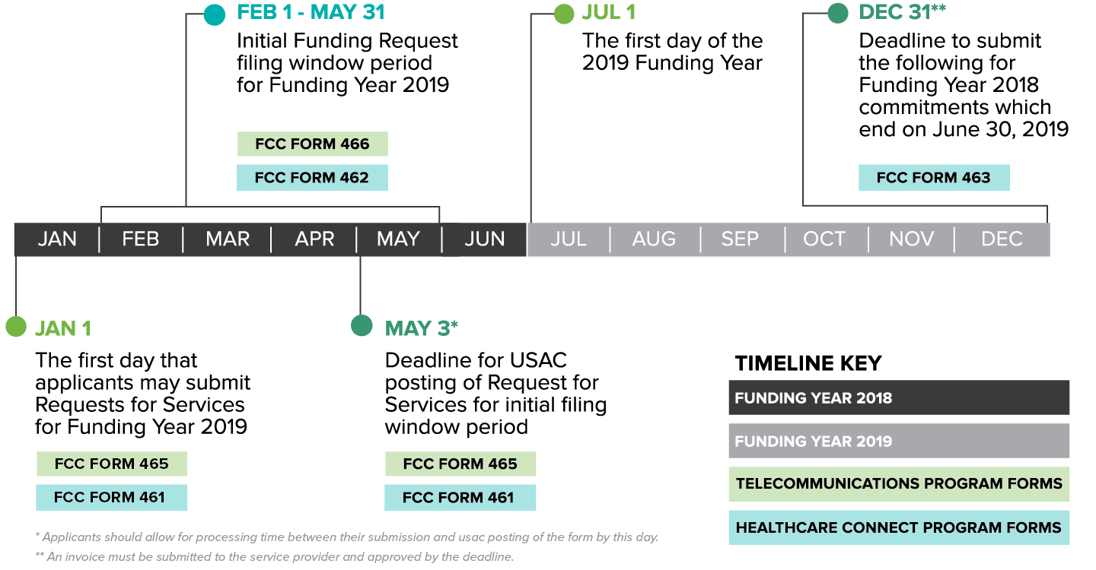
Funding Timeline
Notes:
Now that we’ve reviewed your role and what forms you need to file, on this slide we wanted to show you the timeline for these funds. We have color coded the funding years and the 2 sub-programs differently so you can see when the forms are due.
The funding year starts on 7/1 each year and then ends on 6/30. So currently we are into FY 2018. The calendar can change every year, but this will give you a good idea of when the forms for 2018FY are actually due.
As you can see, the window for bidding opened on Jan 1 this year. Then, on Feb 1 the 2nd form we discussed was available for completion. Unfortunately the window to request funds does close on June 29th. At this time USAC has not indicated if another window will open, but if one does we will be sure to notify our contacts.

Slide 22

USF and RHC Financial Statistics
Notes:
Now you’ve probably decided you definitely need to take part in this available funding, but will there be enough funds to go around? Let’s look at the numbers.

Slide 23
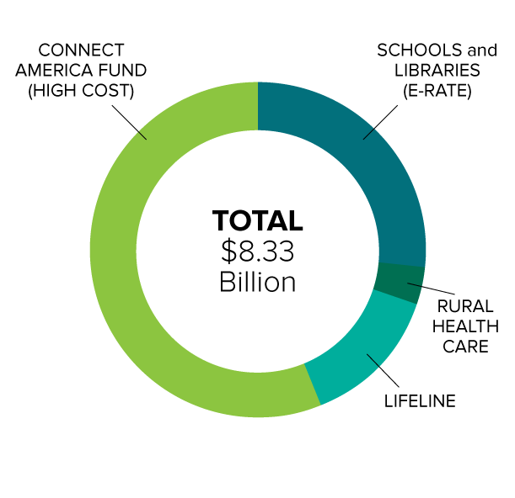
USAC Numbers by Program
Calendar Year 2018
High Cost= ~56.2%
Schools & Libraries (E-rate)= ~26.5%
Rural Health Care= ~ 3.6%
Lifeline= ~13.7%
Source:
https://prodnet.www.neca.org/publicationsdocs/wwpdf/040119usac.pdf
Image: c 2019 TeleQuality Communications
Notes:
As you can see by this chart, in calendar year 2017 there was over 8 billion in funding committed to customers participating in the universal service fund. Yes, I said 8 billion with a B!
This funding has been helping anchor institutions and families in need for many years, and there is certainly plenty of funding available to help your organization as well.

Slide 24
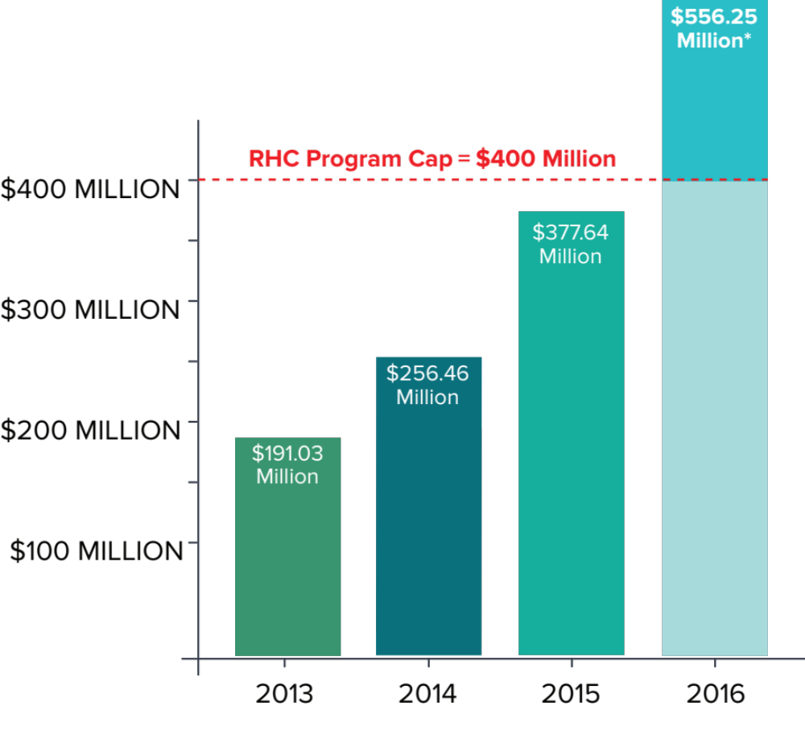

Rural Health Care Program Request History
Demand has exceeded the cap
Pro-rata factor
* Pro-rata factor of 92.5% applied to requests in 2nd filing window for FY2016.
Image: c 2019 TeleQuality Communications
Notes:
For example, the Rural Healthcare Program has always, until this last year, had a cap of $400 million. That cap was never even met until 2016 FY, and at that time customers still received plenty of funding to off-set their telecom costs

Slide 25
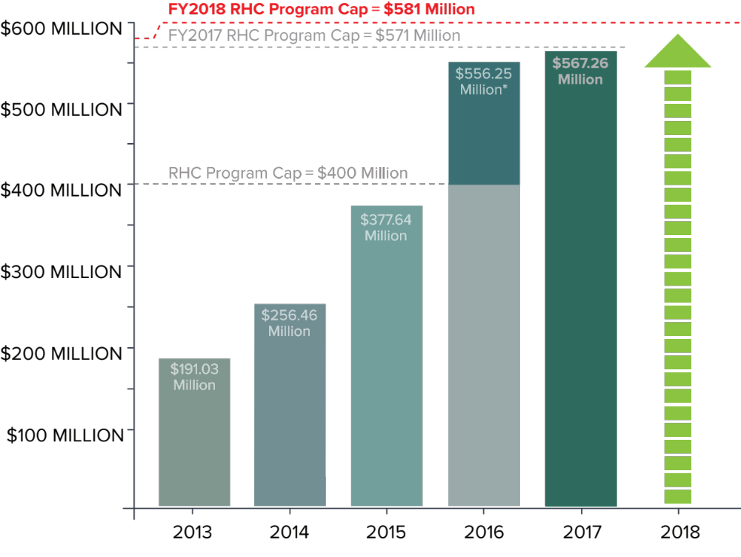
Rural Health Care Program Request Overview
Adjusting the cap
* Pro-rata factor of 92.5% applied to requests in 2nd filing window for FY2016.
Image: c 2019 TeleQuality Communications
Notes:
But in 2017 the applicants definitely blew through the cap so the FCC had to decide what to do. Thankfully they passed new rules and allowed for the cap to expand. So in 2017 FY the cap was raised to 571 Million and every approved application was funded at 100%. And to think ahead the FCC also ruled that future funding years would also have to accommodate for inflation. For that reason, the new cap in 2018 FY will be 581 million.

Slide 26
Funding Year 2019
Funding Year runs July 1, 2019- June 30, 2020
Filing Window runs February 1, 2019-May 31, 2019
Applicants will need to request funding during February 1 – May 31, 2019 for services running from July 1, 2019 through June 30, 2020
Funding Year 2019 funding cap is $593.7M
  This new cap represents a 2.2% inflation-adjusted increase in the
  $581,000,000 cap from FY2018.
Notes:
A few important notes about Funding Year 2019
(click)
Funding Year runs July 1, 2019- June 30, 2020
(click)
The Filing Window for FY2019 runs February 1, 2019-May 31, 2019
(click)
Applicants will need to request funding during February 1 – May 31, 2019 for services running from July 1, 2019 through June 30, 2020
(click)
FY2019 funding cap is $593.7M. This new cap represents a 2.2% inflation-adjusted increase in the $581,000,000 cap from FY2018.

Slide 27
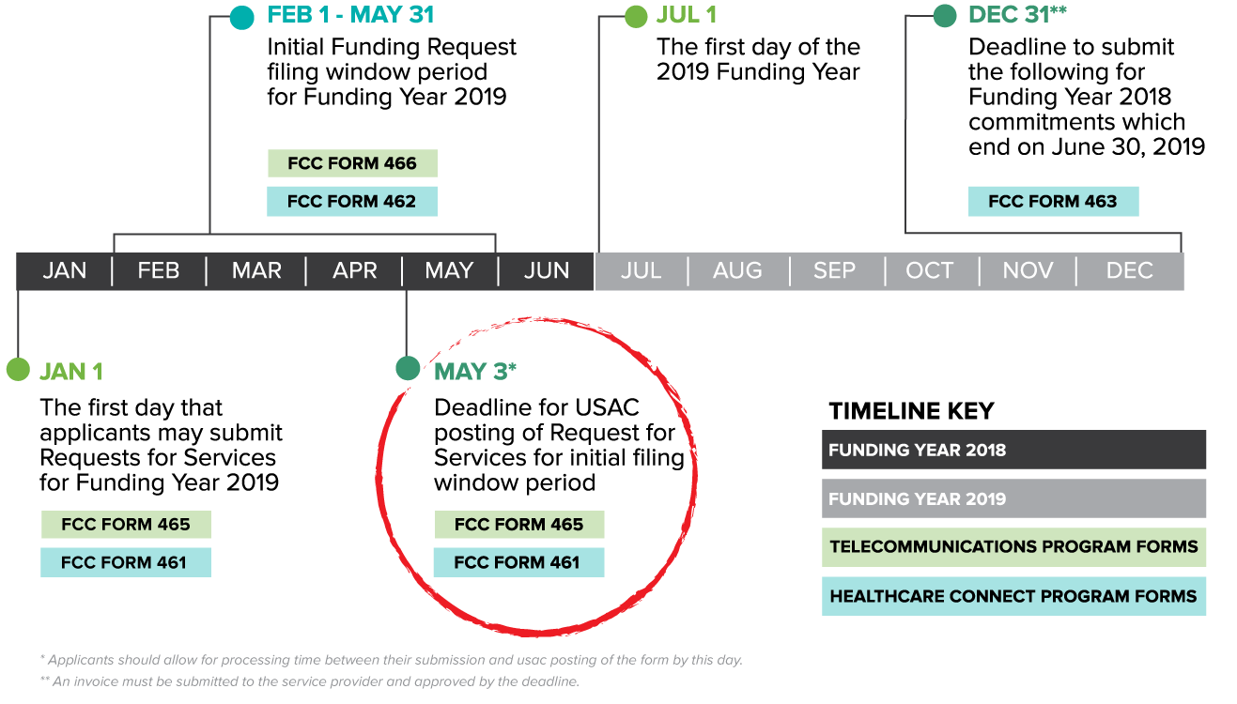
Funding Timeline
Notes:
As a reminder, here is a second look at the timeline. So, any healthcare provider looking to get funding for FY2019 must file the initial forms before May 3rd

Slide 28
Funding Support
USAC Staff
  Work in Washington, D.C.
  Answer questions as needed
  Conduct conference calls regarding RHC Program
Consultants
  File funding paperwork for HCPs
  Charge you 25-40% of the savings
Service Providers
  Provide services to HCPs
  Collect funding on behalf of HCPs
Example: $10,000 X 40%= $4,000 per month
FUNDING
Notes:
We’ve given you a lot of information today, but we also think it’s important to let you know what resources you have available to you so you can start taking advantage of the funding that is available for use.
Here we have listed 3 types of organizations that would be able to provide you with more support. Please know, this is not an all-inclusive list. You have joined this call today because of an amazing association that has helped inform you of this program. So note there are other ways to get information on this funding.
1st is the USAC staff. They are very helpful at answering questions and are available via phone or email to assist you through the process. They also have conference calls reviewing the information. All of these conference calls are recorded and saved on their website for you to review at your convenience.
Next up are consultants. There are many different types of consulting firms. The consultants I’m referring to here are funding consultants. Funding consultants will assist you by completing the funding forms. From what we have seen at TQ, they sometimes charge a flat fee per form, or they may charge you a % of your savings. So it is important, when evaluating these consultants, that you determine what their fee is, and if it is of value to your organization.
3rd on this list are service providers. TQ is a service provider and we fall into this category, so of course I have to mention this group. Service providers are an important piece to the puzzle though because they not only provide you with the telecom service you need, but they also provide you the documentation you need to successfully fill out the forms, and they handle the money for you! Choosing the right partner here is definitely an important piece when utilizing this funding program.
With that….(click)

Slide 29
Resources and Links
Federal Communications Commission (FCC)
  Universal Service- https://www.fcc.gov/encyclopedia/universal-service
  Rural Health Care Program- https://www.fcc.gov/encyclopedia/rural-health-care
Universal Service Administrative Company (USAC)
  Rural Health Care Program- http://www.usac.org/RHC/
  Determining Rurality- http://www.usac.org/rhc/telecommunications/tools/Rural/search/search.asp
  USAC 2018 Annual Report https://prodnet.www.neca.org/publicationsdocs/wwpdf/040119usac.pdf
  USAC Webinars for further information http://usac.org/rhc/telecommunications/outreach/webinar.aspx
Notes:
Here are some additional, very useful websites.
While you are reviewing this slide, I’m happy to now answer any questions you may have.

Slide 30
We Welcome Your Questions

Slide 31






Interested in learning more?
USAC Contact Info:
rhc-assist@usac.org
202-776-0200
email: funding@telequality.com
phone: 210-408-0388
www.telequality.com
THANK YOU
*TeleQuality Communications is not affiliated with The Universal Service Administrative Company which collects and distributes the Universal Service Fund.

