Slide 1
RHC Compliance Update
Alabama Rural Health Association
April 26, 2019
Patty Harper, CEO/Principal
InQuiseek Consulting

Slide 2
So, what are we going to talk about?
Alabama RHC Trivia
Types of CMS Regulations/Guidance
Appendix G/Appendix Z
Top Survey Deficiencies in Alabama
Compliance Challenges & Successes

Slide 3
Alabama RHC Trivia

Slide 4
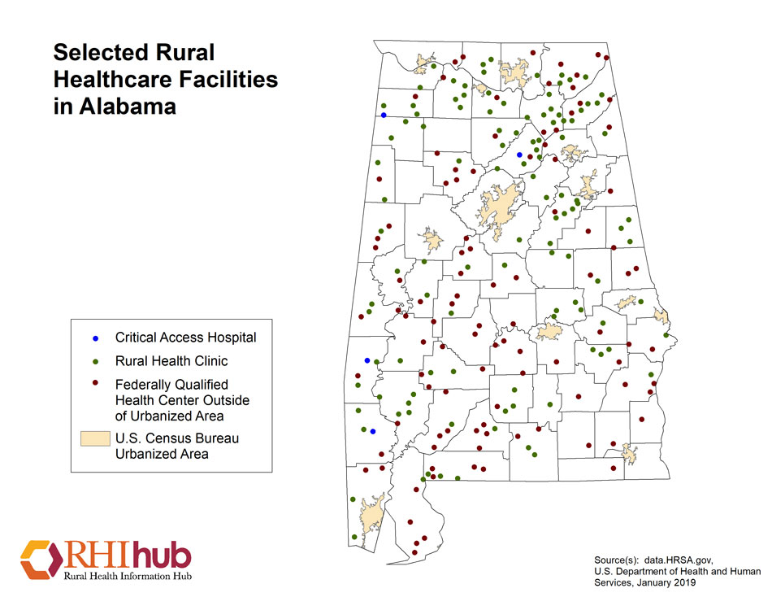
RHCs in Alabama
112 per RHIhub, January 2019
114 per QCOR, April, 2019

Slide 5
Terminated RHCs
2017-2019**
Terminated Rural Health Clinics
Calendar Year | 2017 | 2018 | 2019 YTD
Alabama | 6 | 5 | 0
Nationwide | 163 | 108 | 10
All closures were Voluntary Closures or Mergers/Change of Ownership. Difficult from the QCOR data to distinguish between independent and provider-based status because it is by ownership type in the database.

Slide 6
New RHCs**
2017-2019
New Rural Health Clinics
Calendar Year | 2017 | 2018 | 2019 YTD
Alabama | 7 | 9 | 2
Nationwide | 261 | 292 | 26
Net gain of 7 RHCs from 1/1/2017 to 4/23/2017

Slide 7
Alabama RHC Survey Statistics 2017-2019**
Survey Activity for Alabama
Calendar Year | 2017 | 2018
Alabama | 31 or 27.7% | 24 or 20.9%
Alabama: Complaint | 0 or 0.0% | 0 or 0.0%
National | 814 or 18.7% | 814 or 18.0%
National: Complaint | 34 or 0.7% | 32 or 0.6%

Slide 8
Alabama RHC Survey Statistics 2017-2019**
Total Survey Deficiency Count
Calendar Year | 2017 | 2018 | 2019 YTD
Alabama | 36.0% | 43.4% | 20.6%
National | 38.9% | 55.7% | 5.4%

Slide 9
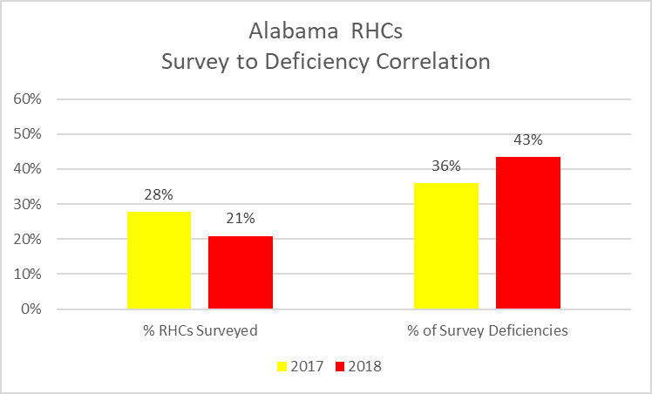

Slide 10
Alabama RHC Survey Statistics 2017-2019
RHCs Overdue for Survey as of April 23, 2019
Calendar Year | # of Clinics | % of Clinics
Alabama | 46 | 41.1%
National | 2,309 | 52.2%

Slide 11
**Data Source
S&C's Quality, Certification and Oversight Reports (QCOR)
https://qcor.cms.gov/main.jsp
Survey data and statistics are available on this site for all CMS certified facility types.

Slide 12
Federal Regulations and Guidance for Medicare & Medicaid Providers

Slide 13
Types of Guidance
Regulatory
  Federal
  State
  Local
Sub-Regulatory
  Paper-based Manuals
  Internet-only Manuals
  Transmittals, Program Memoranda & Change Requests
  MLN Matters Articles
  National and Local Coverage Determinations
  Other CMS Publications, Tools and FAQ
  MAC Information

Slide 14
Federal Register
The daily publication of the United States government.
CMS Adopts Regulations in the Federal Register.
First published as Proposed Rules with a comment period and then published as Final Rules.
CMS publishes notices and links to the Federal Register on their website.
States have a “Register” or Similar Publication.

Slide 15
Code of Federal Regulations
The CFR is a complete volume of all federal regulations for all sectors and is legally binding. The annual edition is updated every Oct 1st . eCF is more up-to-date.
Title 42 applies to Public Health
  Chapter I: Department of Health & Human Services
  Chapter IV: Centers for Medicare & Medicaid Services, HHS
  Chapter V: Office of Inspector General, HH
First published as Proposed Rules with a comment period and then published as Final Rules.
CMS publishes notices and links on their website.

Slide 16
Links to the Federal Register and the eCFR
Federal Register
https://www.federalregister.gov/
eCRF- Title 42
https://gov.ecfr.io/cgi-bin/ECFR

Slide 17
Main Federal Regulations
Medicare Program
42 CFR §405
Federal Healthcare for the Aged and Disabled
42 CFR §420
Program Integrity-Medicare
42 CFR §455
Program Integrity- Medicaid

Slide 18
Main Federal Regulations
Critical Access Hospitals
42 CFR §485
Subpart F
Conditions of Participation

Slide 19
Main Federal RHC/FQHC Regulations
42 CFR §405, Subpart X
42 CFR §491
Conditions for certification
42 CFR §413.65
Provider Based Status

Slide 20
42 CFR §413.65
RHCs as Provider-Based Facilities
Less than 50 Beds
Relationship Between the Parent Hospital and RHC
PB Attestation Voluntary

Slide 21
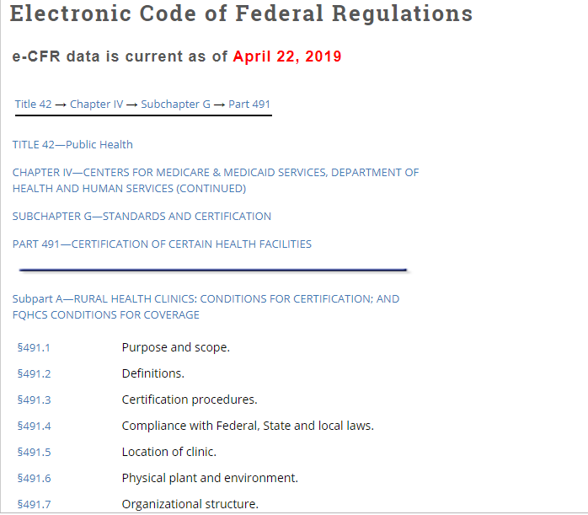
CFR 491
Title Subpart

Slide 22
Regulatory
42 CFR §491
RHC Certification Requirements
Location
Compliance
Staffing/Personnel/HR
Physical Plant/Environment
Provision of Services
Emergency Preparedness
Medical Management
Annual Evaluation
Emergency Preparedness

Slide 23
42 CFR §491:1 THRU §491:12
These section contains all the regulations concerning the conditions of certification and recertification of Rural Health Clinics. This is where the certification and accreditation standards originate. However, the sub-regulatory sources of information are often easier to interpret and more “user-friendly”. The CFR is legally binding. Sub-regulatory guidance must be taken into consideration by Medicare Contractors and Administrative Law Judges and they must explain rulings to the contrary, but they are not obligated to uphold sub-regulatory guidance.
Be mindful of published and effective dates when referring to regulations and sub-regulatory guidance. A Google search can result in an outdated publication.
Text in red indicates the updated portions of the publications.
RHC and FQHC guidance are often in the same documents. Use caution.

Slide 24
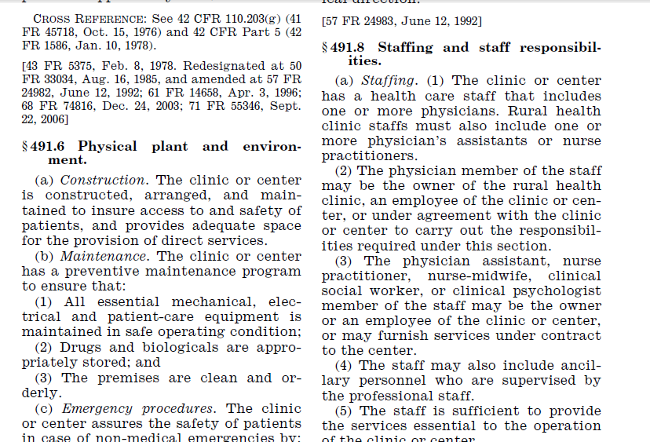


Slide 25
Sub-regulatory
CMS Internet-Only Manuals
Policy Benefit Manual, Chapter 13
https://www.cms.gov/Regulations-and-Guidance/Guidance/Manuals/Downloads/bp102c13.pdf
Claims Processing Manual, Chapter 9
https://www.cms.gov/Regulations-and-Guidance/Guidance/Manuals/Downloads/clm104c09.pdf

Slide 26
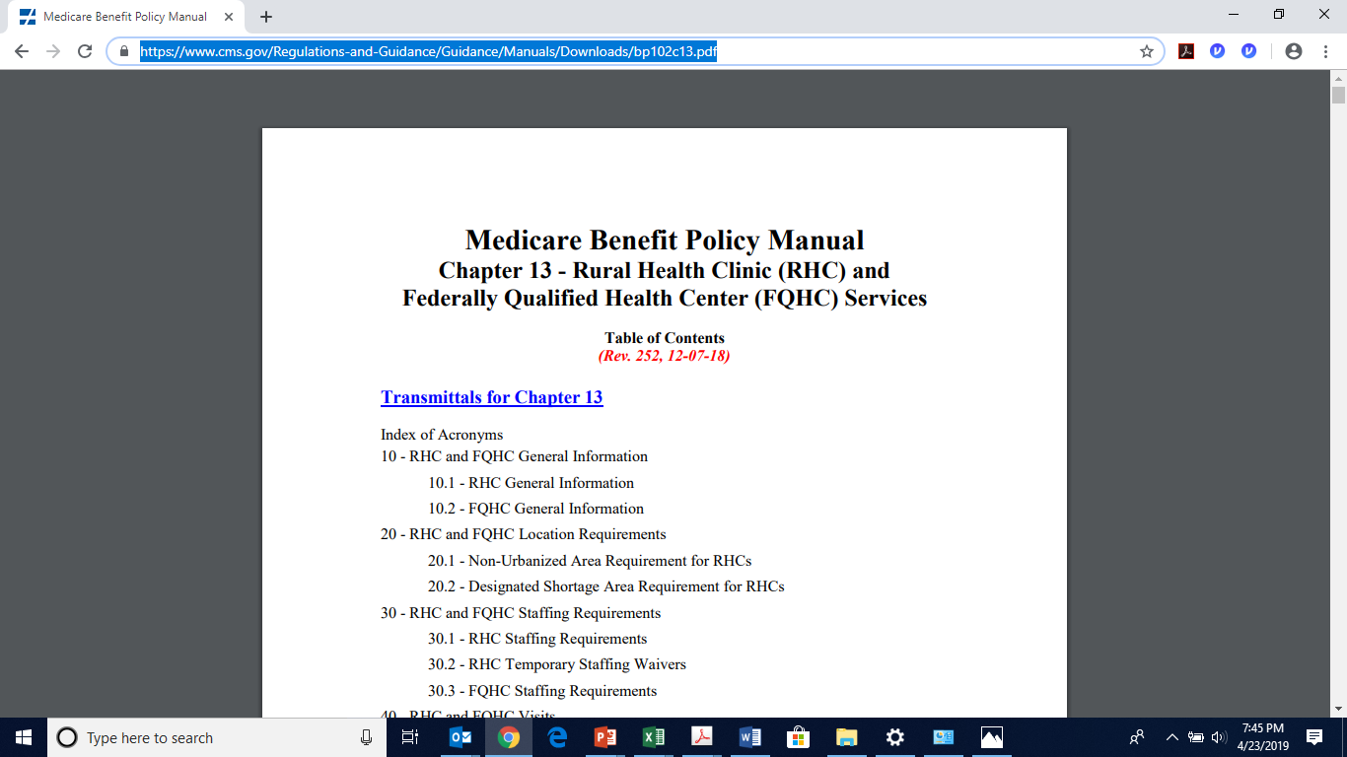
Sub-regulatory

Slide 27
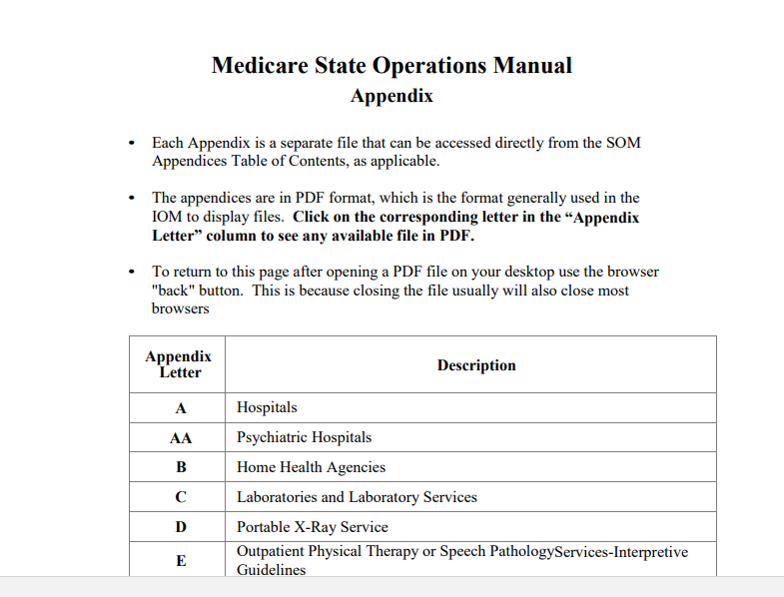
State Operations Manuals
Sub-regulatory

Slide 28
Sub-regulatory
The State Operation Manuals which apply to RHCs are:
Appendix G--Guidance for Surveyors: Rural Health Clinics
42 CFR §491.1 through §491.11
https://www.cms.gov/Regulations-and-Guidance/Guidance/Manuals/downloads/som107ap_g_rhc.pdf
Appendix Z—Emergency Preparedness for all Provider Types, Interpretive Guidance
42 CFR §491.12
https://www.cms.gov/Regulations-and-Guidance/Guidance/Manuals/downloads/som107ap_z_emergprep.pdf

Slide 29
Top 25 RHC Deficiencies for Alabama 2017-2019

Slide 30
When a surveyor cannot find evidence (written proof, observation, interviewing, inspection, auditing, etc.) that the certification standards are being met, you receive a deficiency. Each survey “tag” or standard is tied back to the 42 CFR §491 conditions for RHC certification. Each deficiency is referenced to a regulation subpart, tag or AO standard because it has not been evidenced.
How or why do I get a survey deficiency?

Slide 31

Surveyors are people who come to the task from different backgrounds and perspectives. Even though they have the same standards or conditions to evaluate and the same regulation to govern their surveying, it’s not always as objective or as much of a science as you would think it would be.
Are all surveyors the same?
Is a surveyor a surveyor regardless?

Slide 32
Top 25 RHC Survey Deficiencies in Alabama in 2018**
Tag | Deficiency | % of Surveys | % Providers | # Cited
J0043 | Drug Storage and Handling | 62.5% | 13.0% | 15
J0123 | Provider Review of Policies | 50.0% | 10.4% | 12
E0004 | Developing EPP | 37.5% | 7.8% | 9
J0152 | Complete Medical Records | 37.5% | 7.8% | 9
J0041 | Clinic safe and adequate space | 33.3% | 7.0% | 8
J0042 | Preventative Maintenance | 33.3% | 7.0% | 8

Slide 33
Top 25 RHC Survey Deficiencies in Alabama in 2018**
Tag | Deficiency | % of Surveys | % Providers | # Cited
J0136 | Emergency Care/Kit | 33.3% | 7.0% | 8
E0001 | All Elements of EPP Not Evidenced | 25.0% | 5.2% | 6
J0044 | Environment Clean and Orderly | 25.0% | 5.2% | 6
J0160/J0161 | Annual Program Eval Condition or Standard | 25.0% (S) 20.8% (C) | 5.2% 4.3% | 6 5
E0009 | EPP Collaboration | 12.5% | 2.6% | 3
E0037 | EPP Training | 12.5% | 2.6% | 3

Slide 34
Top 25 RHC Survey Deficiencies in Alabama in 2018**
Tag | Deficiency (paraphrased) | % of Surveys | % Providers | # Cited
E0024 | EPP Volunteers | 12.5% | 2.6% | 3
J0101 | Physician Review of Charts | 12.5% | 2.6% | 3
E0029 | EPP Communication Plan | 8.3% | 1.7% | 2
J0062 | Written Organizational Structure | 8.3% | 1.7% | 2
J0061 | Organizational Structure Medical Dir Disclosed | 8.3% | 1.7% | 2
J0040 | Environment-Condition Level | 8.3% | 1.7% | 2

Slide 35
Top 25 RHC Survey Deficiencies in Alabama in 2018
Tag | Deficiency (paraphrased) | % of Surveys | % Providers | # Cited
J0125 | Written Policies Drug Storage & Handling | 8.3% | 1.7% | 2
J0135 | Required RHC laboratory services | 8.3% | 1.7% | 2
J0080 | Provision of Services Staffing- Conditional | 8.3% | 1.7% | 2
J0100 | Medical Directorship of RHC | 8.3% | 1.7% | 2
E0013 | EPP Risk Assessment | 4.2% | .9% | 1
J0039 | EPP Testing | 4.2% | .9% | 1

Slide 36
First, always ask:
Is what we want to do going to cause a compliance problem? Always assume that it might until you know it won’t.
Examples:
Rebranding or renaming the clinic
Moving or rearranging space in the clinic
Adding visiting specialists or non-RHC services
Use of social media/web site discrepancies

Slide 37
What are your biggest compliance challenges?
Knowing the RHC regulations
Finding Information and Updates
Culture that is not compliance-driven
Policies and Procedures that aren’t actually being followed
Keeping evidence updated
Knowing what to do when
Provider Buy-in/Pushback
Little fish in a big pond?
Staff turnover or burnout

Slide 38
Share how you have had a compliance success
What has worked?
What hasn’t?

Slide 39

Follow-up questions or comments can be directed to:
Patty Harper
InQuiseek Consulting
318.243.2687
pharper@inquiseek.com
www.inquiseek.com

