Slide 1
April 26, 2019
Raising RHC Quality with PCMH
Alabama Rural Health Association
KATE HILL, RN

Slide 2
Goals for the Day
Understand the value of PCMH to your practice
General Understanding of the PCMH Standards
Learn how to begin the PCMH process in your practice
Have a working knowledge of a PCMH Survey

Slide 3
Elements of the PCMH Model
Comprehensive Care
Patient Centered
Coordinated Care
Accessible Services
Quality and Safety

Slide 4
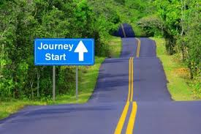
What is a Patient Centered Medical Home?
Clearly it’s a journey, not a destination!

Slide 5
Why Become a Patient Centered Medical Home
Puts patients first
Make primary care more accessible
Improves staff satisfaction
Improves patient satisfaction
Improves patient outcomes
Mitigates health disparities
Increase revenue
Become the provider of choice in your community
Consistent reductions of high cost care

Slide 6
Why Become a Patient Centered Medical Home
PCMH as a Value-Based Strategy
Medicare has moved to change how it structures payment from a quantity to a quality approach. It will provide incentives for better processes and outcomes.
Medicaid programs have made enhanced payments to providers who achieved certain distinctions or process measures.

Slide 7
Why Become a Patient Centered Medical Home
Every $1.00 increase in Primary care spending equals $13.00 in savings.
This study provides another piece of evidence supporting the hypothesis that PCMH can lead ot lower cost of care.
Nevertheless, this study shows a consistent pattern, suggesting a robust cost saving across all the cost categories. Study shows the PCMH impact on each of the three main components of the total cost: acute inpatient, outpatient, and professional costs.
(Geisinger Study)

Slide 8
Barriers to Becoming a Patient Centered Medical Home
Resistance to change
Inadequate financial resources
Low workforce
Low adaptive reserve
Your EHR
Staff buy in
Motivation

Slide 9
Most PCMH Programs can be…
Robs time devoted to patient care.
Rigid
Burdensome
Labor Intensive
Expensive
Overwhelming

Slide 10
Rethinking PCMH
Anything taking you away from patient care is heading in the wrong direction!
Our Team’s PCMH Accreditation Program focuses on getting back to patient care and looks at day to day operations.
Its a Winning Approach for both Clinics and Patients.

Slide 11
Good news
RHCs are already doing much of this informally but not getting credit for it.
Becoming a PCMH formalizes the process and identifies performance gaps.

Slide 12
TCT Approach to Quality Standards
“Operational excellence leads to clinical excellence.”
– Sandy Canally, RN

Slide 13
Introduction to the TCT Quality Standards
TCT PCMH Quality Standards

Slide 14
The Clinic provides advanced access to its patients.
Expanded hours:
  Same day appointments for urgent illness.
  Some evidence of expanded weekday, evening, and weekend appointment offerings.
  Call coverage or arrangement for after-hours emergencies 24/7.
The organization provides patients and their family/caregivers written information regarding the Patient-Centered Medical Home and its services.

Slide 15
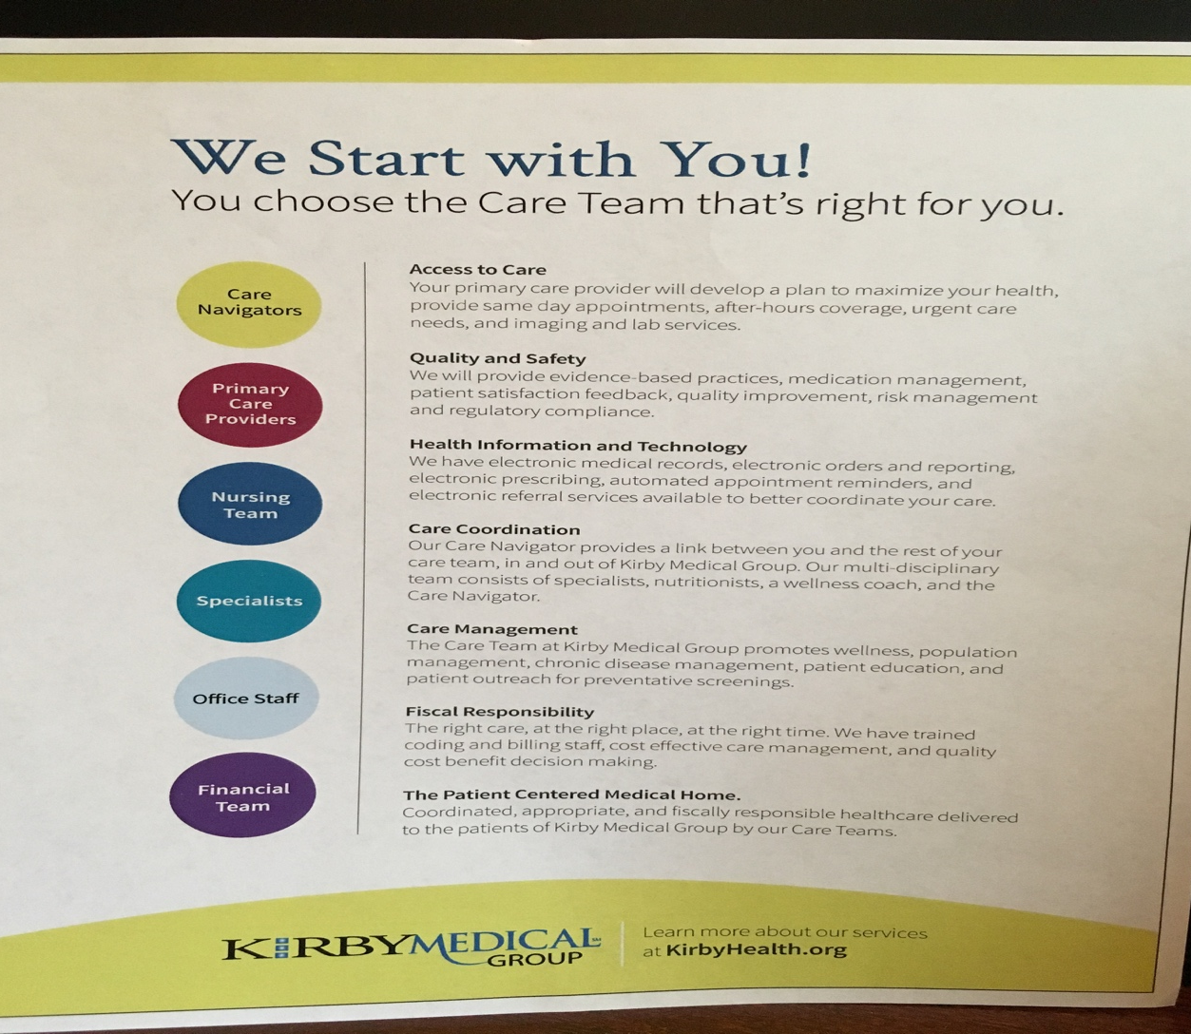
PCMH Handouts
Create brochures to educate your patients.

Slide 16
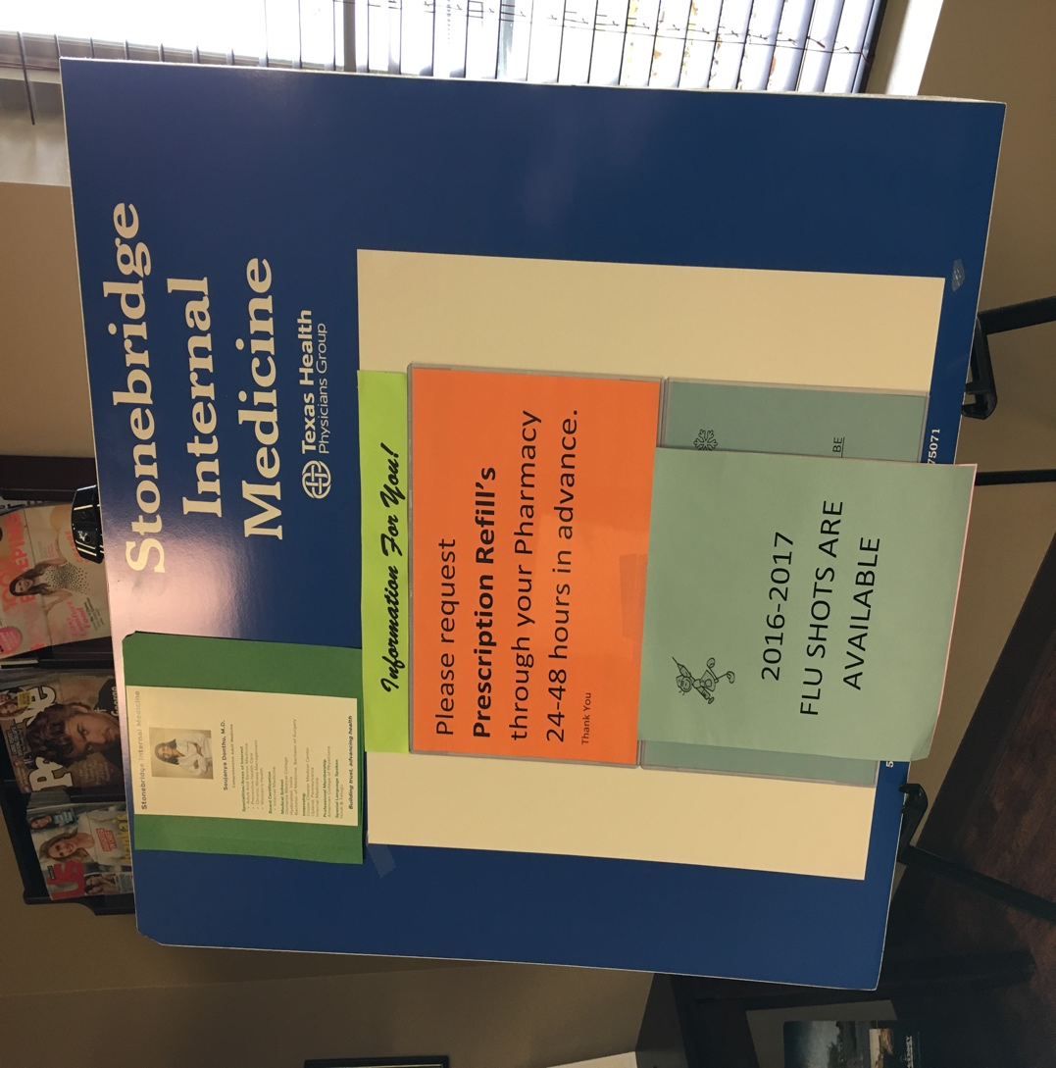
PCMH Handouts
Create brochures a poster for your waiting room to tell you patients about you Patient Centered Medical Home.
Used with permission

Slide 17
The Clinic provides advanced access to its patients.
The organization communicates essential practice information to its patients. This information includes:
  What patients should bring to each appointment.
  How patient calls and prescription requests are handled.
  The routes in which patients can attain healthcare access after-hours.
  Policies regarding the rescheduling or cancellation of appointments.

Slide 18
Example: Info for Care After-Hours
Contacting your providers after hours:
  Call 911 for emergencies
  If you have an urgent questions that cannot wait until regular office hours, you can reach a member of our medical staff 24 hours a day 365 days a year.
  Please refer to the following chart for instructions on how to reach your doctor
  If you don’t have this information with you, after hours instructions can be provided by calling our clinic phone number when the clinic is closed.
  Please note that our on-call providers do not prescribe antibiotics, pain medicine, or ADHD medications over the phone.

Slide 19
The Clinic provides advanced access to its patients.
Evidence exists of advanced access through multiple forms of communication with its patients.
  Examples include: printed handouts, emailed handouts, email access, patient portals, website postings, texted information, automated phone messages, and phone calls from the office staff.
A written-plan for handling patient communication that includes
acceptable time frames for returning patient calls or requests.
All calls or requests from patients are documented with date and time.
  Example: All Rx refill calls returned within 1 business day
  No Friday afternoon refills are left till Monday

Slide 20
Community Resources
Patients are in your office only a small percentage of their lives, so providers should strive to find resources to meet the needs of patients when they leave the clinic.
Community resources should be used to engage with the clinic’s patient population.
  Discharge planners and case workers
  Rehabilitation centers
  Community outreach programs and clubs
  Church programs

Slide 21
The Clinic provides advanced access to its patients.
The clinic actively engages with community resources to reach out to its patient population.
For example:
    Discharge planners,
    Case workers from physical or behavioral healthcare rehabilitation centers,
    Other healthcare professionals providing services not available in the organization,
    Community outreach programs, and
    Community clubs.

Slide 22
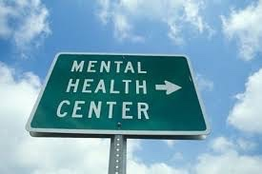
Examples of Community Resources

Slide 23
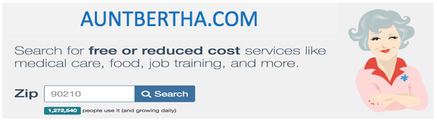
Examples of Community Resources

Slide 24
The Clinic meets the healthcare needs of patients when they are closed.
A written agreement with each entity responsible for handling patient healthcare needs after-hours.
The agreement identifies the contracted provider’s scope of
services, responsibilities for patient care, and hours of operation.
For example:

Slide 25
The Clinic meets the healthcare needs of patients when they are closed.
The clinic’s providers receive and review patient healthcare information from after-hours providers.
All follow-up is documented in the patient healthcare record.

Slide 26
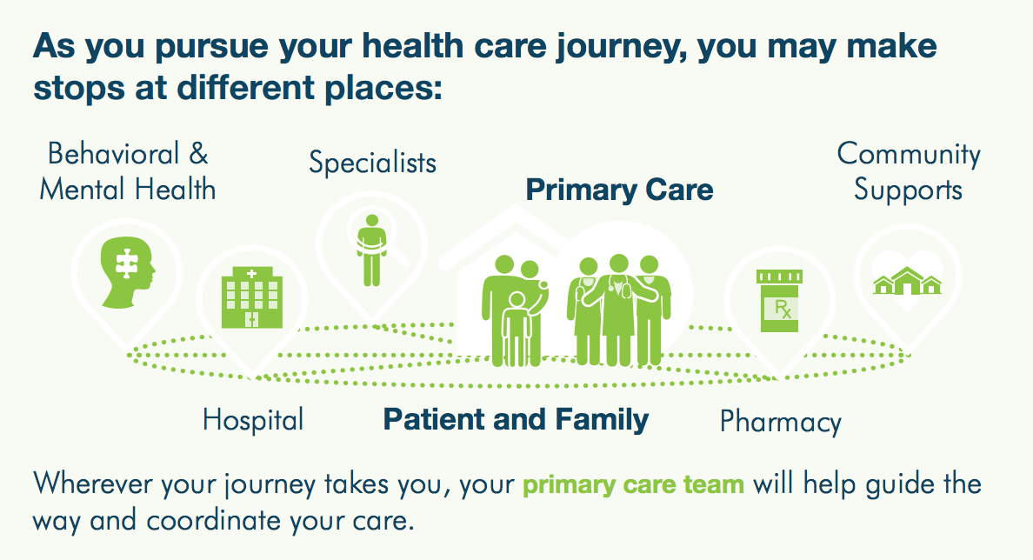
The Clinic utilizes a team-based approach for patient-centered coordinated care

Slide 27
A team-based approach for patient-centered coordinated care.
New patients are assigned to a primary provider
For continuity of care, subsequent visits are provided by the same provider led care team, unless the primary provider orders a change or the patient requests a change.
Provider led care teams are arranged to meet the needs of the patient population(s) served.
For example: Adult, Pediatric, Chronic Care Management, Behavioral Health, and Geriatric Care.

Slide 28
A team-based approach for patient-centered coordinated care.
The organization has one or more designated staff members providing Care Coordination interdependently between PCMH Providers, other Healthcare Professionals, and patient care services provided externally.
“CARE COORDINATOR” “NURSE NAVIGATOR”
“CARE COACH”

Slide 29
Care Coordinator
Care Coordinator duties include:
  Organizing clinical data to support the on-going care of patients, monitoring diagnostic tests, and providing written and/or verbal follow-up on results to patients/caregivers, when clinically indicated.
  Working with patients/caregivers to develop written care goals.
  Utilizing written protocols with hospitals outlining the referral process and admission and discharge notifications.
  Utilizing a system to identify and improve the care of high-risk or special needs patients including:
    Daily huddles
    Communication boards
    Meetings with providers
    Utilizing written protocols with hospitals outlining the referral process and admission and discharge notifications.

Slide 30
A team-based approach for patient-centered coordinated care.
Providing a summary for patients transferring to another medical provider.
Providing support to patients/caregivers by helping them connect to community resources.
Transition Care Management services (as applicable).
The Care Coordinator monitors care provided to patients by other providers including:
  Specialists managing patients’ medications and ordering labs, diagnostics, treatments, procedures, and/or therapies..
  Pharmacists regarding patients’ medication history, adherence, and any involvement with medication therapy management.

Slide 31
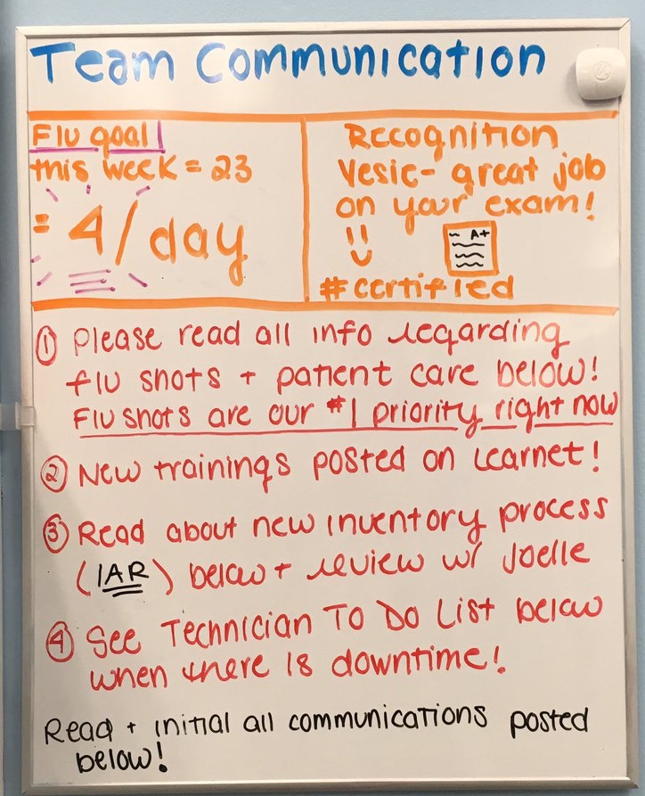
Huddles

Slide 32
Huddles
Start on time, be consistent, have an agenda.
Stand to keep the huddle moving along.
Forms stronger care team bonds with the patient at the center.
Invite each member to share one concern or success from the previous day.
Review patients for the day, identify patients who could have quality and safety issues.
Identify patients who need community resources.
Close the huddle with announcements, schedule changes, or other messages
Thank the team.

Slide 33
Patient health records are complete.
  In addition to the usual elements:
  Behavioral health screening when symptoms are identified
  (e.g. Patient Health Questionnaire
  (PHQ 2 or 9) for depression);
  Cognitive health screening when symptoms are identified or patient is over 65 years of age
    (e.g. Brief interview of Mental Status (BIMS));
    Updated needs assessment (as appropriate);
    Updated patient-centered health improvement plan™(PCHIP™); and
    Updated patient health goals.
    Summary of the encounter and patient instructions.
Documentation and reconciliation of current patient medications (including supplements)and patient allergies.
Identification of provider/care team assigned to the patient.

Slide 34
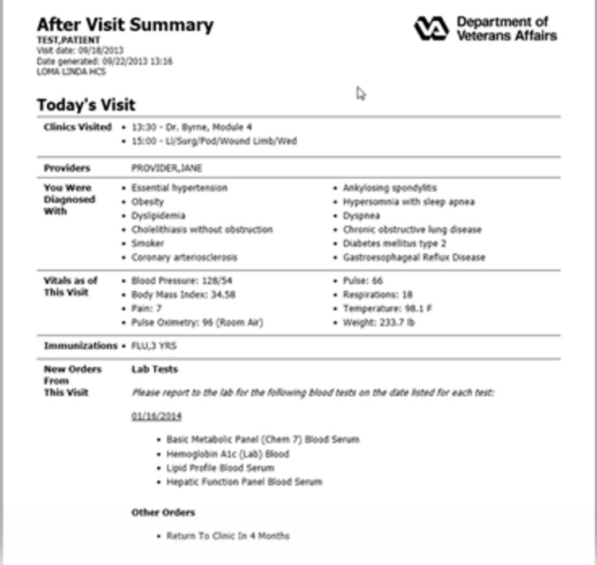
Patient health records are complete.
  In addition to the usual elements:
Identification of patient’s pharmacy by name, location and contact information.
The organization provides an after-visit summary which is given to the patient or is available via a patient portal. The summary includes:
  Current vital signs;
  Relevant health
  Current diagnosis;
  Current medications;
  patient instructions;
  Patient’s short and long-term goals;
  Name of patient’s Provider and; and
  PCMH contact information.

Slide 35
Reduce High Cost
Primary Care
Ambulatory Care
ED Utilization
Community Resources
Home Services
Hospitalization

Slide 36
Patient Centered Health Improvement Plans ™(PCHIP)
The PCHIP™ which addresses the current and future needs of the patient from a whole person perspective focusing on all ages and stages of life.
Identify high risk and/or complex patients in the practice.
Provide patient communication and education through the formats identified to meet the unique needs of each patient (e.g. written, audio, video, technology-enabled, and/or the use of interpreters).
The PCHIP ™ address the communication needs of the patient:
  When a physical or mental impairment or learning disability exists,
  When English is not the primary language spoken, or
  When cultural or religious beliefs may impact the delivery of care.

Slide 37
Patient Centered Health Improvement Plans ™(PCHIP)
Utilize a questionnaire or interview technique to identify and update the healthcare goal(s)most important from the patient’s perspective. It needs to determine current healthcare
limitations and frustrations that interfere with “what matters most” to the patient at this time in their life.
Needs assessment concerning;
  the patient’s ability to perform the activities of daily living,
  safety of the home environment,
  family/caregiver support system,
  access to transportation and
  requirements for healthcare services that cannot be met by the organization.

Slide 38
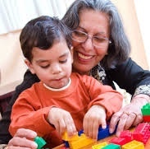
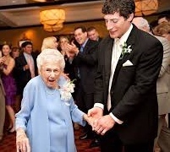
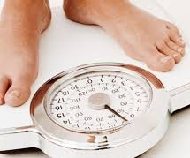
What Matter Most
EXAMPLE: Patient would like to attend grandchild’s wedding, but is unable to do this because she cannot walk long distances without assistance and doesn’t have a wheelchair.

Slide 39
The clinic provides patient education and self-management tools to patients and their families/caregivers.
Self-management tools are offered to the patient to encourage compliance.
Examples of self-management tools include: medication management plans, goal-oriented TO DOs, and web-based interactive health programs.
Healthcare education and self-management tools when health problems are diagnosed, treatment is ordered, or risks are identified.
Education and support includes all appropriate persons, per the direction of the patient, in decision-making regarding care.

Slide 40
Self Management Tools

Slide 41
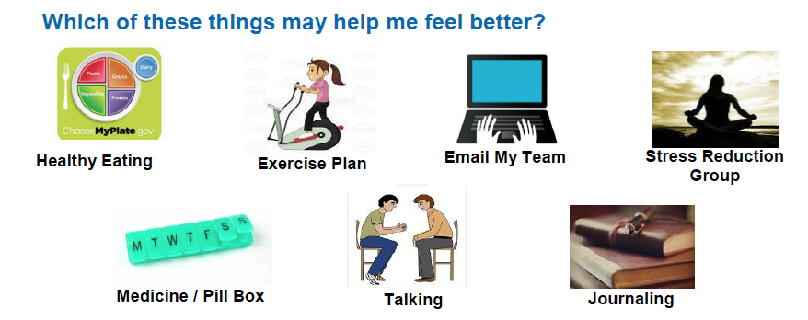
The clinic provides patient education and self-management tools to patients and their families/caregivers.

Slide 42
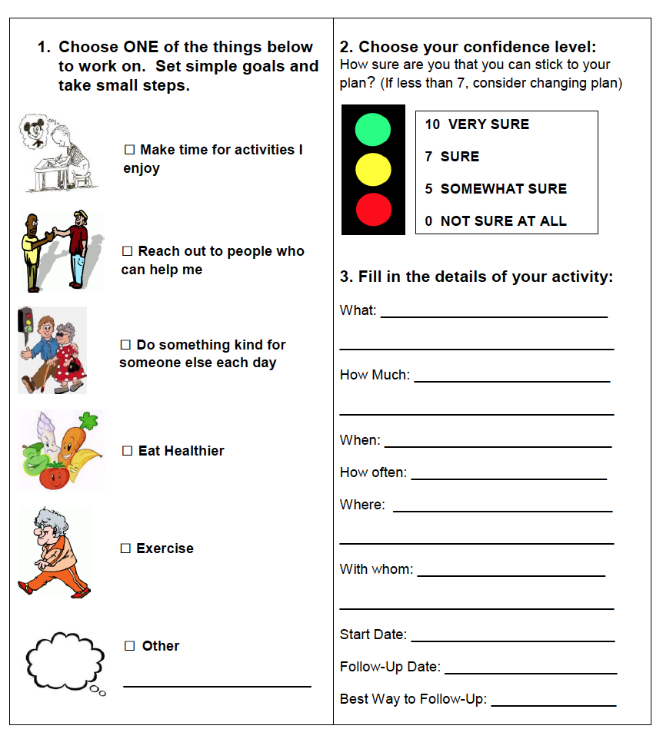
Self Mangagement Tools

Slide 43
Follow Up is the Key
A process to ensure continuity of care in the follow-up of patients regarding:
  Reminder notification system.
  Missed patient appointments.
  Requests for medication refills by patients.
  High-risk medication(s) or in-home treatment(s) that are newly prescribed. Laboratory or diagnostic results that are abnormal.
  Referrals and consultations.
  Preventative care and screening reminders.
  Care coordination activities.
  Those patients who frequent the emergency department.
  Those patients who are discharged from the hospital.

Slide 44
Follow Up is the Key
Memorial Hospital Association in Carthage, IL identified 55 frequent flyers to the ED.
Those 55 were monitored from Jan 1 to March 31, 2017.
An additional bonus was the increase in clinic visits from seeing those 54 patients frequently and mostly on same day appointments.
Results in April showed only one of those patients had been to the ED.
How did they manage that?
The answer is follow up, follow up and then follow up again.
Visits to the clinic increased over those three months.
Savings to payers was huge.

Slide 45
Preventive Health Measures
Mammograms
Pap Smears
Colonoscopy
Immunizations
PSA
Fecal Occult Blood
Tobacco Cessation
Immunizations

Slide 46
Preventive Health Measures
Early and Periodic Screening, Diagnostic and Treatment (EPSDT) is the child health component of Medicaid.
Federal statutes and regulations state that children under age 21 who are enrolled in Medicaid are entitled to EPSDT benefits and that States must cover a broad array of preventive and treatment services.

Slide 47
PCMH is Continuous Quality Improvement
Is your practice providing:
Better healthcare outcomes for the population served by the organization?
Better service from the organization?
Lower costs for the overall care?
QI Review is how to find out…

Slide 48
PCMH Implementation
Have an initial meeting with your leadership and providers
Figure out the timeline for implementation
Have as many staff members as possible attend the webinar for PCMH Quality Standards
Print the standards and take notes
Don’t reinvent the wheel

Slide 49
Studies show that PCMH:
Make primary care more accessible, comprehensive and coordinated.
Provides better support and communication
Creates stronger relationships with your providers
Improves patient outcomes
Lowers overall healthcare costs

Slide 50
Positive outcomes within 4 months!
“Our patients feel more connected because of all the additional contact. That translated to a feeling that Our patients interpret this to mean we care more than we did”
We focus on patient management during transitions of care to decrease readmission; scheduled, proactive outreach to high-risk patients; and initiatives that support patient self-management of chronic diseases (regular calls and emails to patients).”
“We receive a daily census of our admitted patients from hospitals. One of the hospitals automatically sends Emergency Dept., H&P, consult and discharge reports for each transition. Those reports are faxed, and the MAs ensure timely transfer of data to tracking spreadsheets.”
“I interview the patient and family and figure out the holistic needs of the patient. Spending time with outreach programs arranging transportation and Meals on Wheels can make a difference in keeping a chronically ill patient out of the hospital. Its not always medication management,”
“I feel like a nurse again”

Slide 51
Positive outcomes within 4 months!
And the best one:
“Great medicine is being done outside the patient visit.
mostly in follow up activities”

Slide 52
Get in Touch!
Kate Hill, RN
215-654-9110
khill@thecomplianceteam.org
Questions???

