Slide 1
April 25-25, 2019
Strategies for Ongoing RHC Compliance
Alabama Rural Health Association
Kate Hill, RN, VP Clinical Services

Slide 2
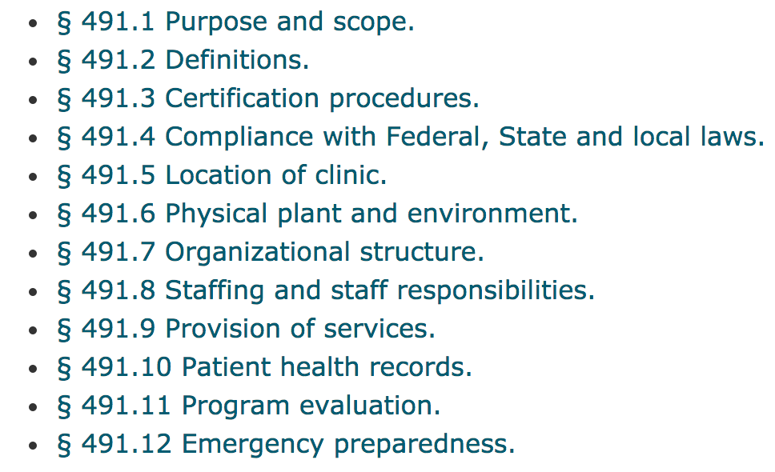
RHC Conditions of Certification
https://www.law.cornell.edu/cfr/text/42/491.4

Slide 3
Policies
Keep policies organized
Review a few policies each staff meeting
Keep your policies simple don’t lock yourself into a tight corner
Know what requires a policy

Slide 4
Policies
Patientcare Policies
Annual Review of Policies by Advisory Group
Storage, Handling, & Dispensing of Drugs & Biologicals
Emergency Preparedness
Health Records
HIPAA
Scope of Services provided and referred

Slide 5
Policies
Lines of Authority
Categories of Practitioners
Developing & Reviewing P&Ps and Clinic Services
Equipment Maintenance
Infection Prevention
Hiring, training and orienting
Quality Improvement
Equipment Management
Emergency Preparedness

Slide 6
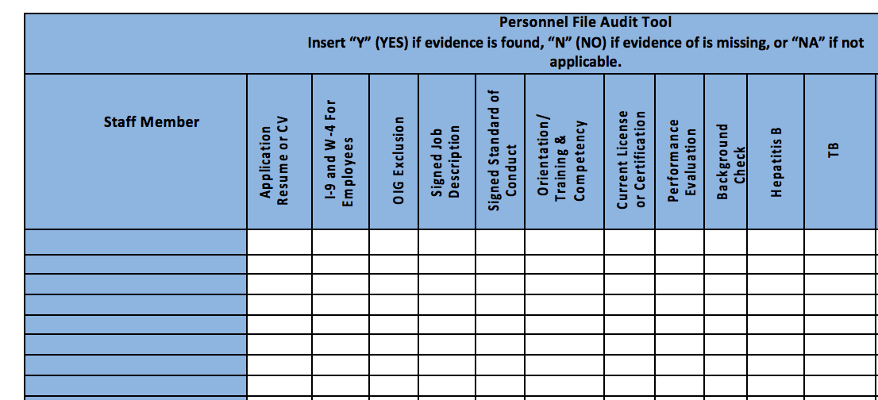
Personnel Files

Slide 7
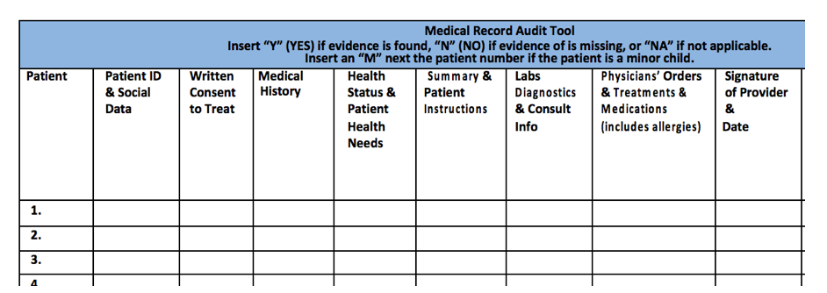
Medical Records 491.10

Slide 8

Touring the Clinic
Name on the sign consistent with CMS 855A application

Slide 9
Touring the Clinic
Before moving: Check with State office of Rural Health and your MAC to be certain your new address is still in a HPSA, even if it’s next door.
Report name changes to CMS
Report change in Medical Director to CMS

Slide 10
Touring the Clinic
Posted Hours of Operation

Slide 11
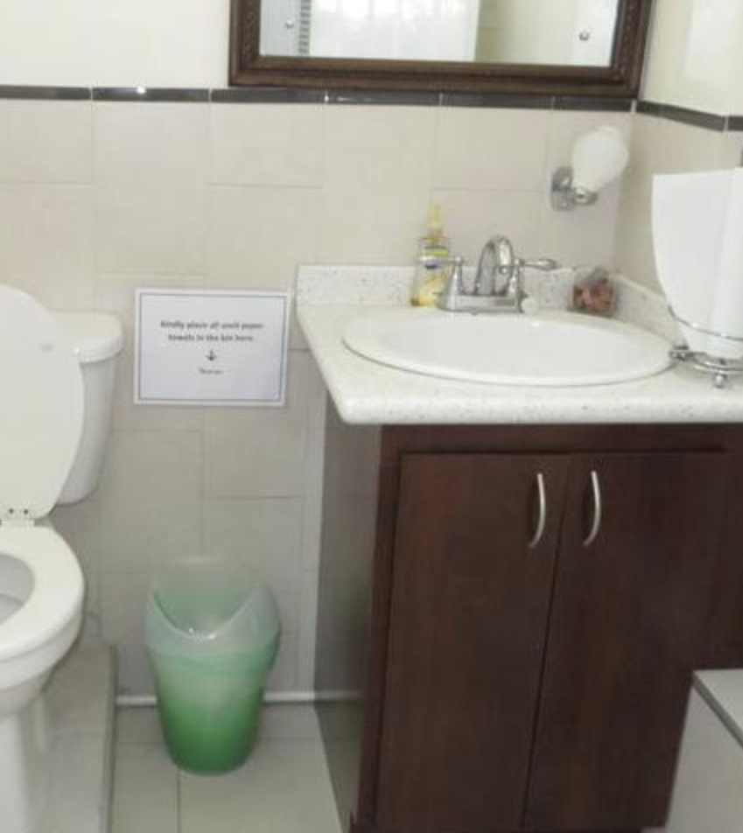
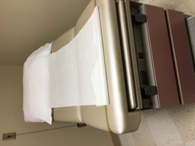
Touring the Clinic
Waiting Room
Exam Tables
Under Sinks

Slide 12
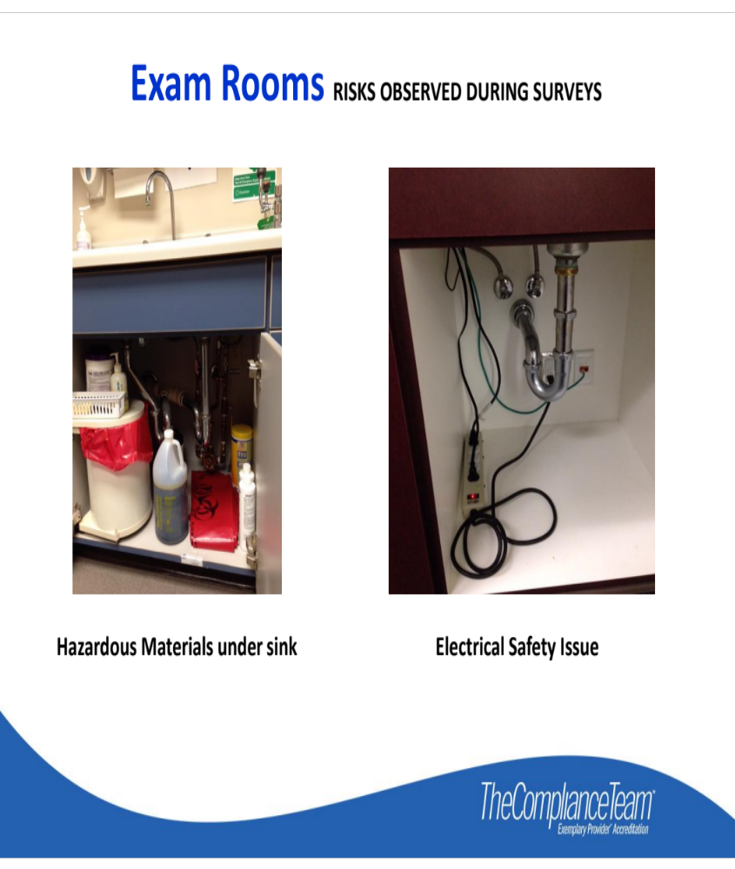
Touring the Clinic
Hazardous material under the sink.
Nothing should be under the sink!

Slide 13
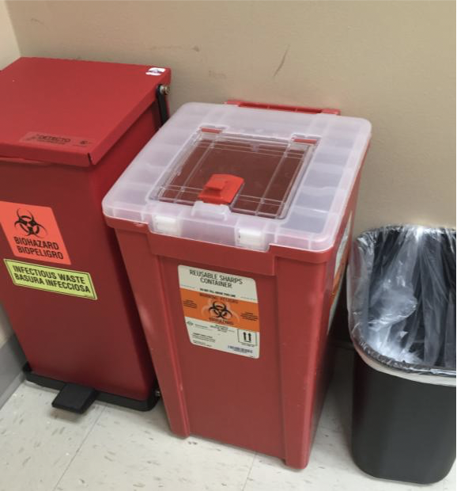
Touring the Clinic
Sharps containers cannot be easily accessibile.
3 States require monthly disposal of sharps containers, FL, NY and MI

Slide 14
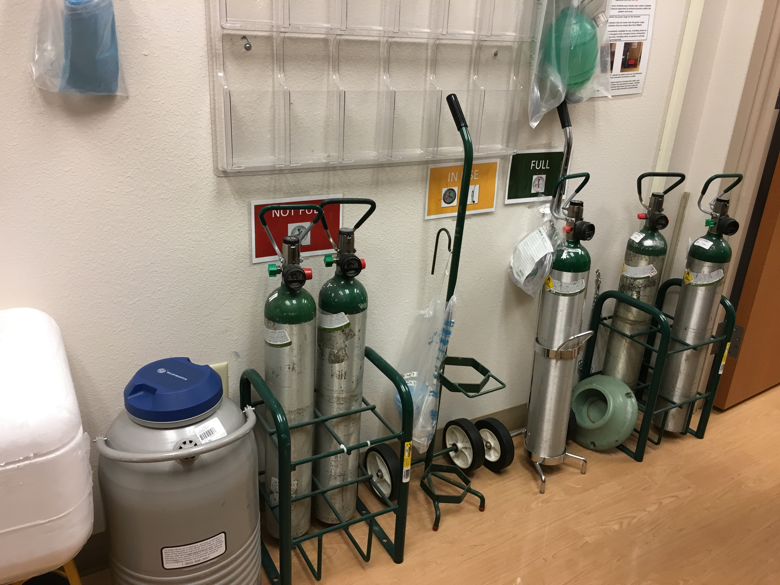
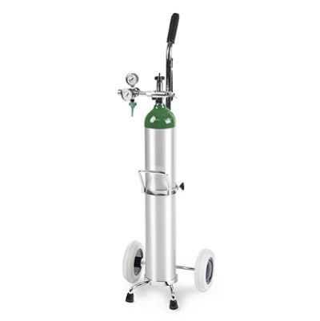
Touring The Clinic
Safe storage of Oxygen: chained or in an approved cart.

Slide 15
Touring The Clinic
2019
State and Federal Posters are required to be in places visible to the staff.
Provider based clinics must have these postings in the clinic even when the clinic in the hospital building.

Slide 16
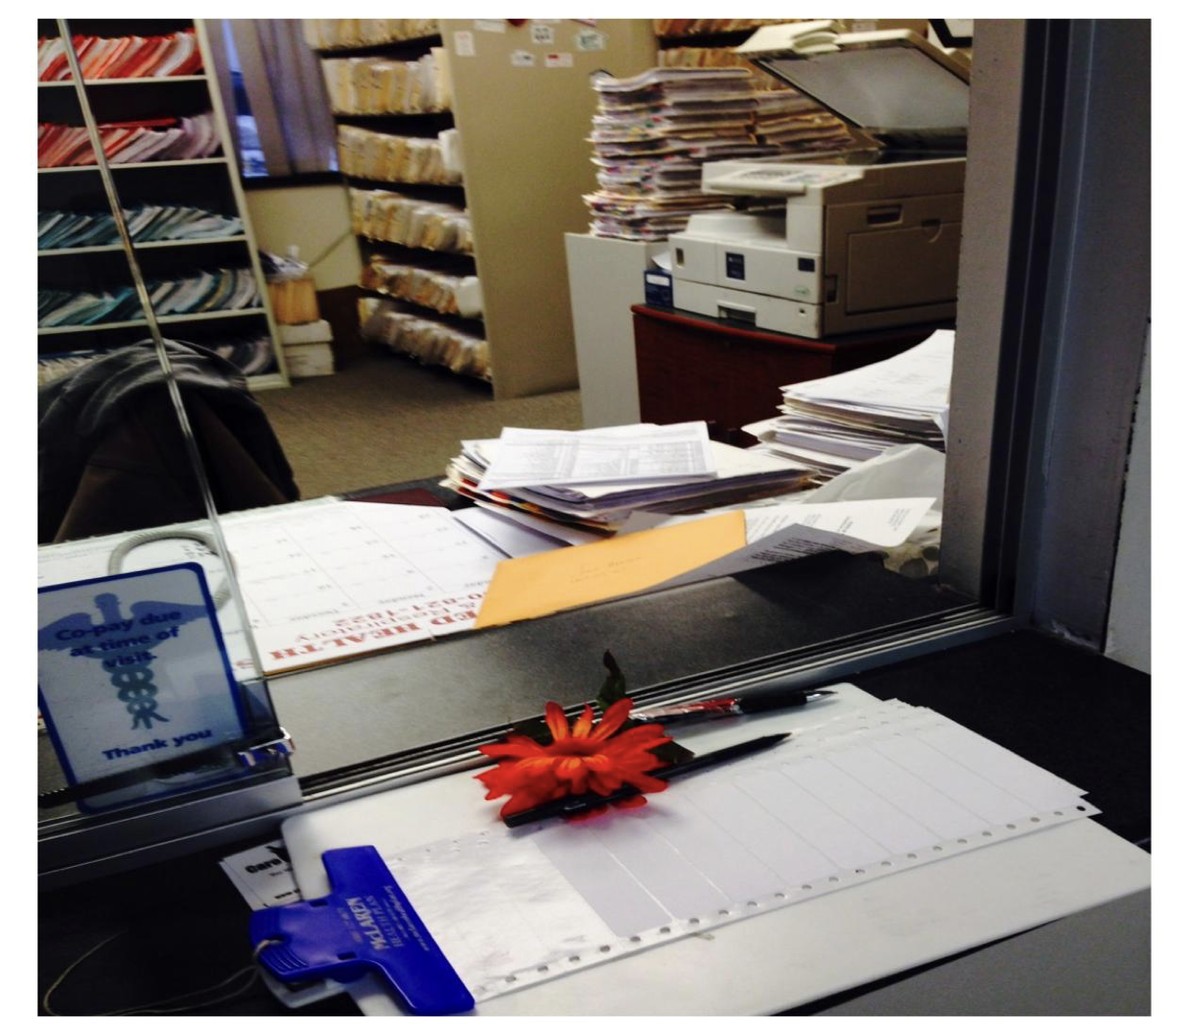
Touring the Clinic
Computer Time Out
Visible PHI

Slide 17
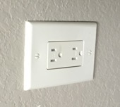
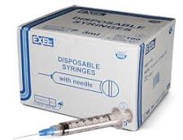
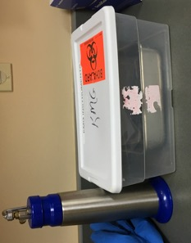
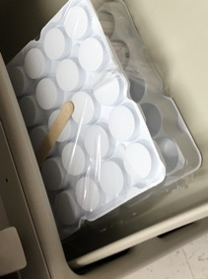
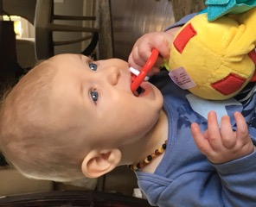
Touring The Clinic

Slide 18
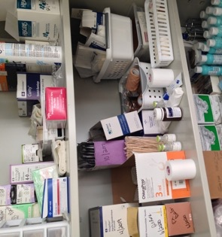
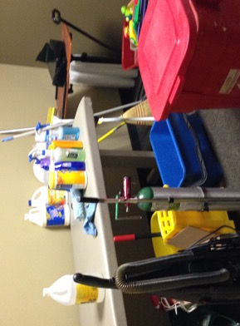
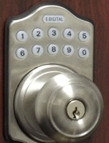
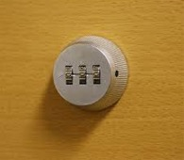
Touring The Clinic

Slide 19
Touring the Clinic
All equipment resides on an Inventory List
Manufacturer’s IFUs determines need for Inspection vs Preventive Maintenance (PM)
Process in place for tracking due dates for PM
Evidence of initial inspection BEFORE use in patient care
Annual Bio-Med inspection is evident with stickers or report
Equipment not in use is labeled as such and stored away

Slide 20
Touring the Clinic
6 Required tests in the Clinic:
  Chemical examination of urine by stick or tablet method
  Hemoglobin or Hematocrit
  Blood Glucose
  Examination of stool specimens for occult blood
  Pregnancy Test
  Primary Culturing for transmittal to a certified lab
Clinic follows all Manufacturer’s IFU for equipment and supplies

Slide 21
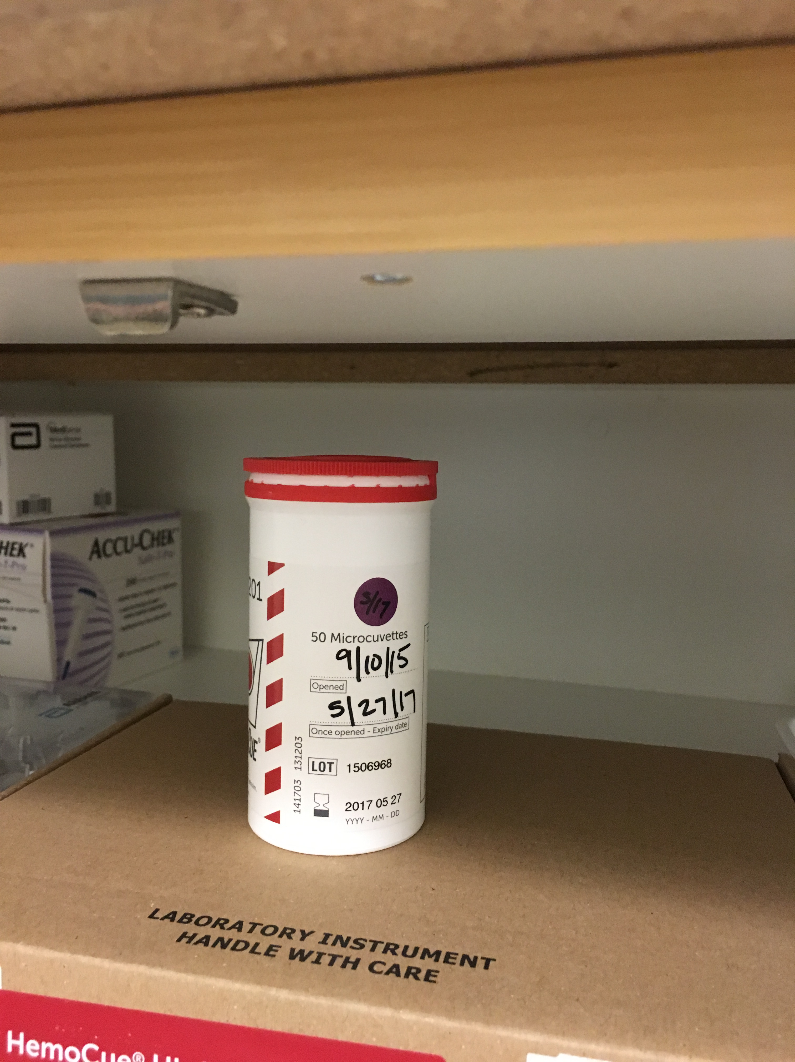
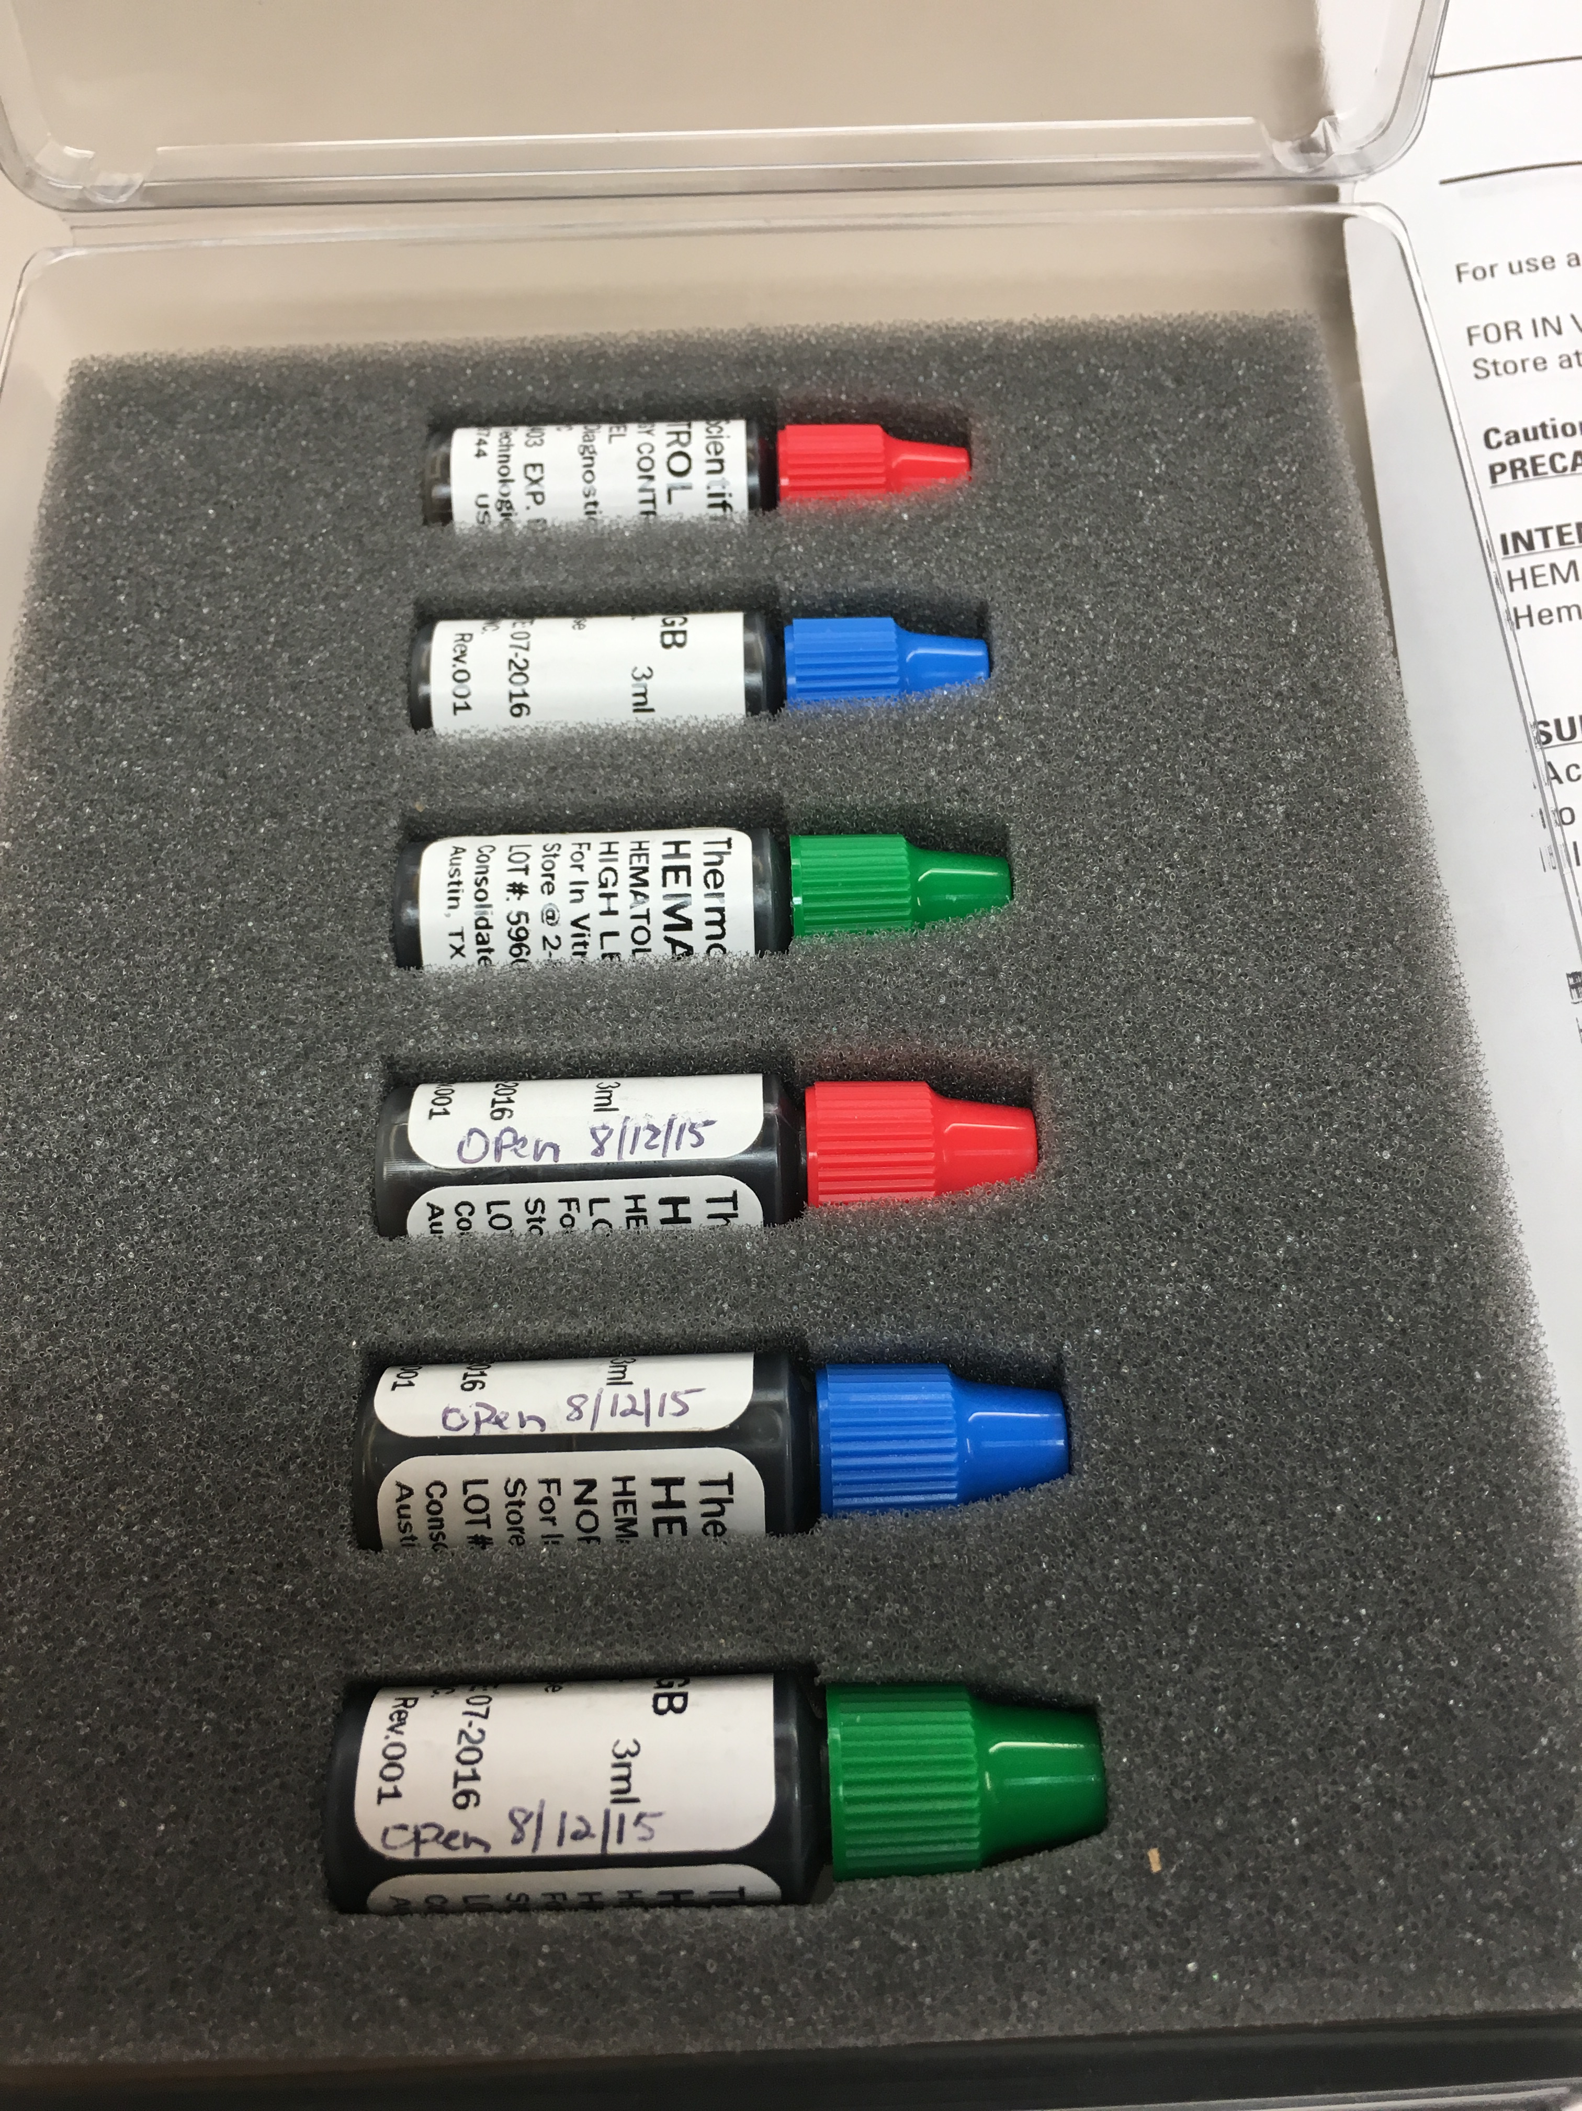
Touring the Clinic
Clinic must have the ability to do all 6 required tests.
Most common one missing is Hemoglobin or Hematocrit for Provider Based clinics.
All reagents, strips, controls etc. must be in date.
CLIA Certificate is current and posted

Slide 22
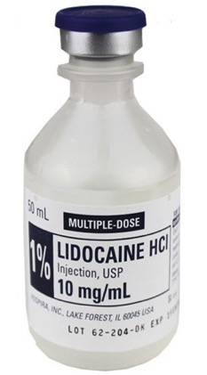
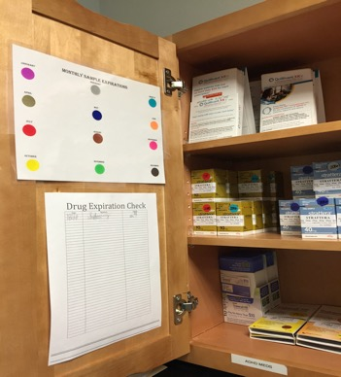
Touring the Clinic
Samples
Multi Dose Vials
Single Dose Vials
Secured/Organized In Original Containers
Do Not Assume All Staff Know the Difference Between SDVs and MDVs...Provide Training
Ensure Single-Dose Vials (SDVs) Are Never Used for More Than One Patient

Slide 23
Touring the Clinic
Ensure Single-Dose Vials (SDVs) Are Never Used for More Than One Patient

Slide 24
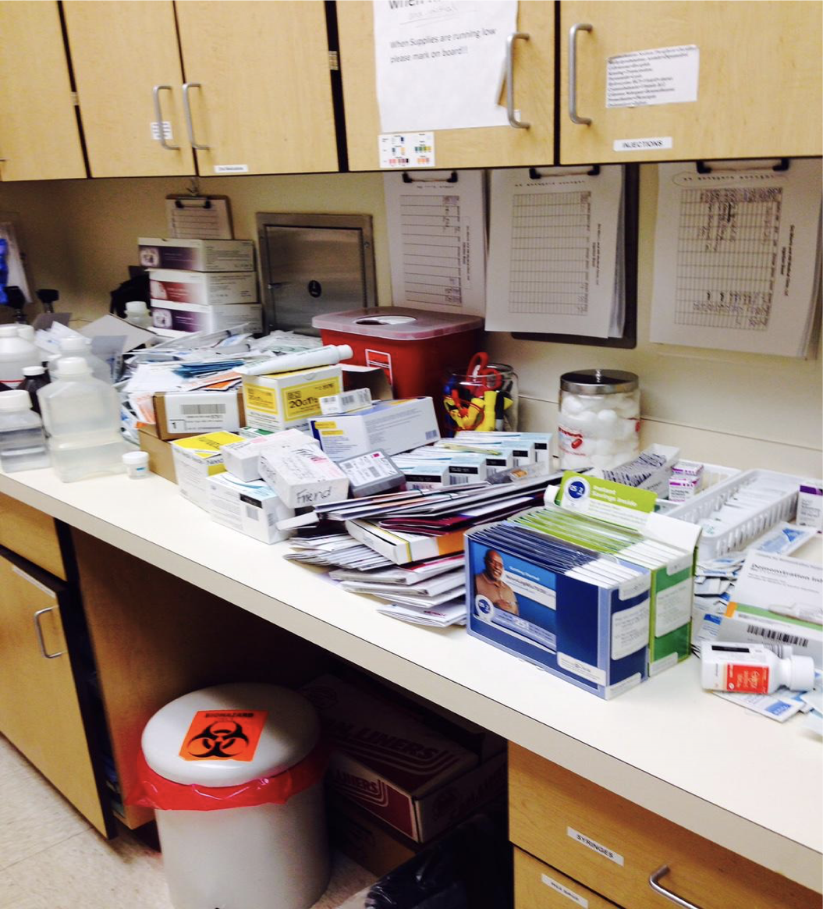
Touring the Clinic
Remember the regulation says expired medications and SUPPLIES.
Telfa, gloves, peroxide, electrodes, needles
Iodoform gauze, etc.
Anything with a date!

Slide 25
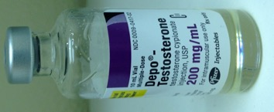
Touring the Clinic
Controlled Substances (CS) locked in a Substantial Cabinet
Recordkeeping Logs for Ordering / Dispensing
MDVs, Storage in Sample Closet, Med Fridge, or Emergency Boxes must be secured.

Slide 26
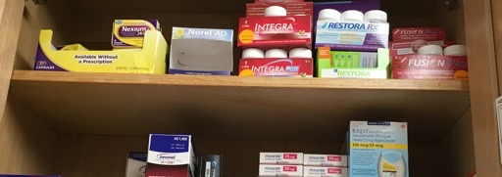
Touring the Clinic
Sample Medications Secured and
Logged to Track in the Event of a Recall

Slide 27
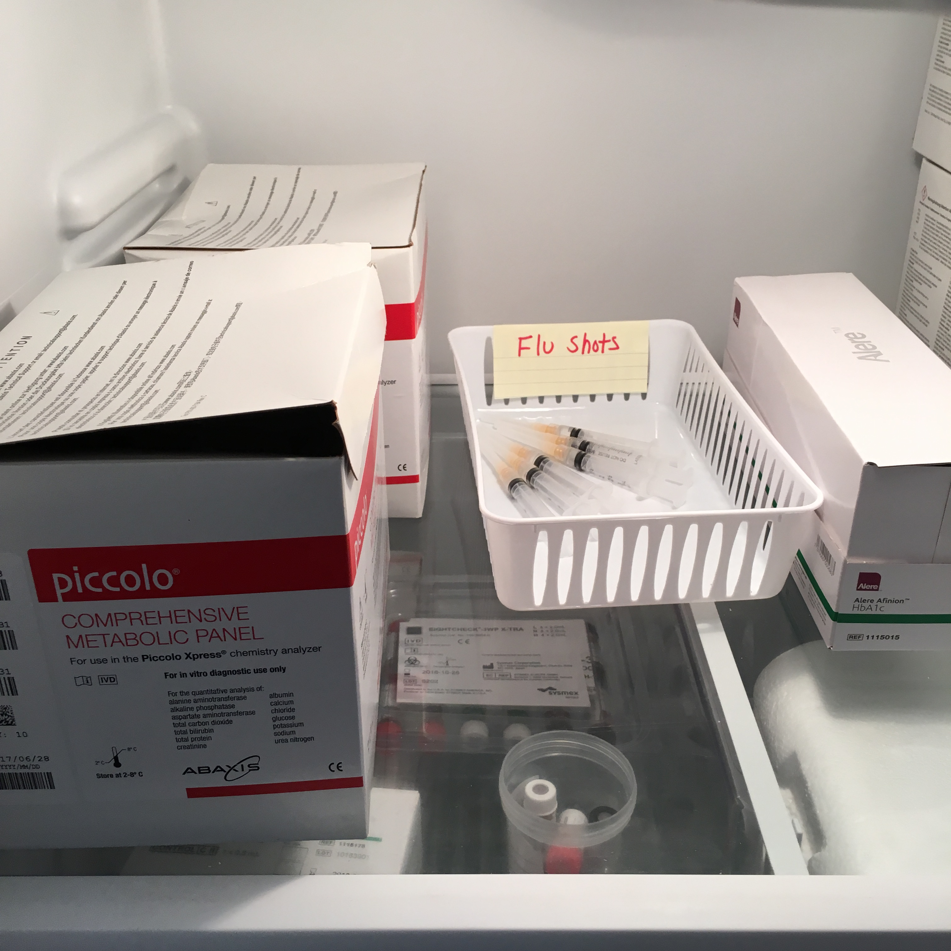
Touring the Clinic
Once vaccine is inside the syringe, it is difficult to tell which
vaccine s which; this may lead to administration errors.
Prefilling syringes leads to vaccine wastage and increases the risk of vaccine storage under inappropriate conditions. Most syringes are designed for immediate administration and not for vaccine storage.
Bacterial contamination and growth can occur in syringes you prefill with vaccines that do not contain bacteriostatic agents, such as the vaccines supplied in single-dose vials.
No stability data are available for vaccines stored in plastic syringes. Vaccine components may interact with the plastic syringe components with time and thereby reduce vaccine potency.
Finally prefilling syringes is a violation of medication administration guidelines, which state that an individual should only administer medications he or she has prepared and drawn up.
This is a quality control and patient safety problem because if you do not draw up the vaccine yourself, you cannot be sure of the composition and sterility of the dose you are administering.

Slide 28
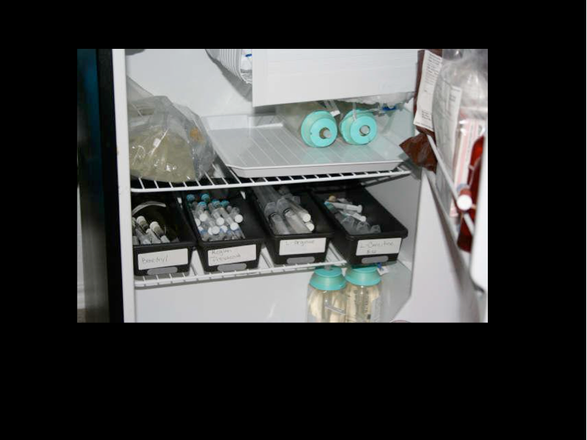
Touring the Clinic
No Medications in door of refrigerator
Use Water bottles to take up dead space
Refer to CDC Vaccine Storage toolkit
https://www.cdc.gov/vaccines/hcp/admin/storage/toolkit/storage-handling-toolkit.pdf

Slide 29
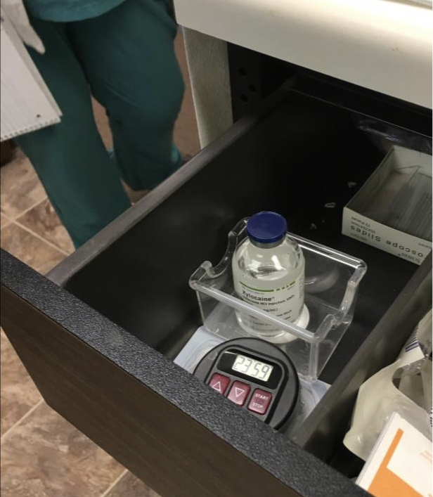
Touring the Clinic
NO medications or hazardous material in this lower exam table drawer
ThinPrep:
It’s a preservative with the following warnings:
Inhaled: may cause depression of the Central Nervous System resulting in weakness, nausea, drowsiness and possibly blindness.
Skin Contact: May cause irritation and or dermatitis
Ingestion: May cause intoxication, CMS depression, nausea and dizziness. May damage liver, kidneys and nervous system.

Slide 30
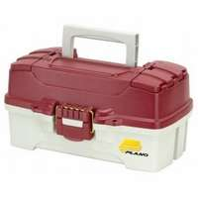
Touring the Clinic
The clinic provides medical emergency procedures as a first response to common life-threatening injuries and acute illness and has available the drugs and biologicals commonly used in life saving procedures.

Slide 31
Touring the Clinic
Infection Prevention
Clean to Dirty Process to Avoid Cross Contamination

Slide 32
Infection Prevention Best Practices
OSHA training upon hire and annually
PPEs are available and accessible
Hand Hygiene when appropriate
Clean/Dirty Segregation in work and storage areas
Avoid Cross-Contamination (disinfecting environment, cleaning patient equipment, sterile processing
No Reuse of Meds/Supplies Designated for Single Use

Slide 33
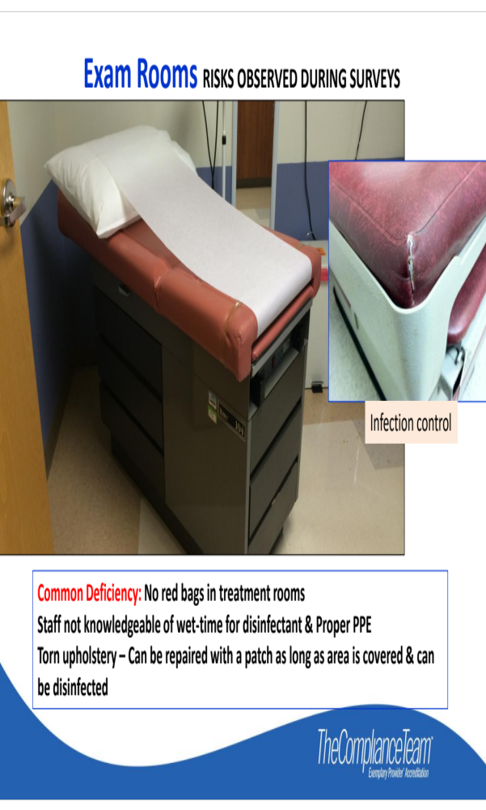
Infection Control
Cleaning a torn table???

Slide 34
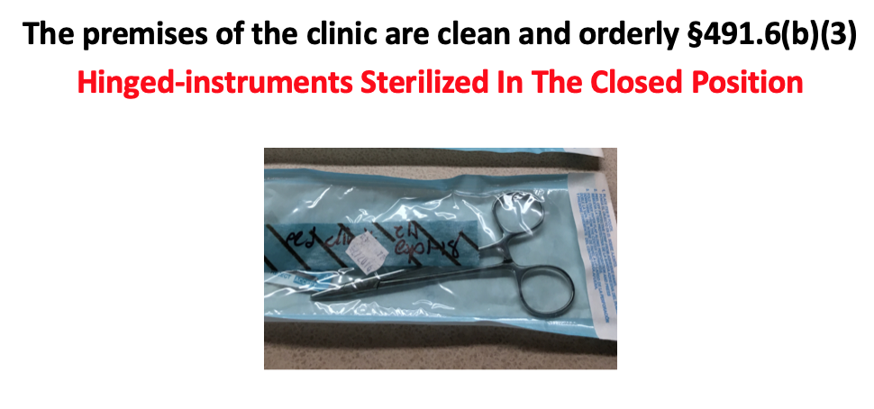
Infection Control
Hinged instruments sterilized in a closed position.

Slide 35
Infection Prevention
Disposable Instrumentation Is the easiest way to meet Compliance with recommended practices from nationally recognized organizations.

Slide 36
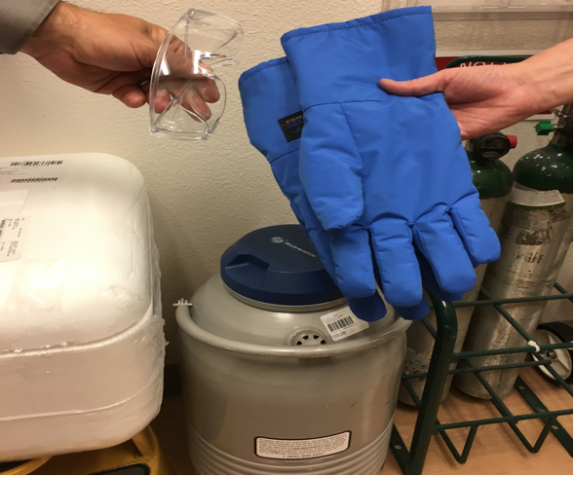
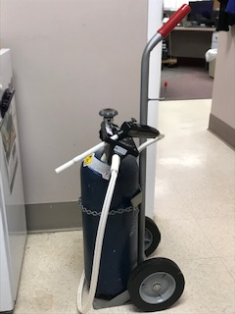
Infection Prevention
Personal Protective Equipment for Staff who handle liquid nitrogen:
Heavy duty gloves
Goggles

Slide 37
Emergency Preparedness
Risk Assessment and Planning
Policies and Procedures
Communications Plan
Training and Testing

Slide 38
Emergency Preparedness
Hazards assessment must be documented
Communication plan is incomplete including name and contact information for all staff and local, regional, state and federal emergency staff
Must participate in a full-scale exercise that is community-based or when not accessible, an individual, facility-based exercise
Documentation of the clinic’s efforts to contact EP officials
Conduct an additional exercise
Analyze the clinic’s response to exercise or activation of plan

Slide 39
Emergency Preparedness
CMS After Action Report (AAR)
Brief overview of the exercise
Enter the capabilities tested by the exercise
Enter the major strengths identified during the exercise
Enter areas for improvement identified during the exercise, including recommendations (include the top 3 areas at a minimum)
Describe the overall exercise as successful or unsuccessful, and briefly state the areas in which subsequent exercises should focus
Can be used after an exercise or an event

Slide 40
Emergency Preparedness
You must do two a year. One can be a full scale community or clinic based drill and one can be a table top; But it must be two.
Staff contact information not listed in the policy.

Slide 41
Annual Evaluation
Includes review of:
Utilization of clinic services, including at least the number of patients served and the volume of services;
A representative sample of both active and closed clinical records; and
The clinic's health care policies.

Slide 42
Annual Evaluation
Why do this:
  To determine whether:
  Utilization of services was appropriate;
  The established policies were followed; and
  If any changes are needed.
The clinic or center staff considers the findings of the evaluation and takes corrective action if necessary.

Slide 43

Appendix G
(Rev. 177, 01-26-18)

Slide 44
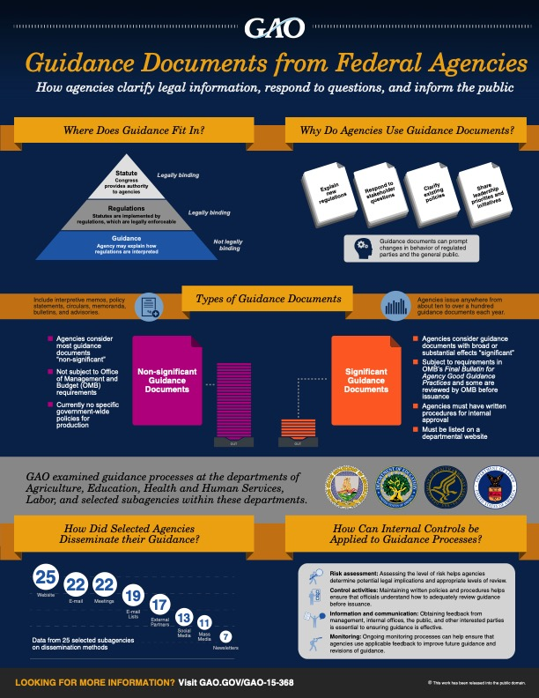
Appendix G

Slide 45
Management by Walking Around
Any New Process – Spot Check to Confirm Staff Understanding
Regular Rounding Encourages Compliance
May be Delegated to Trusted Staff Members
Use a Rounding Checklist
Control Logs
Auditing charts Reviewing
Patient Satisfaction Surveys

Slide 46
Survey Findings
100% compliance is necessary for RHC Certification
Statement of Deficiency will be received with in 10 business days
Clinic has 10 calendar days to submit an acceptable Plan of Correction
Standard level deficiencies must be corrected within 60 calendar days
Condition level deficiencies require re-survey within 45 calendar days from the original survey date (can loose billing number)

Slide 47




Trusted Resources

Slide 48
NARHC
Certified RHC Professional™ Course
Registration for next session opens August 1, 2019!
REGISTRATION FOR NEXT SESSION BEGINS AUGUST 1, 2019!
National Association of Rural Health Clinics Website www.narhc.org aacademy@narhc.org 866.306.1961x2
866.306.1961x2 866.306.1961x2

Slide 49
NARHC
This 8-10 week ONLINE TRAINING* will prepare the learner to successfully run an RHC.
The learner will gain an in-depth knowledge of basic rules, regulations, and laws regarding RHCs.
Culminating in an in-person, final exam held on October 9th, 2019, at the NARHC Fall Institute in St. Louis
Coursework is broken into 4 modules which include video presentations & a series of short knowledge-based tests for each module. These courses are designed to give you the basic, ground level RHC knowledge.
Administration & Finance
Human Resources
Regulatory Compliance & Quality
Billing & Coding

Slide 50
NARHC
Course Description:
This course was designed by an expert panel of 18 people; a Who’s Who of RHC Consultants, NARHC Board Members, and RHC Attorneys to teach the fundamental skills and expand the professional knowledge needed to successfully manage a Rural Health Clinic.
Who Should Take the Course:
Directors, Clinic Administrators and other RHC leaders
Cost of Course Materials and Exam Fee: $45
0 $450.00 Member Fee
$600.00 Non-Member Fee
Length:
  Enrollment begins August 1st, 2019 with limited spots available. Enrollment begins August 1st, 2019 with limited spots available. Access to the program begins upon registration and coursework needs to be completed at the learner’s own pace by October 9th.

Slide 51

NARHC MEETING In St Louis
Registration information is on the NARHC website:
https://www.web.narhc.org/assnfe/CourseView.asp?MODE=VIEW&clCourseID=1
National Association of Rural Health Clinics
2 E Main St. Fremont, MI 49412 866-306-1961x2 academy@narhc.org
Final Exam in St. Louis– October 9th, 2019

Slide 52
Thank You
        Kate Hill, RN
        VP Clinical Services
        215-654-9110
        khill@thecomplianceteam.org

Slide 53
Questions

