Slide 1

HRSA Resources
2019 Alabama Rural Health Association
April 25, 2019
Judy Trawick, RN, BSN, CPHQ
Public Health Analyst
Health Resources and Services Administration (HRSA)
Region 4 - Atlanta

Slide 2
HRSA Resources for Alabama Rural Health
Overview and National Impact
Key Programs in Alabama
Notices of Funding Opportunities
HRSA-funded Data Resources
Office of Regional Operations

Slide 3
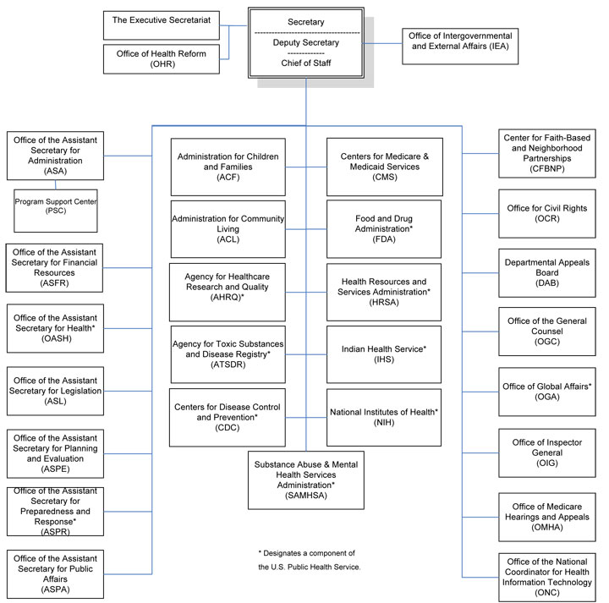
U.S. Department of Health and Human Services (HHS)

Slide 4
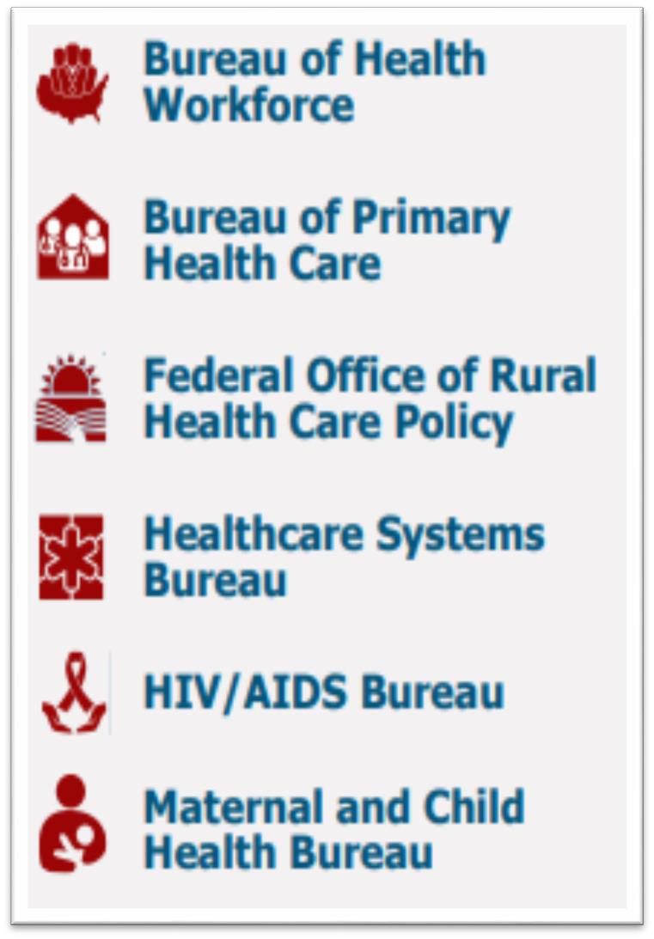
Health Resources and Services Administration (HRSA)
Overview
Supports more than 90 programs that provide health care to people who are geographically isolated, economically or medically challenged
HRSA does this through grants and cooperative agreements to more than 3,000 awardees, including community and faith-based organizations, colleges and universities, hospitals, state, local, and tribal governments, and private entities
Every year, HRSA programs serve tens of millions of people, including people living with HIV/AIDS, pregnant women, mothers and their families, and those otherwise unable to access quality health care

Slide 5
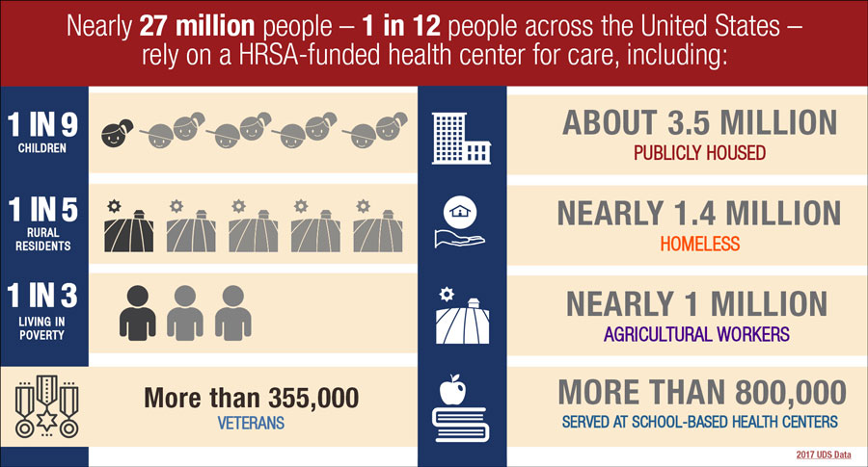
National Impact
Source: Uniform Data System, 2017

Slide 6
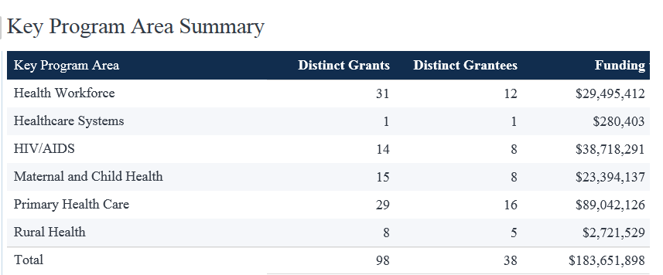
HRSA Funding in Alabama (dollars in millions)

Slide 7
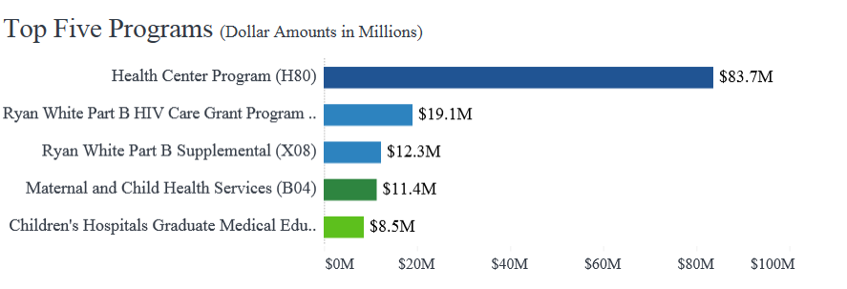
HRSA Funding in Alabama (dollars in millions)
Source: data.hrsa.gov/topics/grants FY 2018

Slide 8
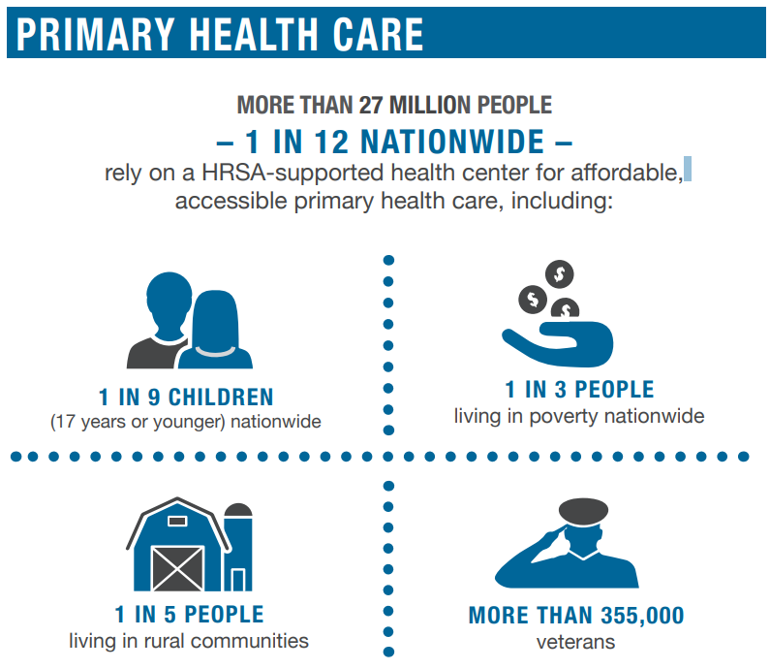
Health Center Program
Alabama
15 Grantees
319,327
Total Patients Served (2017)

Slide 9
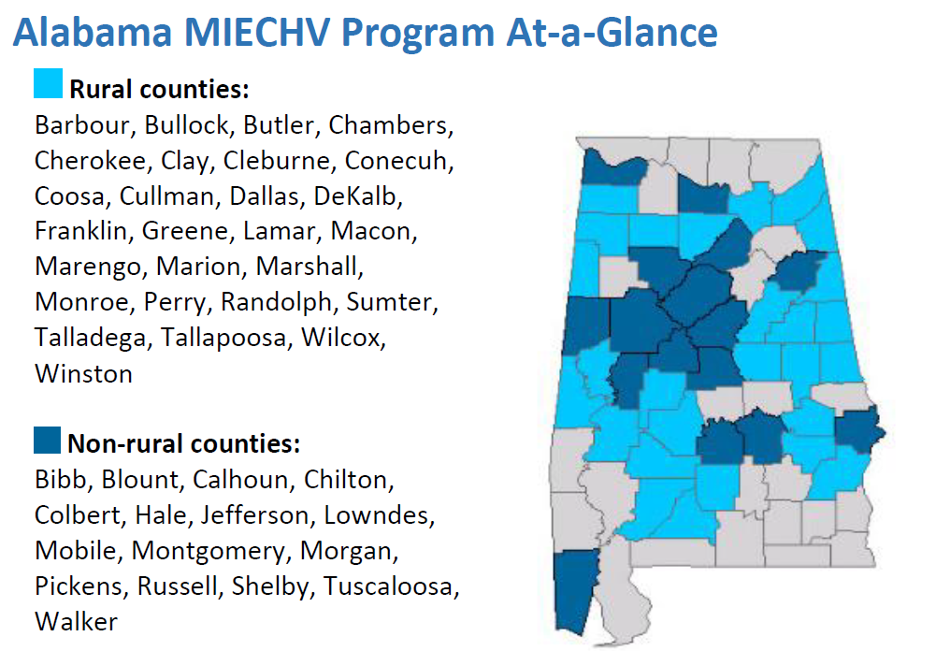

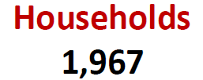

Maternal and Child Health
MCH Block Grant Program- Grants to 59 states and jurisdictions to provide health care and services to nearly 56 million mothers and children in the United States, including:
  86% of all pregnant women
  99% of infants
  55% of all children, including those with special health care needs

Slide 10
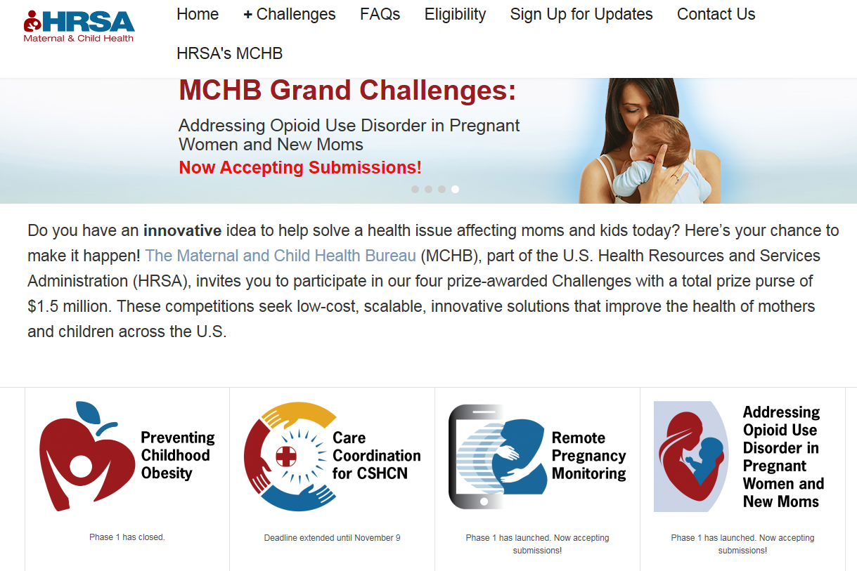
Maternal and Child Health
MCHBGrandChallenges.hrsa.gov

Slide 11

Ryan White HIV/AIDS Program
More than half of the people living with diagnosed HIV in the United States—535,000 individuals—receive services through at least one Ryan White HIV/AIDS Program-funded service
86% of Ryan White HIV/AIDS Program clients receiving HIV medical care are virally suppressed, up from 70% in 2010, and exceeding the national average* of 60%
In Alabama…..
9,113 clients served in 2017
Source: RWHAP Annual Client-Level Data Report 2017
*Viral suppression among people >=13 years old diagnosed with HIV in 34 states and DC

Slide 12
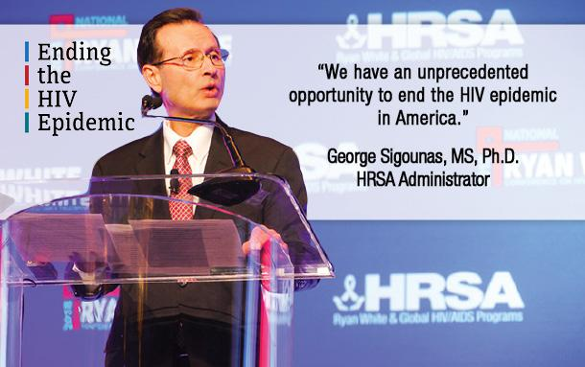
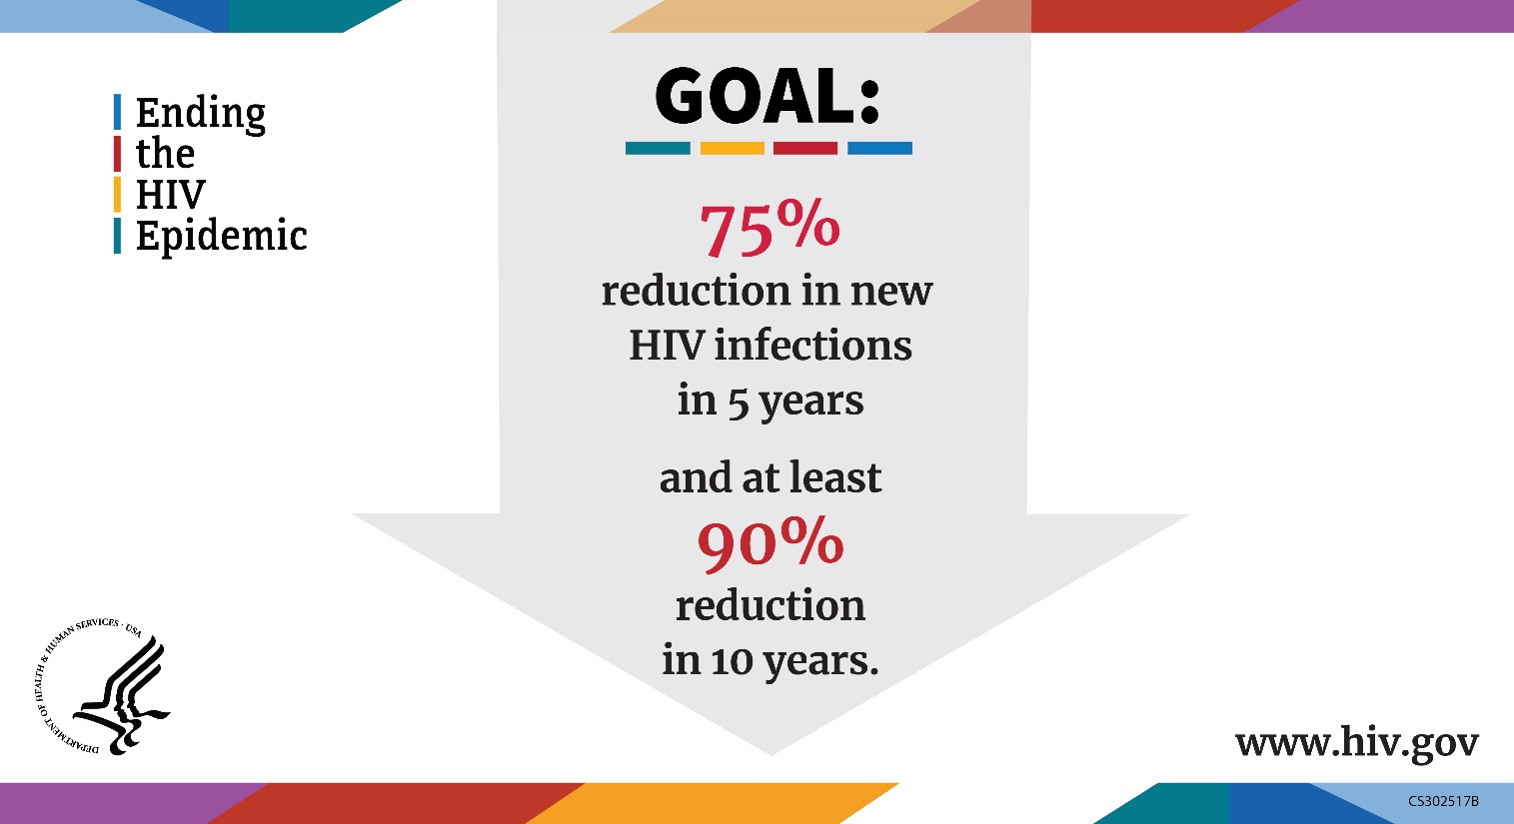
HRSA In Action…

Slide 13
Federal Office of Rural Health Policy
Community-Based Division
Office for the Advancement of Telehealth
Delta State Rural Development Network
Rural Communities Opioid Response (Planning)
Rural Health Care Services Outreach
Rural Health Network Development
Small Healthcare Provider Quality Improvement
Rural Network Allied Health Training Program
Black Lung Clinics Program
Radiation Exposure & Screening Education
Telehealth Network Grants
Telehealth Resource Centers
Telehealth Research Center
Telehealth Centers of Excellence
Flex Rural Veterans Health Access
Licensure Portability
Policy Research Division
Hospital-State Division
Rural Health Research Centers
Rural Health Research Gateway
Rural Health Information Hub
Rural Policy Analysis
Rapid Response Data Analysis
Rural Health Value
State Offices of Rural Health
Medicare Rural Hospital Flexibility Grants
Small Rural Hospital Improvement Program
Rural Quality Improvement Technical Assistance Cooperative Agreement
Small Rural Hospital Transitions Project

Slide 14
Health Care Systems
Organ Transplantation
  Currently, over 145 million people are registered to be organ donors—an all time high
  Over 19 million people are registered to be bone marrow donors
  In 2017, HRSA’s transplantation programs facilitated:
    34,770 organ transplants (the highest ever)
    Nearly 6,000 bone marrow and cord blood transplants
340B Drug Pricing Program
  Drug manufacturers provide discounts to eligible entities that meet criteria for serving safety net patients
  Qualified safety net organizations obtain a 25-50% discount on outpatient drugs
Poison Control Program
  Poison control centers receive approximately 2.2 million human exposure calls annually
  67 percent of human exposure calls to the Poison Help Line were managed through the helpline, thereby reducing hospitalizations
  Poison control centers save Americans more than $1.8 billion every year in medical costs and lost productivity

Slide 15

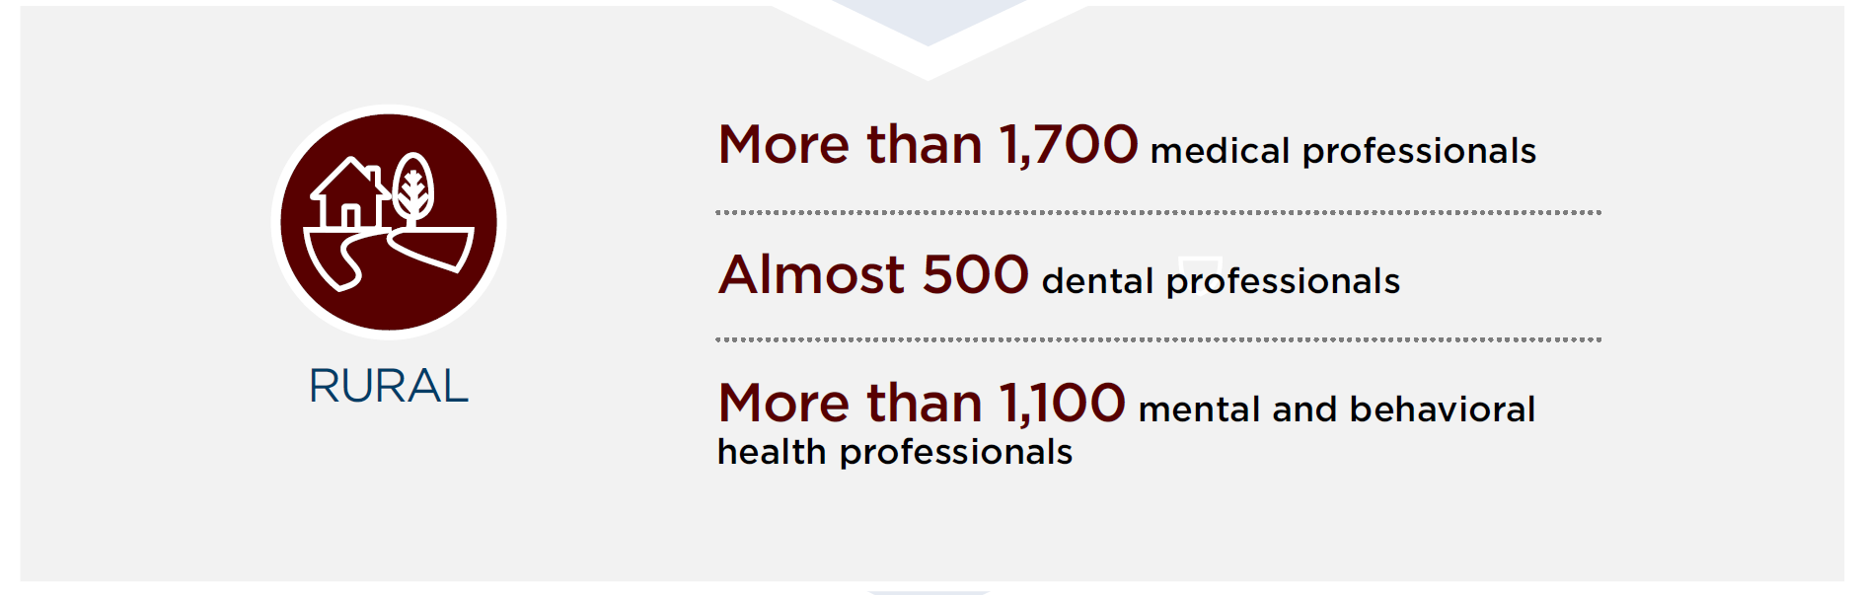
National Health Service Corps and Nurse Corps
Alabama NHSC
Dental Health Care | 8.00
Mental Health Care | 37.24
Primary Health Care | 42.98
Total Providers FTE | 88.22
NHSC Scholar | 3.00
NHSC Loan Re-payor | 81.22
NHSC Student to Service | 4.00
Urban | 42.84
Rural | 43.38
Source: NHSC Current Provider FTE Summary by State Report

Slide 16
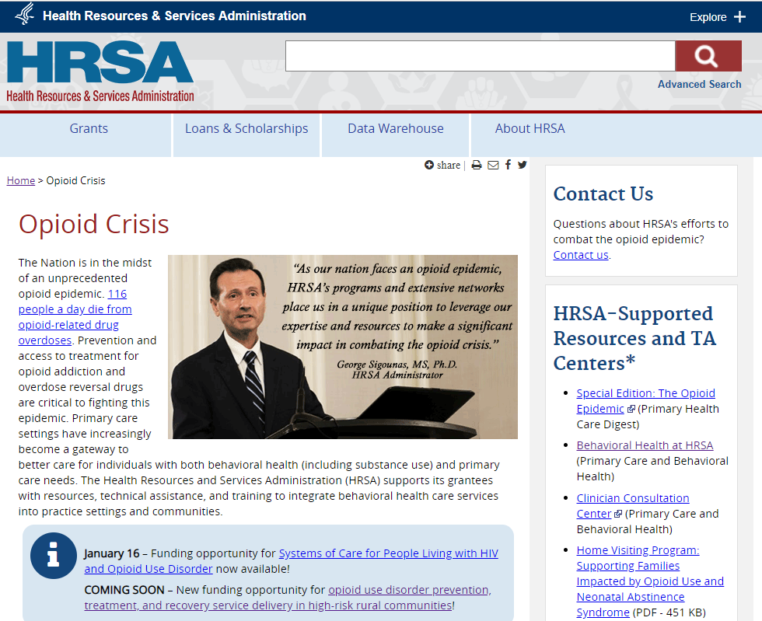
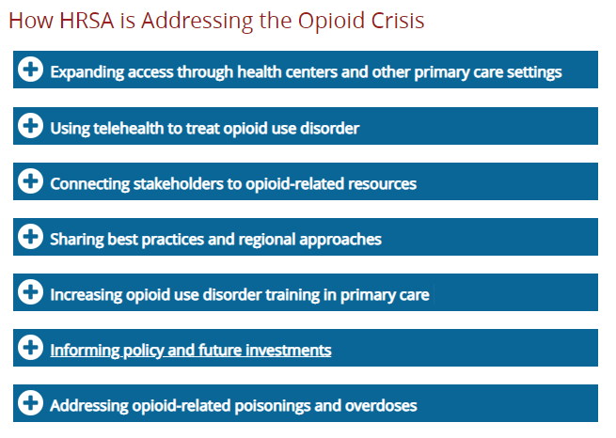
HRSA and Opioids…
HRSA.gov/Opioids

Slide 17
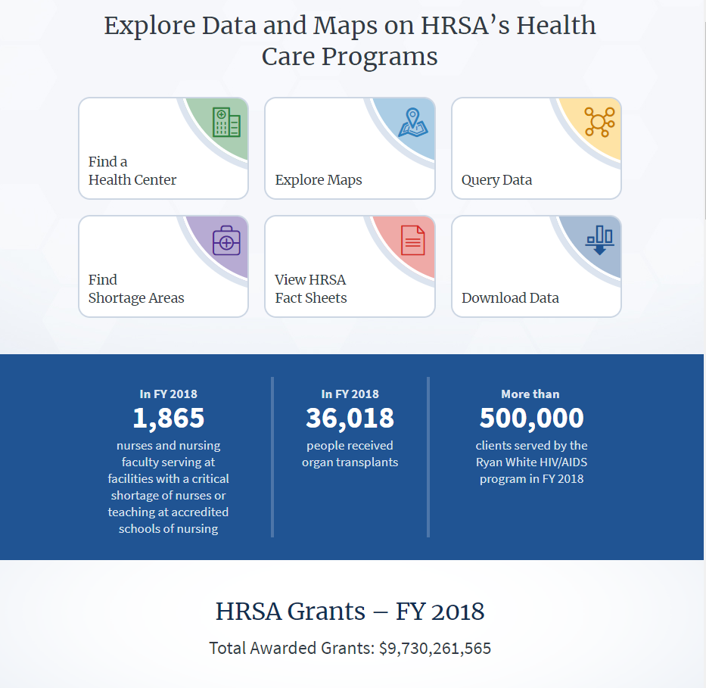
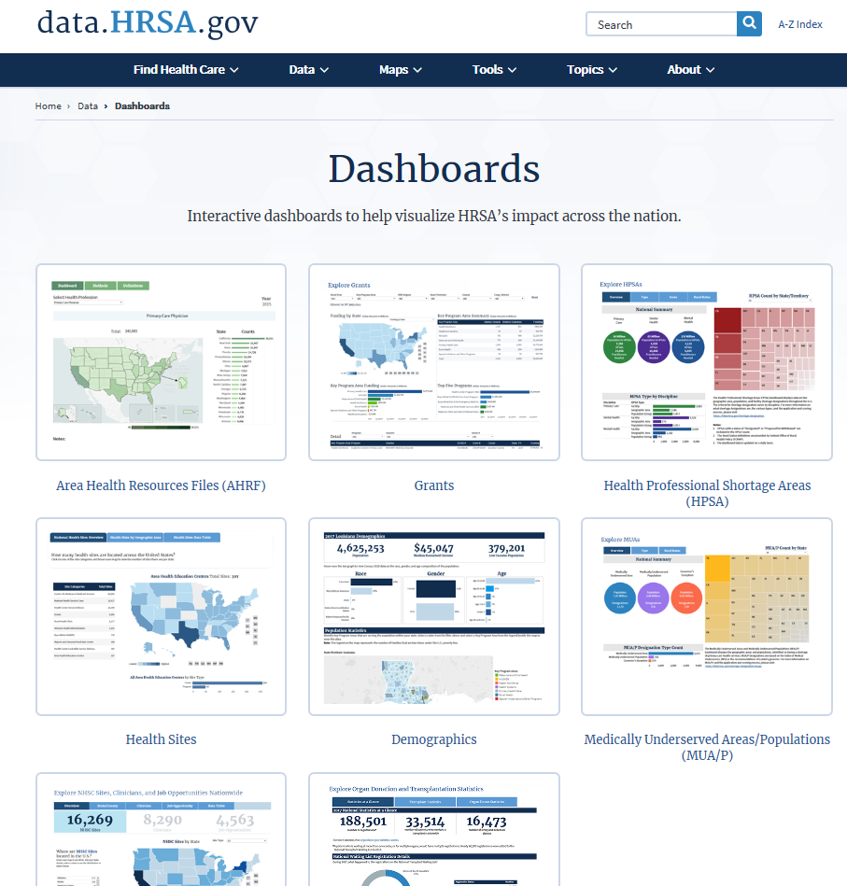
HRSA Data Warehouse
data.HRSA.gov

Slide 18
Notice of Funding Opportunities
Program | Announcement Number | Program Category | Application Deadline
Networks for Oral Health Integration within the Maternal and Child Health Safety Net | HRSA-19-053 | Maternal & Child Health Bureau | 04/29/2019
Newborn Screening State Evaluation Program | HRSA-19-097 | Maternal & Child Health Bureau | 05/06/2019
Rural Communities Opioid Response Program - Evaluation | HRSA-19-083 | Federal Office of Rural Health Policy | 05/06/2019
Rural Communities Opioid Response Program - Implementation | HRSA-19-082 | Bureau of Health Workforce | 05/06/2019

Slide 19
Notice of Funding Opportunities
Program | Announcement Number | Program Category | Application Deadline
Opioid Workforce Expansion Program (OWEP) Paraprofessionals | HRSA-19-089 | Bureau of Health Workforce | 05/07/2019
Opioid Workforce Expansion Program (OWEP) Professionals | HRSA-19-085 | Bureau of Health Workforce | 05/07/2019
Rural Maternity and Obstetrics Management Strategies Program | HRSA-19-094 | Federal Office of Rural Health Policy | 05/24/2019
Hrsa.gov/Grants/funding opportunities, March 26, 2019

Slide 20

Rural Health Research Gateway
Funded by HRSA’s Federal Office of Rural Health Policy
Free online library with access to research from all ten federally-funded Rural Health Research Centers
Use the library to find:
  rural health research products and journal articles
  information about the research centers
  information about individual researchers
  current research center projects
https://www.ruralhealthresearch.org

Slide 21

Rural Health Information Hub
Funded by the Health Resources and Services Administration’s (HRSA) Federal Office of Rural Health Policy
Nation’s rural health information source
  library of resources
  coverage of rural issues
  state guides
  toolkits
  program models
  much more!
Provides customized assistance
  By phone: 1.800.270.1898
  By email: info@ruralhealthinfo.org
https://www.ruralhealthinfo.org/

Slide 22
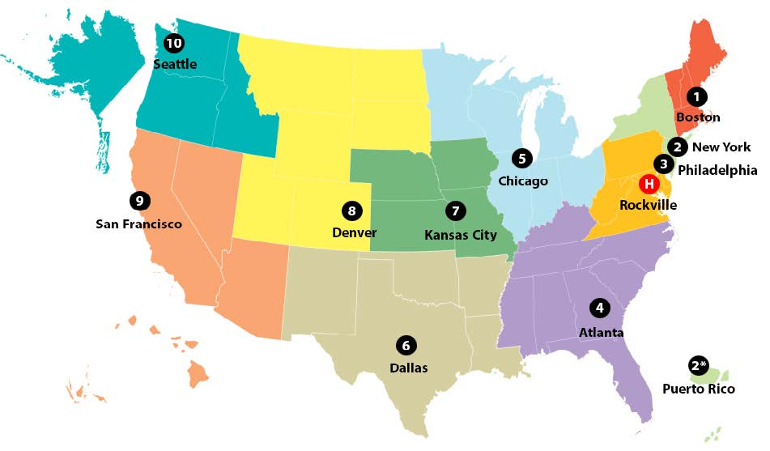
Office of Regional Operations (ORO)
To improve health equity in underserved communities through on-the-ground outreach, education, technical assistance and partnering with local, state and federal organizations.

Slide 23

Office of Regional Operations
Network
ORO STAKEHOLDERS
HRSA Grantees
State Leadership
Tribal Organizations
Community & Faith-Based Organizations
Colleges/Universities
Private Sector Organizations & Foundations
HHS Regional Directors/Regional Health Administrators
HHS Operating Divisions
Federal Departments or Agencies

Slide 24
Office of Regional Operations
Connect
When should you contact ORO?
When you would like to connect with HRSA or HHS programs
When you have questions about HRSA or HHS programs, data, policies, or resources
When you are looking for a new type of partner or resource (including funding opportunities)
When you would like HRSA representation at a meeting or event
Simply to connect!

Slide 25
THANK YOU!
Judy Trawick
Pubic Health Analyst
Health Resources and Services Administration
Office of Regional Operations
Region 4- Atlanta Regional Office
JTrawick@hrsa.gov
404-562-7980

Slide 26






Connect with HRSA
To learn more about our agency, visit
www.HRSA.gov
Sign up for the HRSA eNews
FOLLOW US:

