Slide 1
RURAL EMS
CHALLENGES AND OPPORTUNITIES

Slide 2

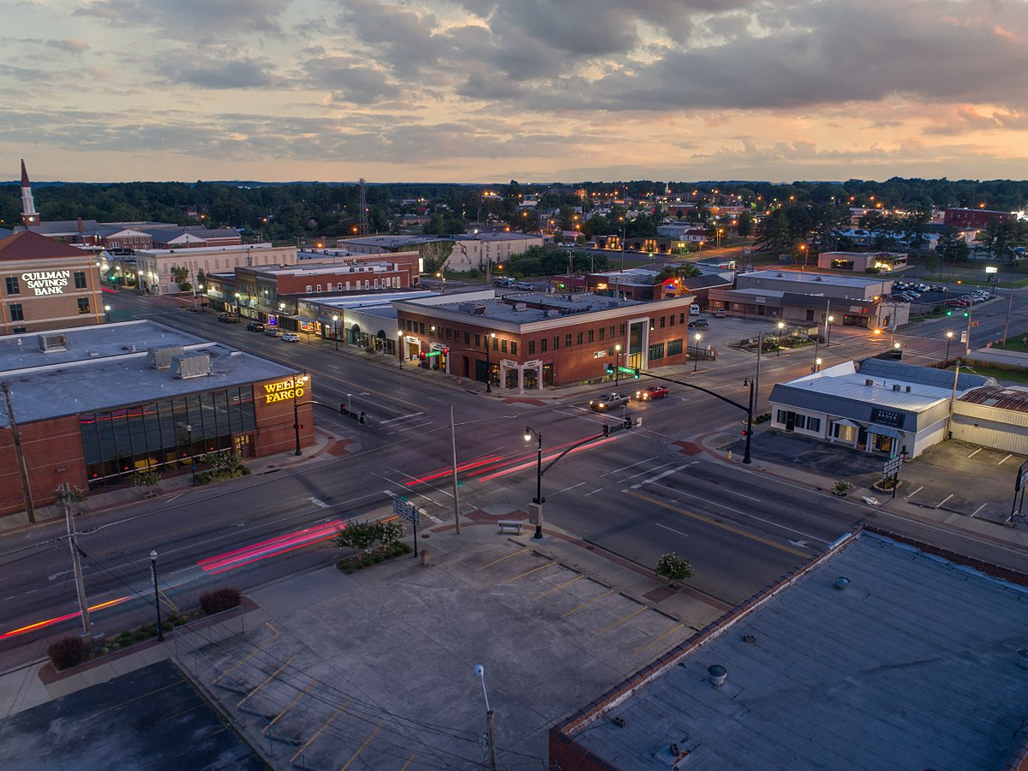
What is Rural America?

Slide 3
What is Rural America?
“Rural encompasses all population, housing, and territory not included within a United States Census Bureau Alabama Urbanized Area of 50,000 or more people” – Alabama Rural Health Association
“Low population density, small number of people, distance from metro area” - US Census Bureau 2018

Slide 4
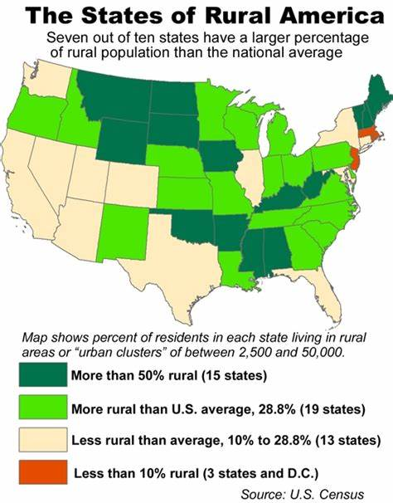

Slide 5
 | United States | Alabama | Cullman County
Population | 327,167,434 | 4,887,871 | 82,755
% pop. rural | 19.3% | 40.6% | 100%
Uninsured < 65yr old | 10.2% | 11.1% | 12.8%
High school graduate | 87.3% | 85.3% | 82.1%
# EMT’s / Medics | 248,000 | 3,920 | 100
Median income | $57,617 | $46,257 | $45,044
% in poverty | 12.3% | 16.9% | 13.8%

Slide 6
Overall Health Ranking
“ Health is a state of complete physical, mental, and social well-being and not merely the absence of disease or infirmity.” – World Health Organization
Alabama is ranked as the 47th Healthiest State
  - United Health Foundation 2018

Slide 7
CHALLENGES for Rural EMS
Staffing
Repeat Callers
Mental Health
Level of Available care / Hospital access
Coverage Area
Attitude
Money

Slide 8
Staffing
20-30% turnover rate – JEMS Journal of Emergency Medical Services Nov 2018
Alabama is in the bottom 10 for EMS pay – All healthcare – 2019
28 day period – 20 unfilled positions out of 504 slots
3 open fulltime positions right now
For the hospital = Delayed throughput in hospital

Slide 9
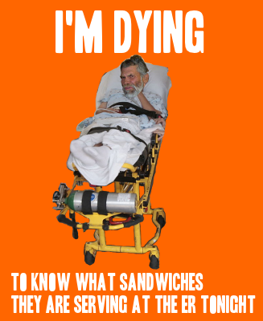
Repeat callers
Readmissions
Alabama – 22nd in US
>65 Medicare – 30 day readmissions
Alabama - 14.4%
USA – 14.9%
- Dartmouth Atlas of Health Care

Slide 10
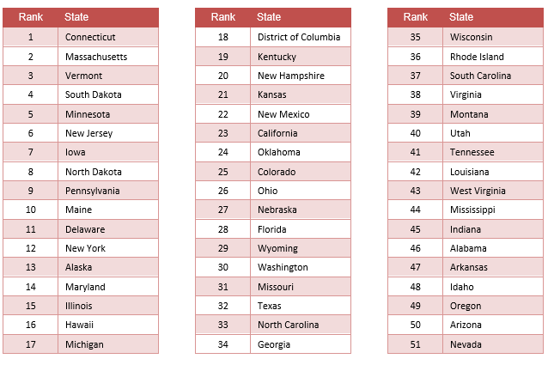
Mental Health
Mental Health America ranking 2018

Slide 11
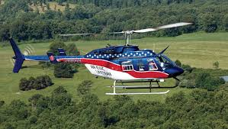
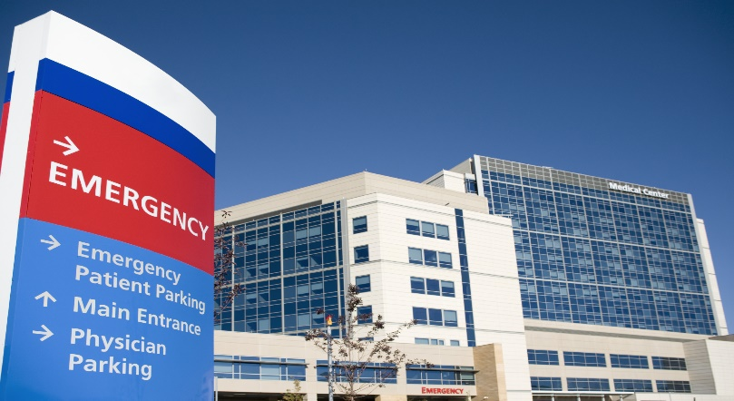
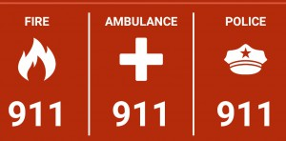
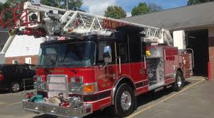
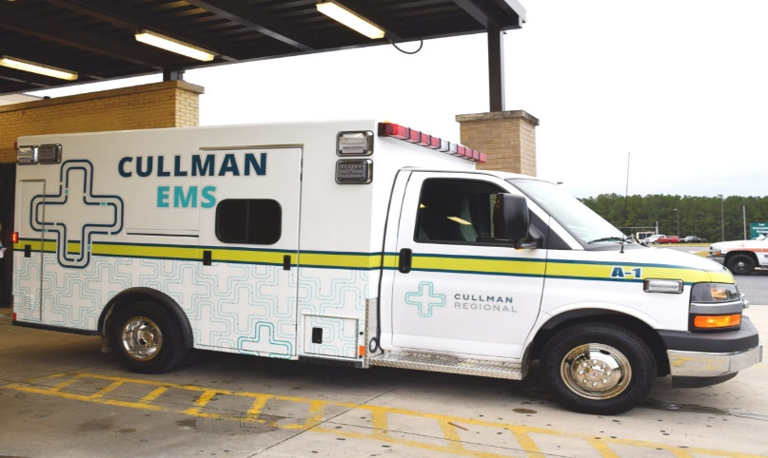
Level of Care / Access Special Service

Slide 12
37 Million 911 calls a year for EMS

Slide 13

Attitude
“That’s not how we have always done it!”

Slide 14

Money
Comfort Zone
Repeat Callers
EMS Resources
Mental Health
Staffing

Slide 15


Slide 16
Solution - Integrated healthcare platform
Patient

Slide 17
Case Management
Local non-profit
Medical Control
Free Clinic

Slide 18
So what is the impact from the integration?
Reduced readmissions
Shared costs
Faster throughput
Reduced call volume for EMS units
Better quality of life for the people who are the most vulnerable

Slide 19


Slide 20
California CP Pilot Program
24 month pilot program 2,515 enrolled patients
Post hospital follow-up – 1,401
Frequent EMS users - 103
TB observation (partnership with public health) - 270
Hospice support - 270
Alternate destination:
  Mental health Crisis center- 251
  Sobering Center - 400
  Urgent Care (cancelled)- 48

Slide 21
California CP Pilot Program

Slide 22
Outcome
Readmission rate dropped by 9.1%
96% taken to Mental Health Crisis Center (only 4% required transfer to ER)
35% reduction in 911 Frequent caller events in San Diego

Slide 23
Potential Cost Savings on Post Discharge
UCLA $403,284
San Bernardino $417,687
Cullman Regional - $14,500 (8)

Slide 24
ACTION WINS THE DAY
BETTER OUTCOMES
CP PROGRAM
EMS
HOSPITAL

Slide 25

James Curtis
Cullman Regional Medical Center
James.Curtis@cullmanregional.com

