Slide 1
Alabama Coordinated
Health Network:
Primary Care Providers
(ACHN)
Managed Care Division

Slide 2
Disclaimer
All content subject to CMS approval

Slide 3
A new direction…
  Single care coordination delivery system combining Health Homes, Maternity Program, and Plan First
  Replaces silos in current care coordination efforts
  Care coordination services provided by
  regional Primary Care Case Management Entities (PCCM-Es), or network entities.
  Seven newly defined regions; primary care physicians practicing in district comprise at
  least half of board

Slide 4

What does this mean for providers?

Slide 5
If you are a Primary Care Provider…
  New opportunity to earn bonus payments for achieving quality-related goals in addition to FFS payments
  If you earned “bump” payments previously, you can earn increased amounts if you participate with Medicaid and a regional ACHN entity

Slide 6
If you are a Primary Care Provider…
  You will not have a patient panel to manage, but will work in partnership with licensed social workers and nurses
  who will help manage your complex or
  non-compliant patients
  You can see patients regardless of where they live

Slide 7
If you are a Primary Care Provider…
  Referrals not needed for primary care
  Referrals will be required only for certain medical specialties
  EPSDT referrals will continue to be required

Slide 8

Why this approach?

Slide 9
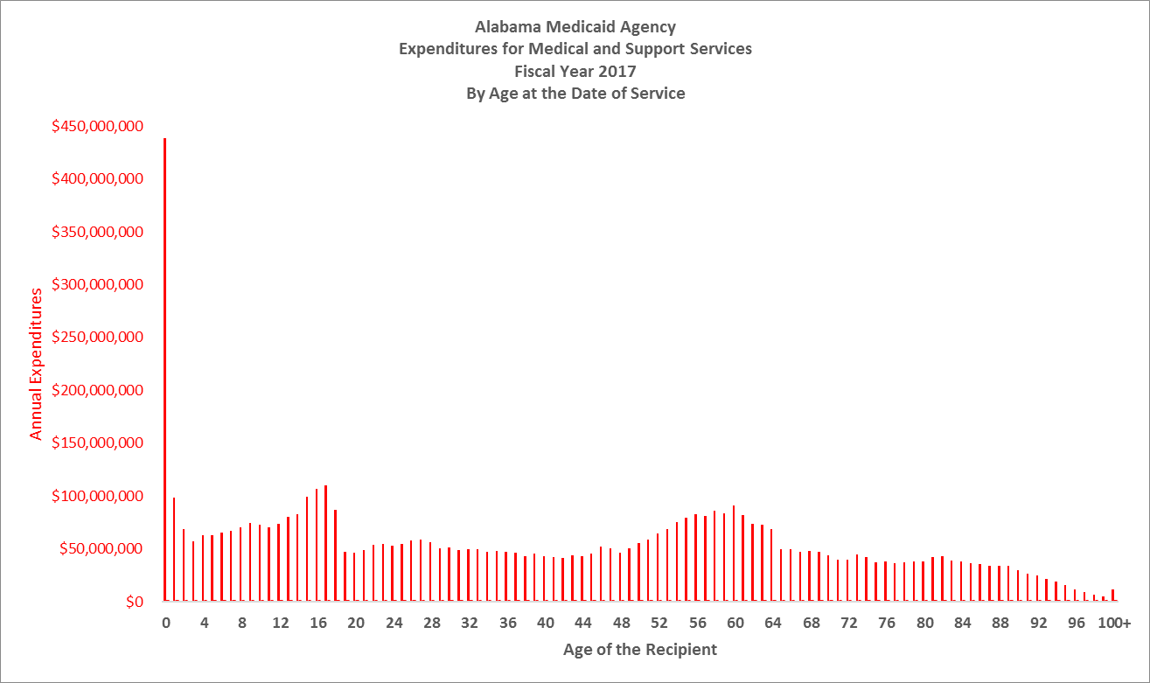

Slide 10
The ACHN Approach
  Past care coordination efforts in the areas of family planning, maternity care and primary care have not been in synch
  A system that works holistically with a Medicaid recipient to address issues impacting health can make a positive difference

Slide 11

ACHN Operation

Slide 12
ACHN Operation
  Statewide operation, one entity in each of seven pre-defined regions
  Each network will be responsible for creating a care coordination delivery system within the region
  Care coordination will be provided based on recipient’s county of residence.
  ACHN entities will not make payments to physicians

Slide 13
ACHN Operation
  Statewide system will manage care coordination services now provided by 12 maternity programs, six health home programs and ADPH staff in 67 counties
  Regional entities will be incentivized along with primary care providers to achieve better health outcomes and to provide a higher volume of care coordination services

Slide 14
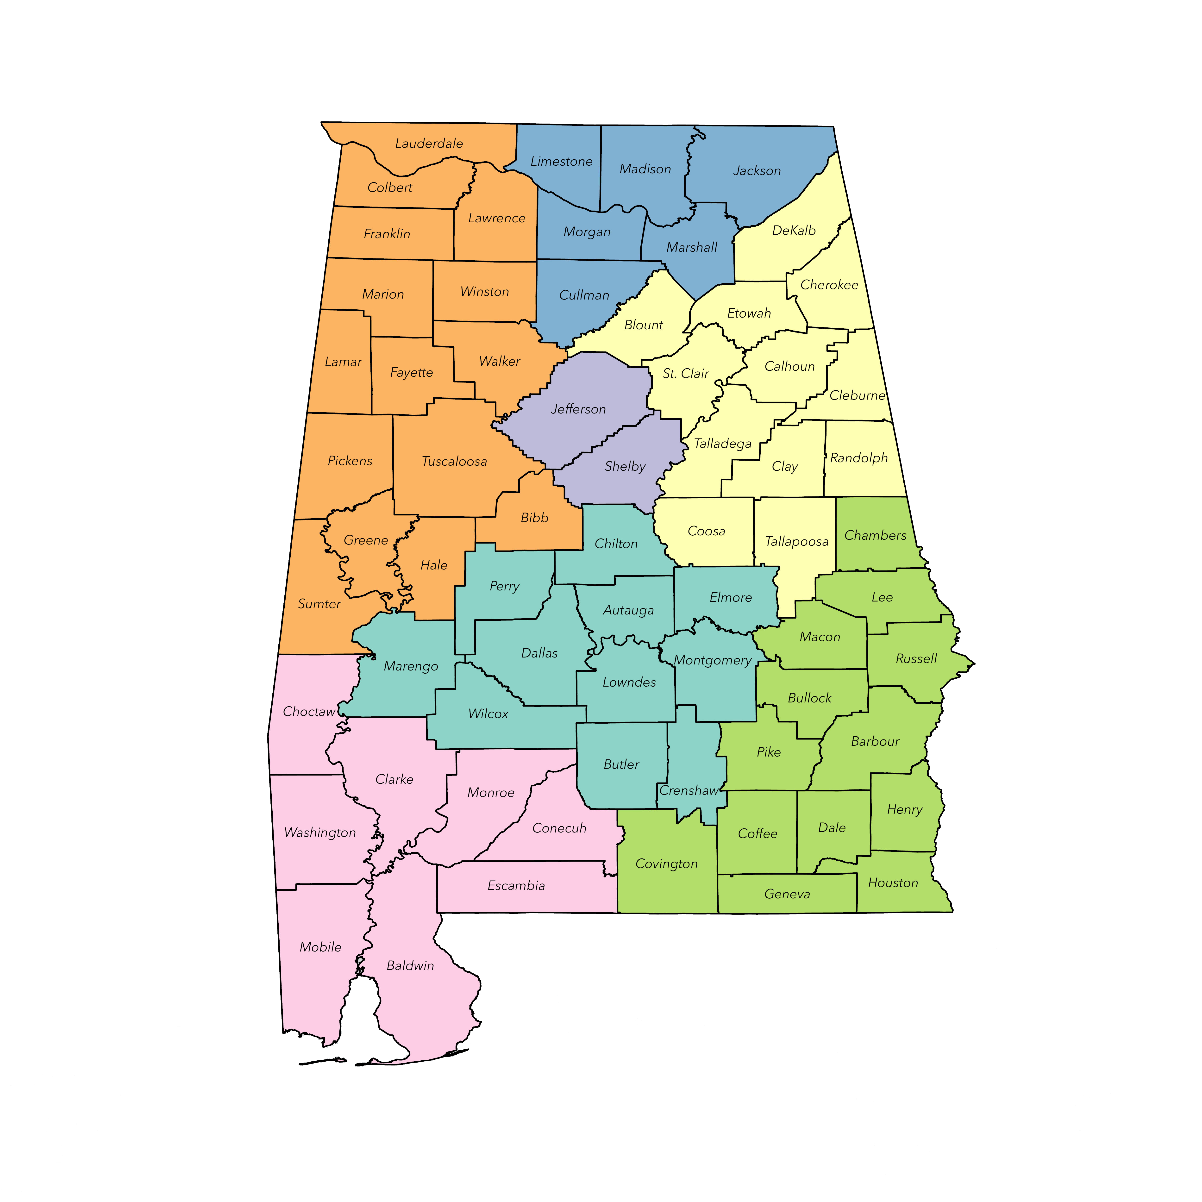
ACHN Regions
  Based on:
  Existing patterns of care
  Access to care
  Ability to ensure financial viability of regional ACHN entities

Slide 15
ACHN Participants
  General Population – Current Patient 1st recipients, plus current/former foster children
  Medicaid-eligible maternity care recipients
  Plan First – Women ages 19-55 and men age 21 and over

Slide 16

Care Coordination Services

Slide 17
Care Coordination Services
  Care Coordination referrals may be requested by providers, recipients or community sources
  Care Coordination services provided in setting of recipient’s choice, to include provider offices, hospitals, ACHN entity office, public location or in the recipient’s home

Slide 18
Care Coordination Services
  Screening and assessment of recipient needs
  Assist recipients in obtaining transportation or applying for Medicaid
  Help recipients with appointments or appointment reminders
  Coordinate and facilitate referrals
  Educate or assist recipients with medication or treatment plans

Slide 19
Care Coordination Services
  Help recipients seek care in the most appropriate setting (e.g. office vs ER)
  Facilitate communication between patient and care providers
  Help recipients locate needed community services

Slide 20

Primary Care Physician (PCP) Referral Process

Slide 21
Referral Process
  PCPs no longer have assigned patient panels
  PCPs / PCP groups will not need a referral to see a recipient
  Nurse practitioners or physician assistants collaborating within a PCP group will not need referrals
  EPSDT referral process will not change; correct coding will continue to be essential to ensure coverage beyond 14-visit limit

Slide 22
Referral Process
  PCP referrals to most specialists will be required for specialists to receive payment
  Referrals to NPs or PAs collaborating with specialty groups will also require a referral
  When a PCP cannot be identified, the ACHN entity may provide a referral

Slide 23

Reimbursement and Payment

Slide 24
Bonus / Incentive Payments
  Goals aligned for physician, ACHN and Medicaid
  Networks incentivized to meet quality goals
  Payments made quarterly
  Structured to keep PCPs whole during transition

Slide 25
PCP Payment Structure
Quality Metric Performance
Cost Effectiveness
Patient-Centered
Medical Home Activities
Regional ACHN Participation Payment
Enhanced FFS rate (Same as “Bump”)
Above payments are achievable if physician participates with regional ACHN entity
Base Fee-For-Service – Current FFS schedule for all physicians

Slide 26
PCP Payment Structure
Base Fee-For-Service – Current FFS schedule for all physicians

Slide 27
PCP Payment Structure
Regional ACHN Participation Payment
Enhanced FFS rate (Same as “Bump”)
Above payments are achievable if physician participates with regional ACHN entity
Base Fee-For-Service – Current FFS schedule for all physicians

Slide 28
ACHN Qualifications for Participation
  Participation rate payments will be made to PCPs who actively participate in an ACHN network
  Qualifications:
    Board-certified MD/DO with a specialty or subspecialty of family medicine, general internal medicine or pediatrics that is recognized by the Board of Medical Specialties, the American Board of Physician Specialties or the American Osteopathic Association and must actually practice in their specialty; OR
    Non board-certified provider who practices in one of the above fields, if he/she can attest that 60 percent of their paid Medicaid procedures billed are for certain specified procedure codes for E&M services and certain VFC vaccine administration codes during the most recently completed CY, or for newly-eligible physicians, the prior month.

Slide 29
Agreements Required
  Alabama Medicaid Provider Agreement
  Alabama Medicaid Primary Care Physician Group Agreement
  Agreement between ACHN entity and the PCP group
  Only necessary to sign the one ACHN agreement; may participate with any region

Slide 30
ACHN Participation Requirements
  Physician groups must also meet the following criteria for participation:
  Actively work with the ACHN entity to review recipient care plans
  Participate as needed in ACHN Multi-Disciplinary Care Team (MCT)
  Participate in ACHN initiatives centered around quality measures

Slide 31
ACHN Participation Requirements
  Participate in at least two quarterly Medical Management Meetings and one webinar/facilitation exercise with the regional ACHN medical director over a
  12-month period
      NPs and PAs may attend for PCP
  Review data provided by the ACHN to help achieve regional and state Medicaid goals

Slide 32
ACHN Participation Requirements
  Alternate payment methodologies are used for these providers:
    FQHCs and Rural Health Clinics
    Physicians who are part of the
    medical faculty as determined by
    a state university

Slide 33
PCP Payment Structure
Patient-Centered
Medical Home Activities
Regional ACHN Participation Payment
Enhanced FFS rate (Same as “Bump”)
Above payments are achievable if physician participates with regional ACHN entity
Base Fee-For-Service – Current FFS schedule for all physicians

Slide 34
Patient-Centered Medical Home
Bonus Payments
  Based on:
  Attainment of PCMH recognition by the appropriate national organization; or
  Documented progress toward PCMH recognition; evaluated annually
  Paid quarterly

Slide 35
Patient Attribution for Quality and Cost Effectiveness
  Recipients will not be assigned to individual PCPs, but will be attributed at PCP group level
  Recipients will be attributed to PCP group based on where they received services
  Score will be calculated for each recipient/provider combination

Slide 36
Patient Attribution for Quality and Cost Effectiveness
  The provider with the highest score for the recipient will be attributed to that recipient
  More recent claims and preventive visits will receive higher values in this calculation
  Recipients will only be attributed to one PCP group per quarter
  Attribution will be updated quarterly

Slide 37
PCP Payment Structure
Cost Effectiveness
Patient-Centered
Medical Home Activities
Regional ACHN Participation Payment
Enhanced FFS rate (Same as “Bump”)
Above payments are achievable if physician participates with regional ACHN entity
Base Fee-For-Service – Current FFS schedule for all physicians

Slide 38
Cost Effectiveness
Bonus Payments
  Risk-adjusted payments
  Cost effectiveness payments based on patient attribution to PCP/PCP group
  Cost effectiveness calculated based on:
      Two year “look back” of medical claims
      One year “look back” of maintenance medication claims history
      Will compare peer-to-peer
  Updated quarterly

Slide 39
Cost Effectiveness
Bonus Payments
Quarter 1 | Quarter 2 | Quarter 3 | Quarter 4 | Quarter 5 | Quarter 6
Full | Full | Full | Full | Calculated | Calculated

Slide 40
PCP Payment Structure
Quality Metric Performance
Cost Effectiveness
Patient-Centered
Medical Home Activities
Regional ACHN Participation Payment
Enhanced FFS rate (Same as “Bump”)
Above payments are achievable if physician participates with regional ACHN entity
Base Fee-For-Service – Current FFS schedule for all physicians

Slide 41
Quality Bonus Payments
  For at least four quarters, all practice groups will automatically receive a full Quality Bonus payment at the first of each quarter
  In the future, Medicaid will calculate a Quality Bonus payment based on performance
  Payments will be based only on measures relevant to a group’s practice

Slide 42
Quality
Bonus Payments
Quarter 1 | Quarter 2 | Quarter 3 | Quarter 4 | Quarter 5 | Quarter 6
Full | Full | Full | Full | Calculated | Calculated

Slide 43
Quality Measures
  Well-child visits for children, ages 3-6
  Adolescent well care visits
  Immunization status – Child/Adolescent
  Antidepressant medication management
  HbA1c test for diabetic patients
  Follow-up after ER visit for alcohol or other drugs

Slide 44
ACHN Payment Summary
Patient 1st (ending September 30, 2019) | ACHN
Panels | -------
Case Management Payments | -------
BUMP | Participation Rate
------- | Bonus Payments

Slide 45
ACHN Summary
Current Program | ACHN
12 Maternity Districts | 7 Networks/Regions
6 Health Homes in 5 Regions | 7 Networks/Regions
ADPH Staff serving 67 Counties | 7 Networks/Regions
Care Coordination programs are in silos | Care Coordination is combined into a single delivery system
Medical Management Meetings require Physician Attendance | Medical Management Meetings will allow a NP or PA to attend for the Physician
PMP to PMP Referral Required | PCP to PCP referral not required
PMP Agreement with Health Home is required for each Health Home the PCP is working with | Only one agreement will be required, but will cover all 7 Networks

Slide 46
Questions
  Website: www.Medicaid.alabama.gov
  Newsroom>Special Initiatives>ACHN
  Direct Link to Frequently Asked Questions
  Submit questions for official response to:
  ACHN@medicaid.alabama.gov

