Slide 1

New Opportunities for
Rural Students
Alabama Rural Health Association
April 25, 2019
David L. Bramm, MD FAAFP
Associate professor UAB SOM
Director, Rural Medicine Program

Slide 2
Need
Programs (Current and Future)
Outcome data.
Recruiting efforts.

Slide 3
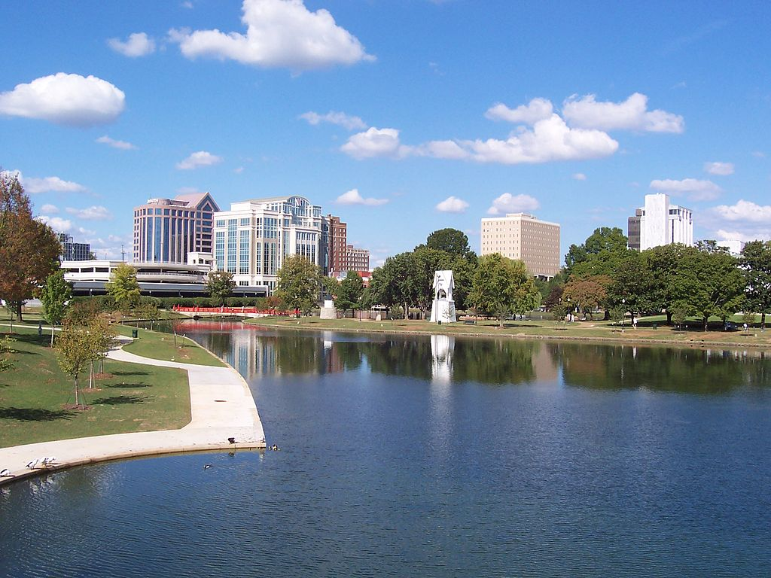

Slide 4
What is the specialist who?
Works as an ER physician?

Slide 5
What is the specialist who?
Works as an ER physician?
Delivers babies and is expert in women’s health?

Slide 6
What is the specialist who?
Works as an ER physician?
Delivers babies and is expert in women’s health?
Performs surgical procedures?

Slide 7
What is the specialist who?
Works as an ER physician?
Delivers babies and is expert in women’s health?
Performs surgical procedures?
Cares for children from birth to young adulthood?

Slide 8
What is the specialist who?
Works as an ER physician?
Delivers babies and is expert in women’s health?
Performs surgical procedures?
Cares for children from birth to young adulthood?
Performs colonoscopies and endoscopies?

Slide 9
What is the specialist who?
Works as an ER physician?
Delivers babies and is expert in women’s health?
Performs surgical procedures?
Cares for children from birth to young adulthood?
Performs colonoscopies and endoscopies?
Does critical care in the ICU?

Slide 10
What is the specialist who?
Works as an ER physician?
Delivers babies and is expert in women’s health?
Performs surgical procedures?
Cares for children from birth to young adulthood?
Performs colonoscopies and endoscopies?
Does critical care in the ICU?
Is the main detective in diagnosing the patient’s disease?

Slide 11
What is the specialist who?
Works as an ER physician?
Delivers babies and is expert in women’s health?
Performs surgical procedures?
Cares for children from birth to young adulthood?
Performs colonoscopies and endoscopies?
Does critical care in the ICU?
Is the main detective in diagnosing the patient’s disease?
Is involved in public, community and population health?

Slide 12
Rural Family Physicians

Slide 13
Rural health disparity is not defined by distance alone.
Access to transportation, food security, sanitation and other things are part of the equation.

Slide 14
The Economic Policy Institute
Estimated that, following the NAFTA
851,700 net jobs had been displaced by the U.S.'s trade deficit with Mexico.
“…especially in industries exposed to the removal of trade barriers: textile, apparel, automotive, and agriculture."

Slide 15
Characteristics of Rural Alabama
Older

Slide 16
Characteristics of Rural Alabama
Older
Less formal education

Slide 17
Characteristics of Rural Alabama
Older
Less formal education
Greater racial / ethnic diversity

Slide 18
Characteristics of Rural Alabama
Older
Less formal education
Greater racial / ethnic diversity
Less wealthy

Slide 19
Characteristics of Rural Alabama
Older
Less formal education
Greater racial / ethnic diversity
Less wealthy
Poorer health status

Slide 20
United Nations Rapporteur, Philip Alston
Toured rural Alabama communities and said of the shocking poverty:
“I had never before seen conditions like that in the developed world”.
December 15, 2017

Slide 21
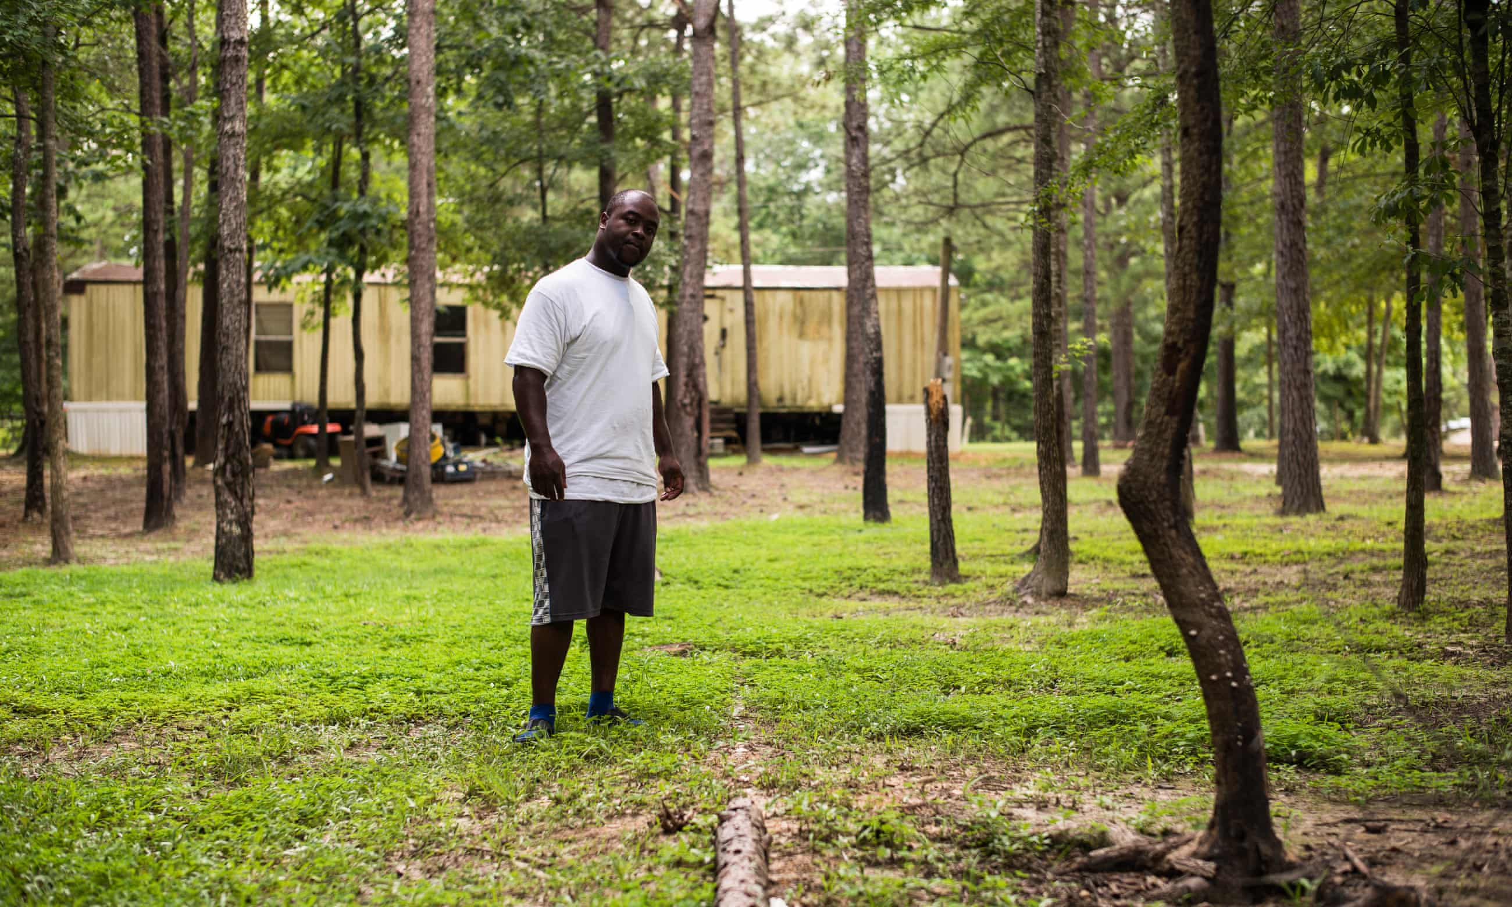

Slide 22


Slide 23
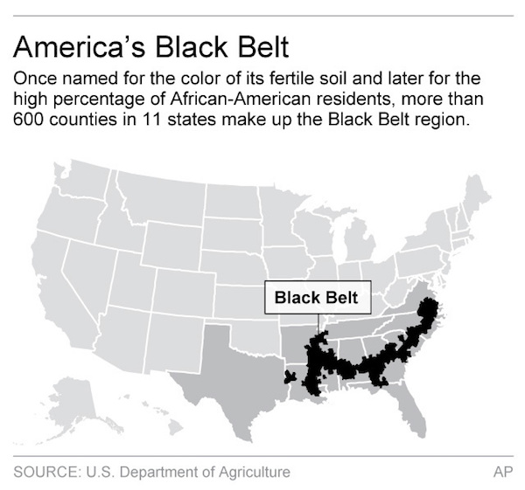

Slide 24
CENTREVILLE DEMOGRAPHICS
    POPULATION 1,671
67.44% African American citizens
Median income for a family: $18,077
40.1% of the population is below the poverty line

Slide 25
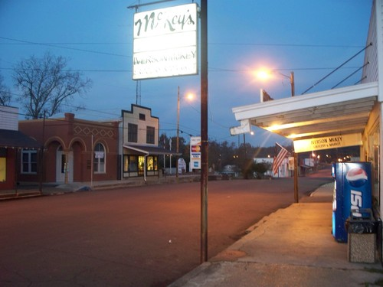

Slide 26
Challenges to Rural MD Recruitment:
Substantial school debt

Slide 27
Challenges to Rural MD Recruitment:
Substantial school debt
Opportunities for spousal employment

Slide 28
Challenges to Rural MD Recruitment:
Substantial school debt
Opportunities for spousal employment
Opportunities for professional associations

Slide 29
Challenges to Rural MD Recruitment:
Substantial school debt
Opportunities for spousal employment
Opportunities for professional associations
Lack of urban amenities

Slide 30
Challenges to Rural MD Recruitment:
Substantial school debt
Opportunities for spousal employment
Opportunities for professional associations
Lack of urban amenities
Competition from urban recruiters

Slide 31
Overcoming Challenges
It is axiomatic that the doctor most likely to return to rural Alabama is one who is from rural Alabama.

Slide 32
This phenomenon has been reaffirmed in Washington, Idaho, Alaska, Montana,
Wisconsin, New Mexico, Arizona, Texas, Mississippi, Kentucky, Tennessee, Georgia, Minnesota, Pennsylvania, Scotland, Australia, Northern Ontario, and Japan.

Slide 33
UAB SOM Rural Pipeline
Targets only Alabama Students
1. Huntsville Rural Premedical Internship
2. UAB SOM Rural Programs (Med students)
3. Integrated Residency in Family Medicine

Slide 34
UAB SOM Rural Pipeline
Targets only Alabama Students
1. Huntsville Rural Premedical Internship

Slide 35
Began in 1992
Stipend is $3,000
Curriculum
Clinical training
Medical Education
Shadowing
Research

Slide 36
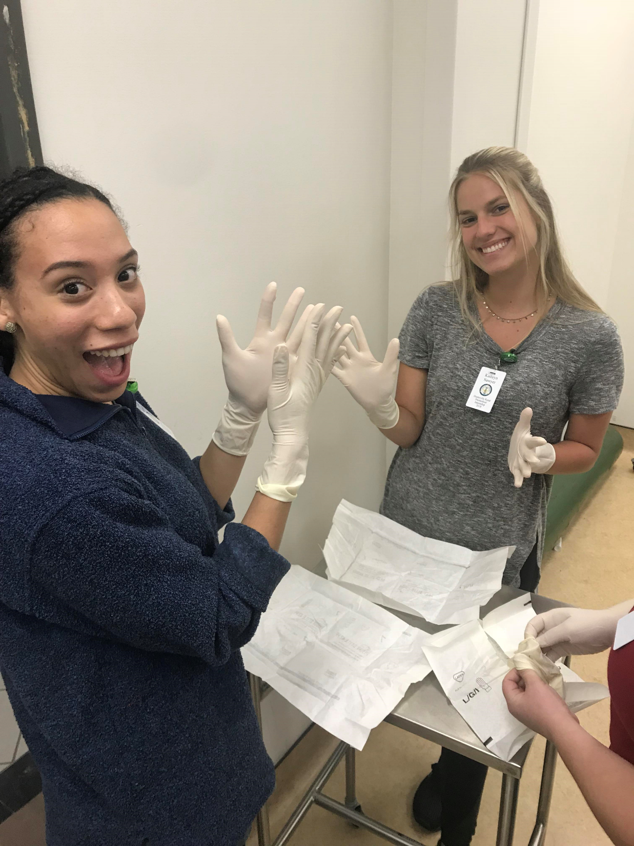

Slide 37
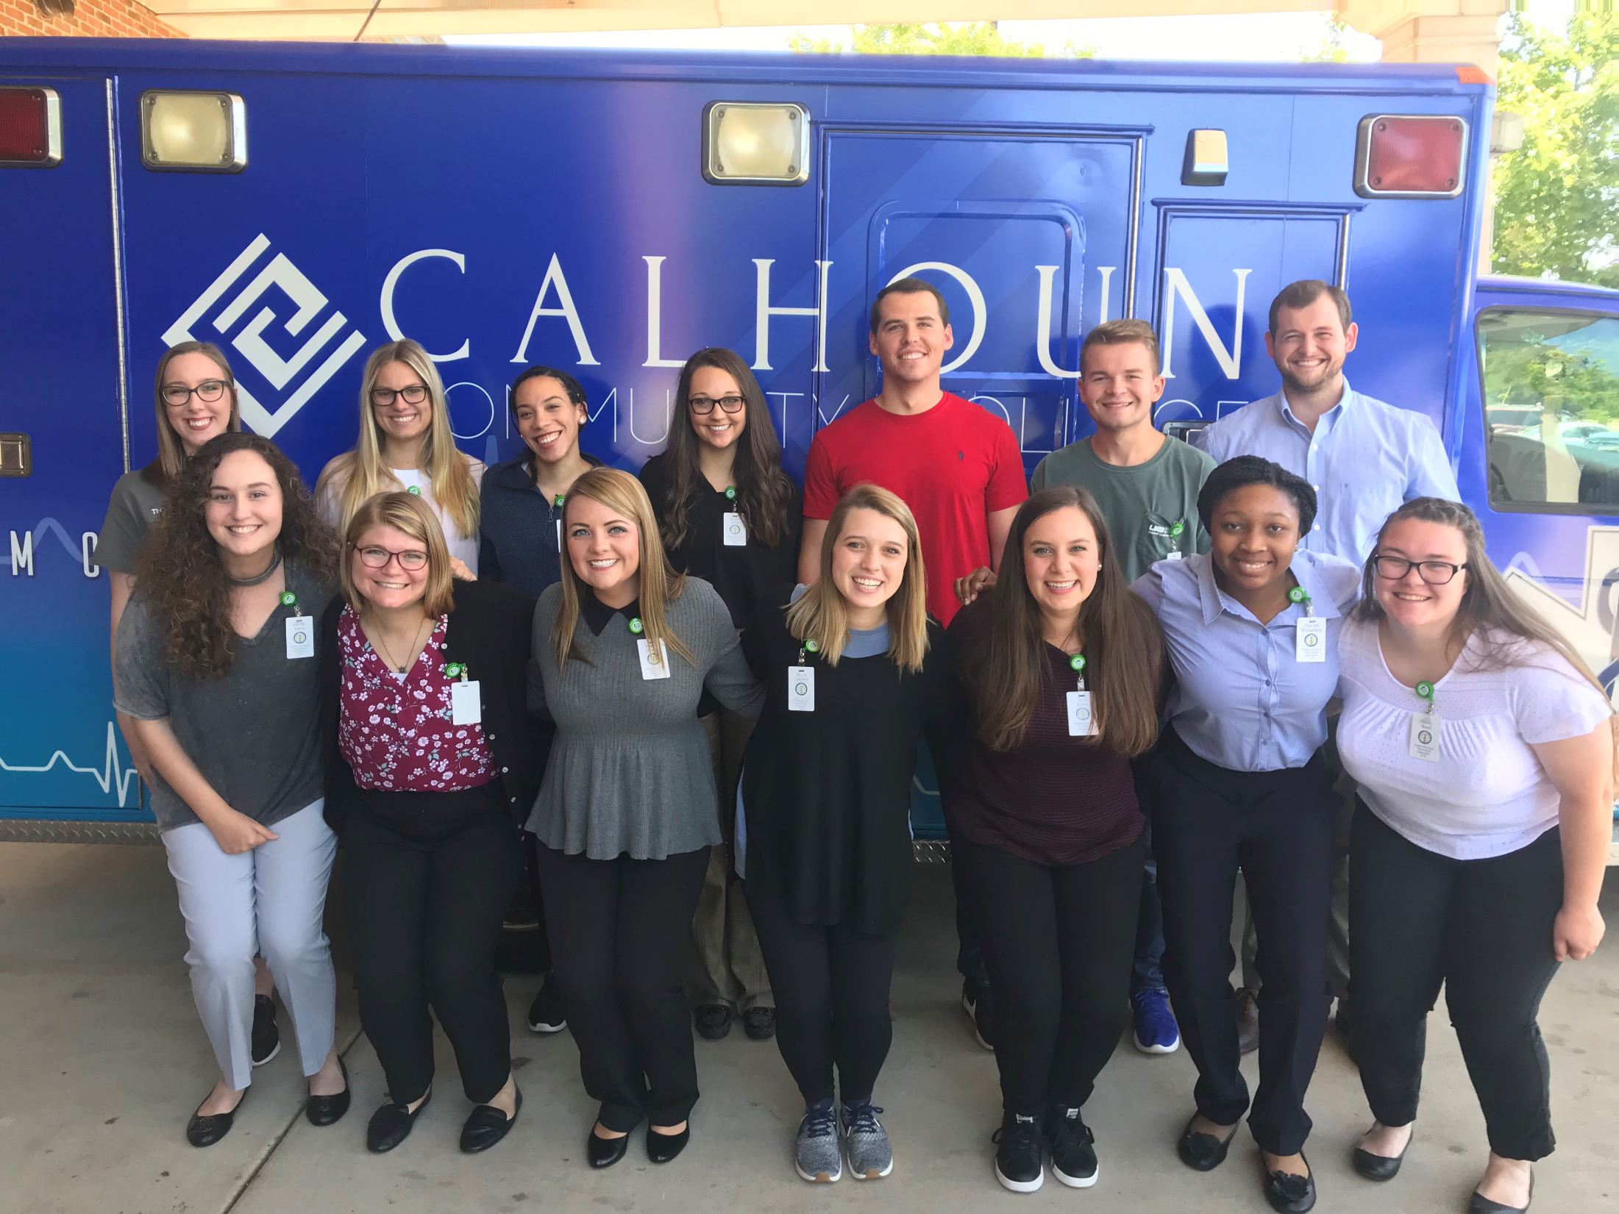

Slide 38
Tuscaloosa Campus pre-college programs
Rural Minority Health Scholars
Rural Health Scholars

Slide 39
UAB SOM Rural Pipeline
Targets only Alabama Students
1. Huntsville Rural Premedical Internship
2. UAB SOM Rural Programs (Med students)

Slide 40
Rural Medical Scholars Program Tuscaloosa
Rural Medicine Program Huntsville

Slide 41
UAB SOM Rural Programs (Medical School)
Assured Admission to UAB SOM
May require a post graduate year
Students are exclusively from rural Alabama

Slide 42
For Whom are we Looking?
First in the family to go to college

Slide 43
For Whom are we Looking?
First in the family to go to college
Was cared for by a rural Family Physician

Slide 44
For Whom are we Looking?
First in the family to go to college
Was cared for by a rural Family Physician
Lower GPA and ACT/MCAT scores

Slide 45
For Whom are we Looking?
First in the family to go to college
Was cared for by a rural Family Physician
Lower GPA and ACT scores
Lack of internet in the home

Slide 46
For Whom are we Looking?
First in the family to go to college
Was cared for by a rural Family Physician
Lower GPA and ACT scores
Lack of internet in the home
Lower income expectations

Slide 47
For Whom are we Looking?
First in the family to go to college
Was cared for by a rural Family Physician
Lower GPA and ACT scores
Lack of internet in the home
Lower income expectations
Experiences demonstrating a rural sense of place

Slide 48
Rural Identity
When asked, “What elements of your background suggest to the committee that you are rural?”

Slide 49
“ I won the National Delo antique tractor restoration competition”.

Slide 50
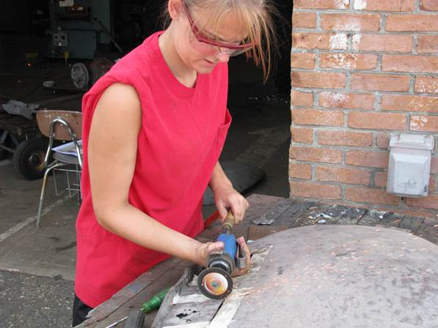

Slide 51
Why do you consider yourself rural?
“I was bitten by a water moccasin at my community pool and momma had to drive me 35 miles to the doctor”

Slide 52
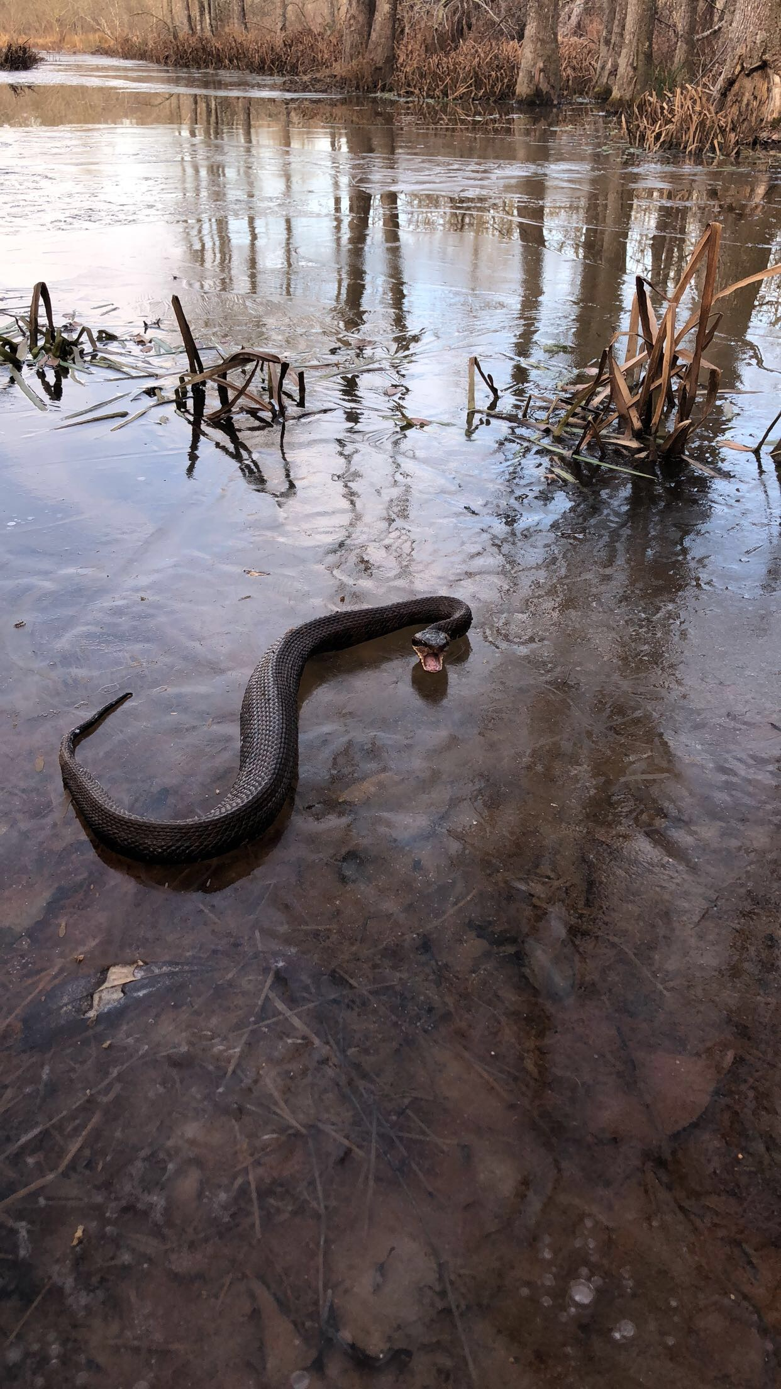

Slide 53
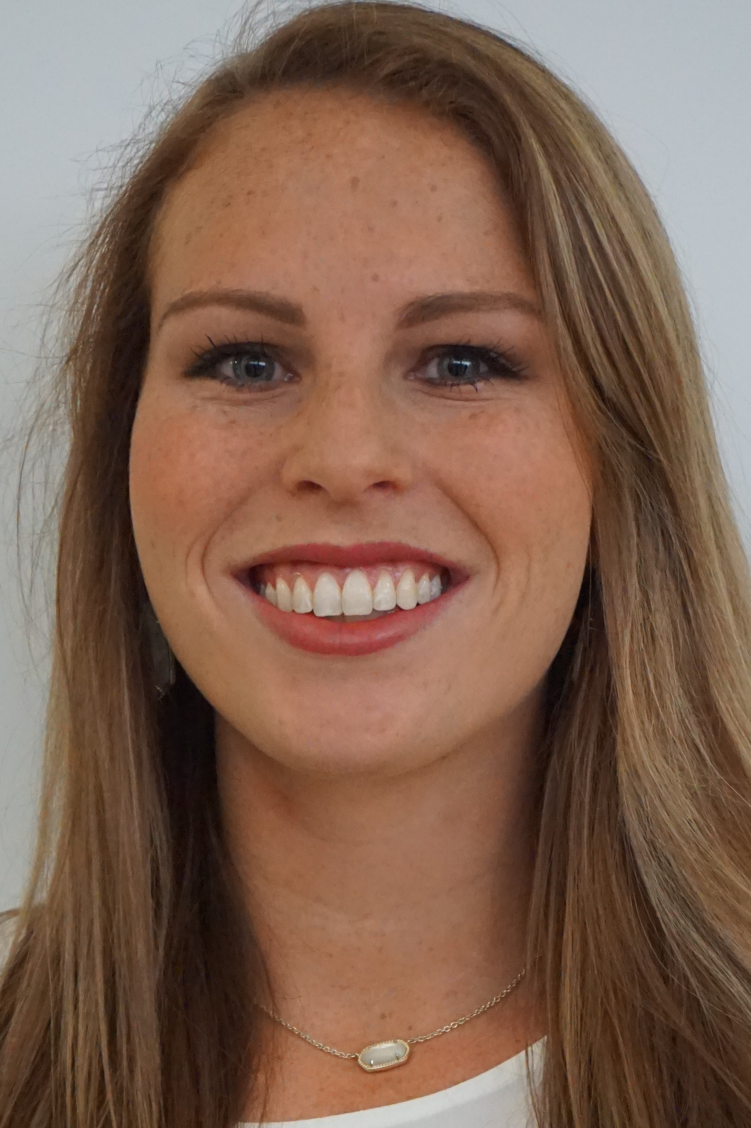

Slide 54
Why do you consider yourself rural?
I Was Ranked by the NBHA

Slide 55
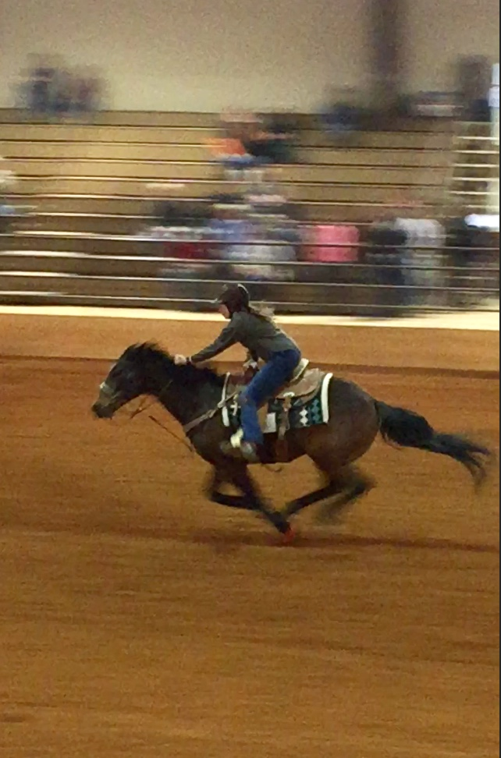
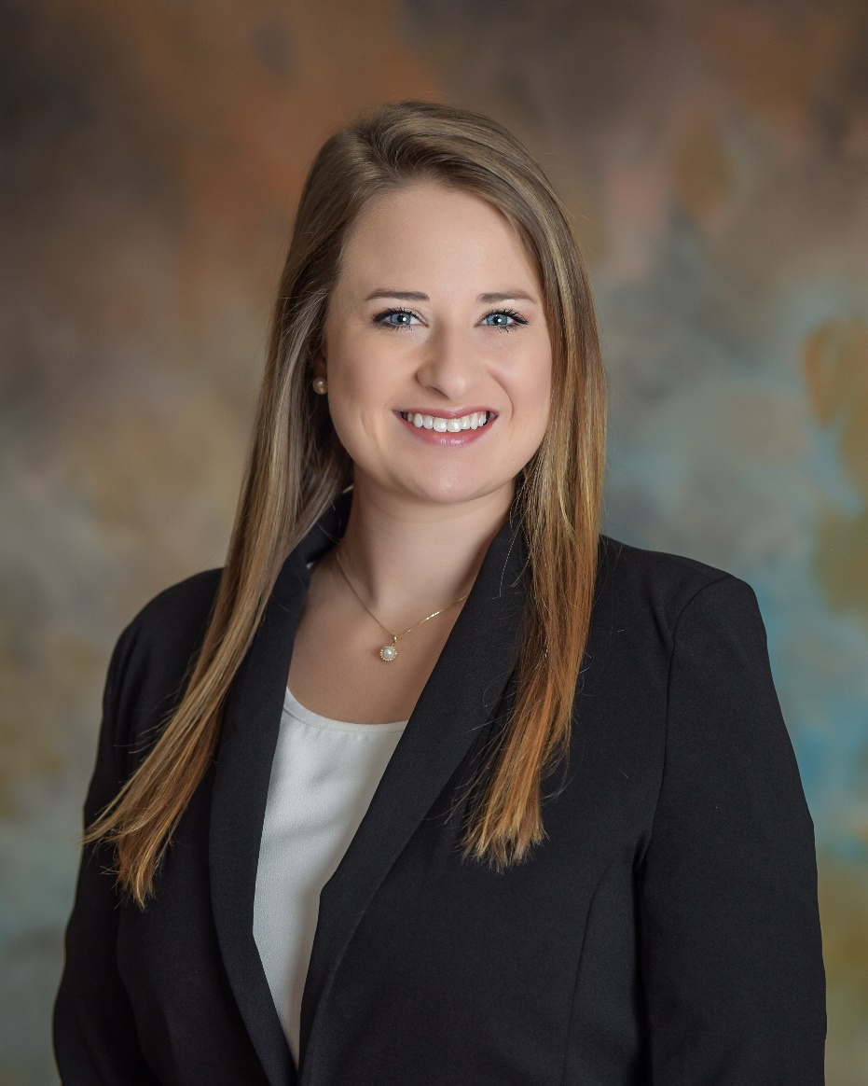
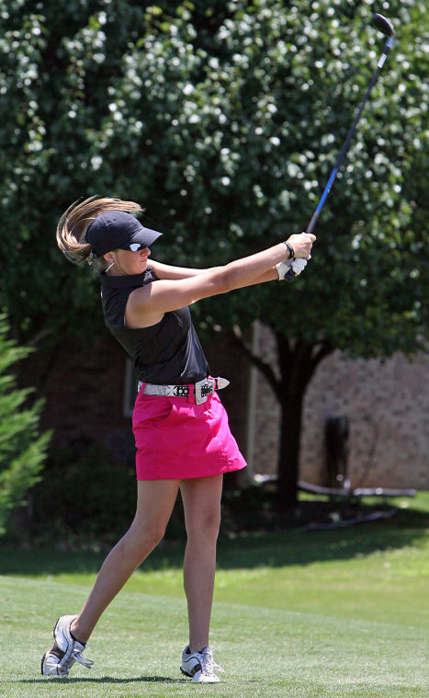

Slide 56
Why do you consider yourself rural?
I was selected to be the judge at the
Clio, Alabama Chitlin’ Cook-off.

Slide 57
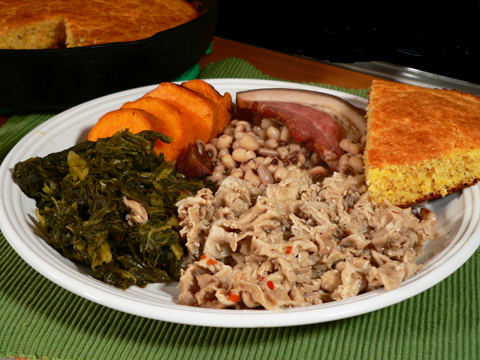

Slide 58
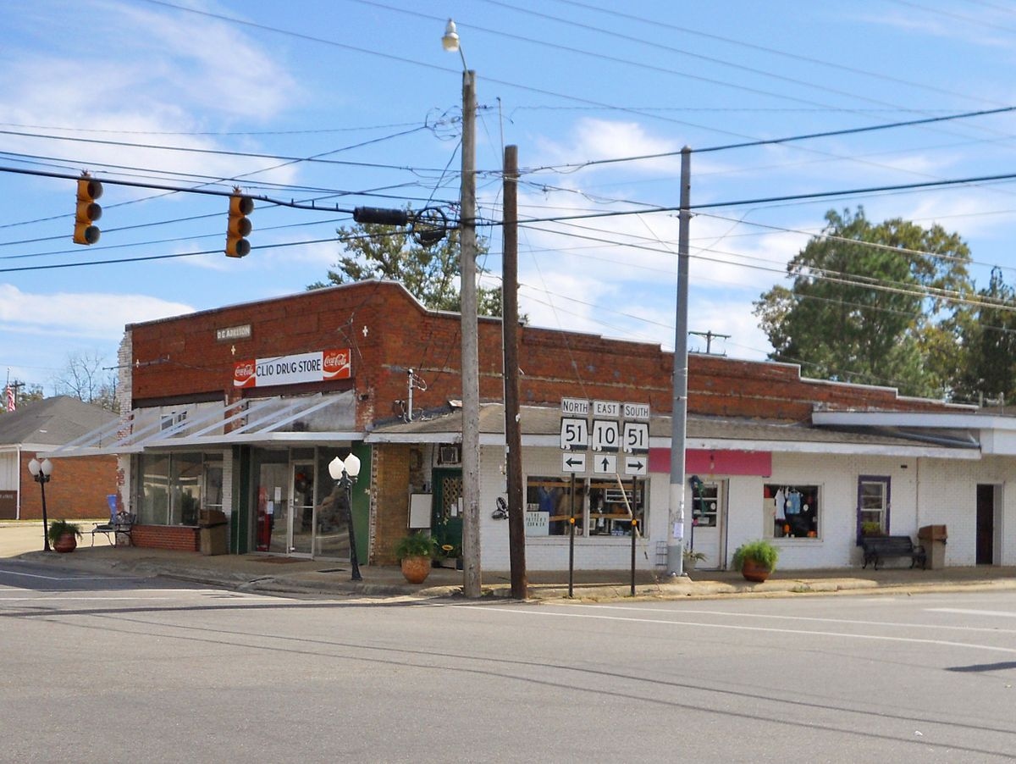

Slide 59
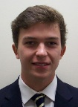
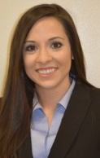
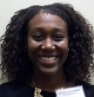
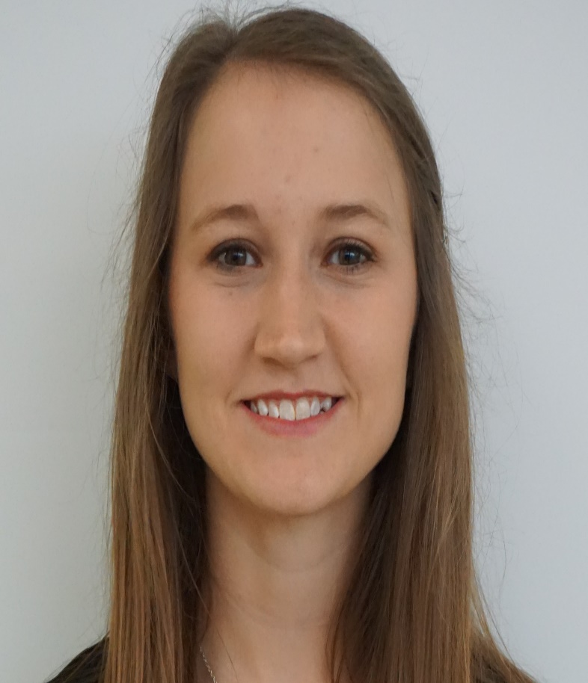
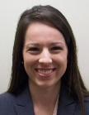
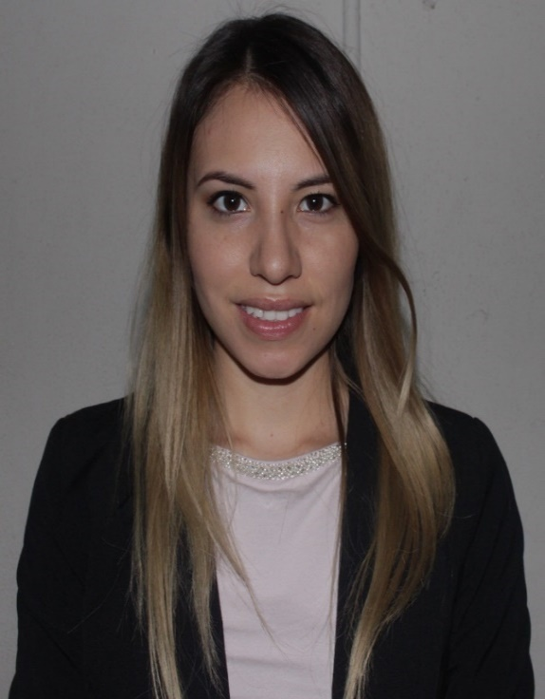

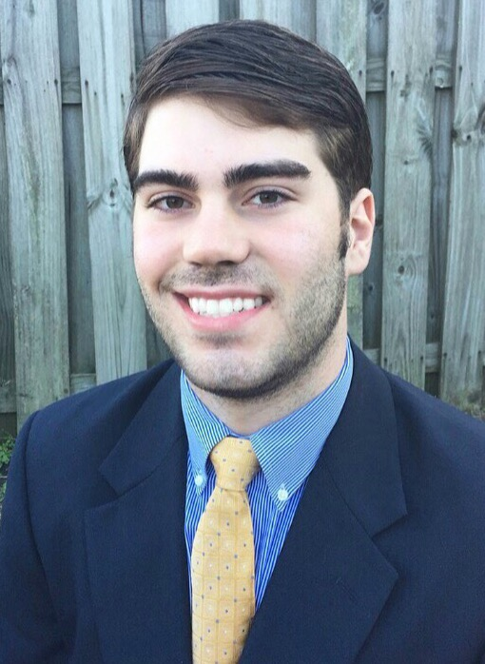

Slide 60
HRPI & Rural Track Program
Currently in practice
FM 80%
FM Rural 67%

Slide 61
AL College of Osteopathic Medicine, Dothan
Part of the ACOM mission places “emphasis on patient-centered primary care to serve the underserved areas of Alabama and the nation”.

Slide 62
Edward Via College of Osteopathic Medicine
Auburn, Alabama (established 2015)
The focus is to “train primary care physicians to serve a rural population (Appalachia)”.

Slide 63
Tuscaloosa Based Primary Care Track
Community Based Education
Leverages quality primary care role models

Slide 64
UAB SOM Rural Pipeline
Targets only Alabama Students
1. Huntsville Rural Premedical Internship
2. UAB SOM Rural Programs (Med students)
3. Integrated Residency in Family Medicine

Slide 65
There are 73 first year FM residents in Alabama
Only 32 are FROM Alabama.
There are 73 second year FM residents in Alabama and only 27 are FROM Alabama.

Slide 66
UAB SOM INTEGRATED RESIDENCY IN
FAMILY MEDICINE FOR
FOURTH YEAR MEDICAL STUDENTS

Slide 67
Program Goals
Increase the number of Family Physicians in Rural Alabama
Enable the student to more effectively utilize the 4th year.
Provide residency classes a cadre of specially enabled interns.
Avoid losing quality students to other programs &/or states.

Slide 68
Number of Alabama State Residents Matching Alabama’s Family Medicine Programs
Location # of slots (2018) (2019) %
Huntsville 12 9 (7 rural) 8 (6 rural) 71
Tuscaloosa 16 0 5 16
St. Vincent’s 5 4 5 90
Montgomery 8 6 5 69
Selma 6 0 0 0
Cahaba 12 5 (4 rural) 4 38
Univ. S. Alabama 6 1 1 17
S. Baldwin (Foley) 8 2 4 38

Slide 69
The Board of Medical Scholarship Awards (BMSA)
Unaffiliated with any school
Open to all DO and MD students from Alabama
$160,000 typically awarded in FM residency
The BMSA has representation from each school.

Slide 70
BMSA Results The Data Speaks for Itself :
109 have completed service 96.3% remain in AL

Slide 71
BMSA Results The Data Speaks for Itself :
109 have completed service 96.3% remain in AL
97.9% remain in primary care

Slide 72
BMSA Results The Data Speaks for Itself :
109 have completed service 96.3% remain in AL
97.9% remain in primary care
90% (129/143) are in rural practice

Slide 73
BMSA Results The Data Speaks for Itself :
109 have completed service 96.3% remain in AL
97.9% remain in primary care
90% (129/143) are in rural practice
BMSA doctors practice in 76 towns in 49 counties

Slide 74
BMSA Results The Data Speaks for Itself :
109 have completed service 96.3% remain in AL
97.9% remain in primary care
90% (129/143) are in rural practice
BMSA doctors practice in 76 towns in 49 counties
79% are under age 50, 41% under age 40

Slide 75
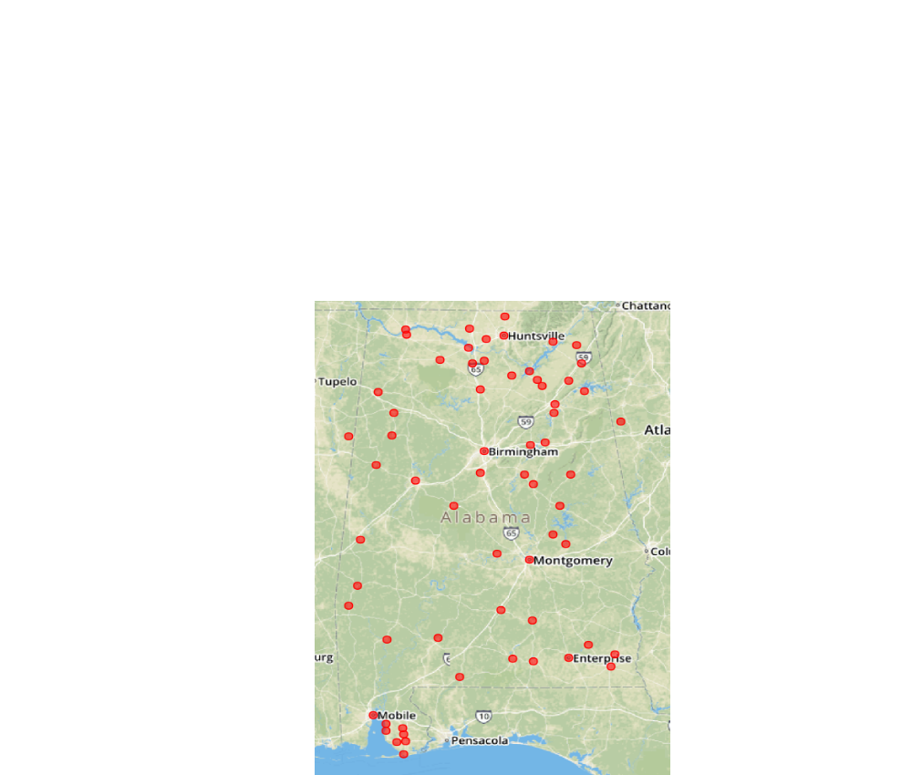

Slide 76
As one state senator said of the BMSA,
“They have given us as many rural physicians as we have given them money for”.

Slide 77
New Training Programs are Coming:
North Alabama Medical Center IM 12 Residents

Slide 78
New Training Programs are Coming:
North Alabama Medical Center IM 12 Residents
Marshall Medical Center North FM 6 Residents

Slide 79
New Training Programs are Coming:
North Alabama Medical Center IM 12 Residents
Marshall Medical North FM 6 Residents
Thomas Hospital Fairhope IM 9 Residents

Slide 80
New Training Programs are Coming:
North Alabama Medical Center IM 12 Residents
Marshall Medical North FM 6 Residents
Thomas Hospital Fairhope IM 9 Residents
Crestwood Hospital Huntsville FM 6 Residents

Slide 81
New Training Programs are Coming:
North Alabama Medical Center IM 12 Residents
Marshall Medical North FM 6 Residents
Thomas Hospital Fairhope IM 9 Residents
Crestwood Hospital Huntsville FM 6 Residents
SE AL Med Center Dothan IM 13 Residents

Slide 82
New Training Programs are Coming:
North Alabama Medical Center IM 12 Residents
Marshall Medical North FM 6 Residents
Thomas Hospital Fairhope IM 9 Residents
Crestwood Hospital Huntsville FM 6 Residents
SE AL Med Center Dothan IM 13 Residents
E AL Med Center & Gadsden 70 total positions in
FM, IM and Psychiatry

Slide 83
Best and Worst Practice Locations in the US Based Upon the Following:
Malpractice
Quality of Life
Physician density
Economic factors useful to millennials
Assessment of dual-income households.
Economic opportunities
Lifestyle amenities.

Slide 84
Best and Worst
States in Which to Practice Medscape 2016
1. North Carolina 1. New Mexico
2. Texas 2. W. Virginia
3. Alabama 3. Washington DC
4. Idaho 4. Mississippi
5. Ohio 5. Rhode Island

Slide 85
Best and Worst Places to Practice Medicine (March 2018) Based Upon:
Professional Opportunity
Medical Environment
Average Wages Adjusted for Cost of Living
Number of hospital beds per capita
Quality of public hospitals
Percent of Insured Population

Slide 86
BEST WORST
Nebraska Illinois
Idaho California
Iowa Maryland
Minnesota Oregon
Wisconsin Massachusetts
Kansas Washington DC
Montana Hawaii
N Dakota New York
Wyoming Rhode Island
Alabama New Jersey

Slide 87
TO REDUCE THE RISK OF BURNOUT:
“Physicians who, early in their career opt for a more varied practice, e.g. obstetrics and hospital work are significantly less likely to report burnout. There was no association noted with amount of night call, weekend work, income or number of patients seen”.
Annals of Family Medicine, May/June, 2018

Slide 88
Lowest Burnout Rate Highest
Montana Idaho
Nebraska Delaware
Alaska Kentucky
Utah New Hampshire
North Dakota Rhode Island
Maine Oregon
Alabama Arizona
Oklahoma Minnesota
Hawaii Colorado

Slide 89
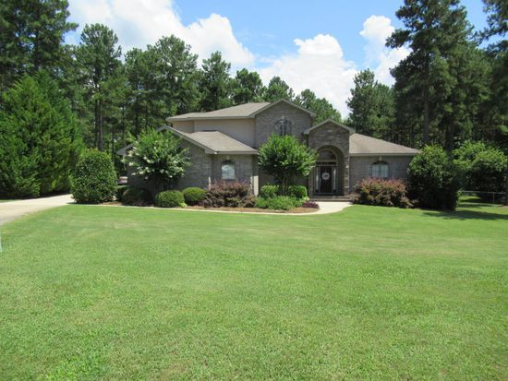
Tallassee, Alabama
4 BR, 3 1/2 Baths, 1.6 Acres, $279,000

Slide 90
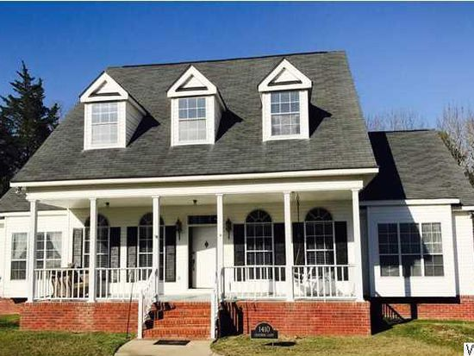
4 BR, 3 BA, 3,890 sq ft, $299,999
Demopolis, Alabama

Slide 91
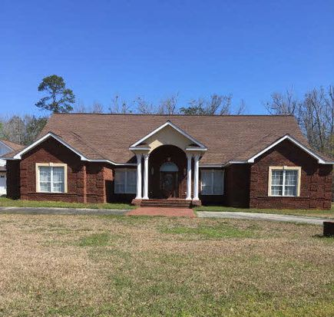
3 BR, 3 BA, 3900 sq ft, $270,000
Brewton, Alabama

Slide 92
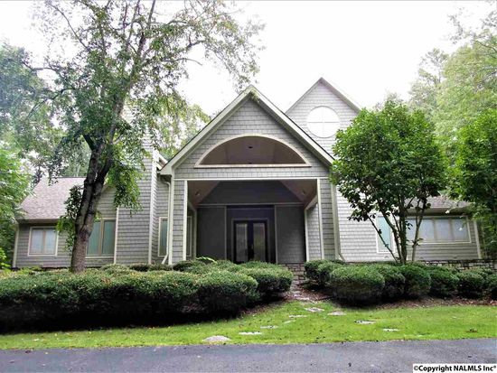
4 BR, 4 BA, 6,663 sq ft 2.3 acres $199,900
Moulton, Alabama

Slide 93
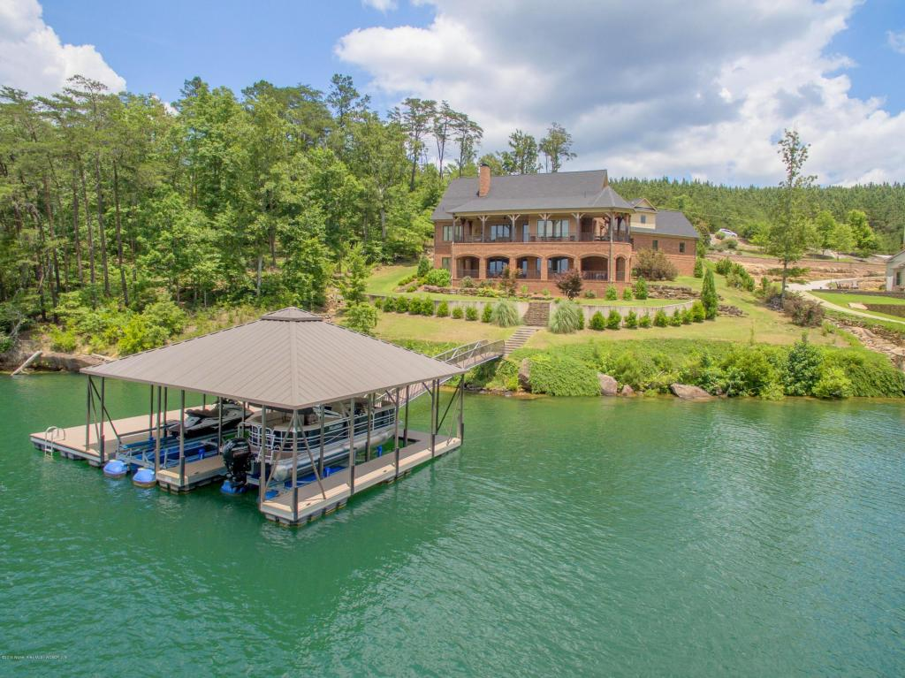

Slide 94
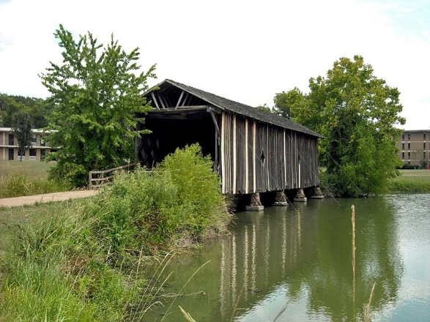
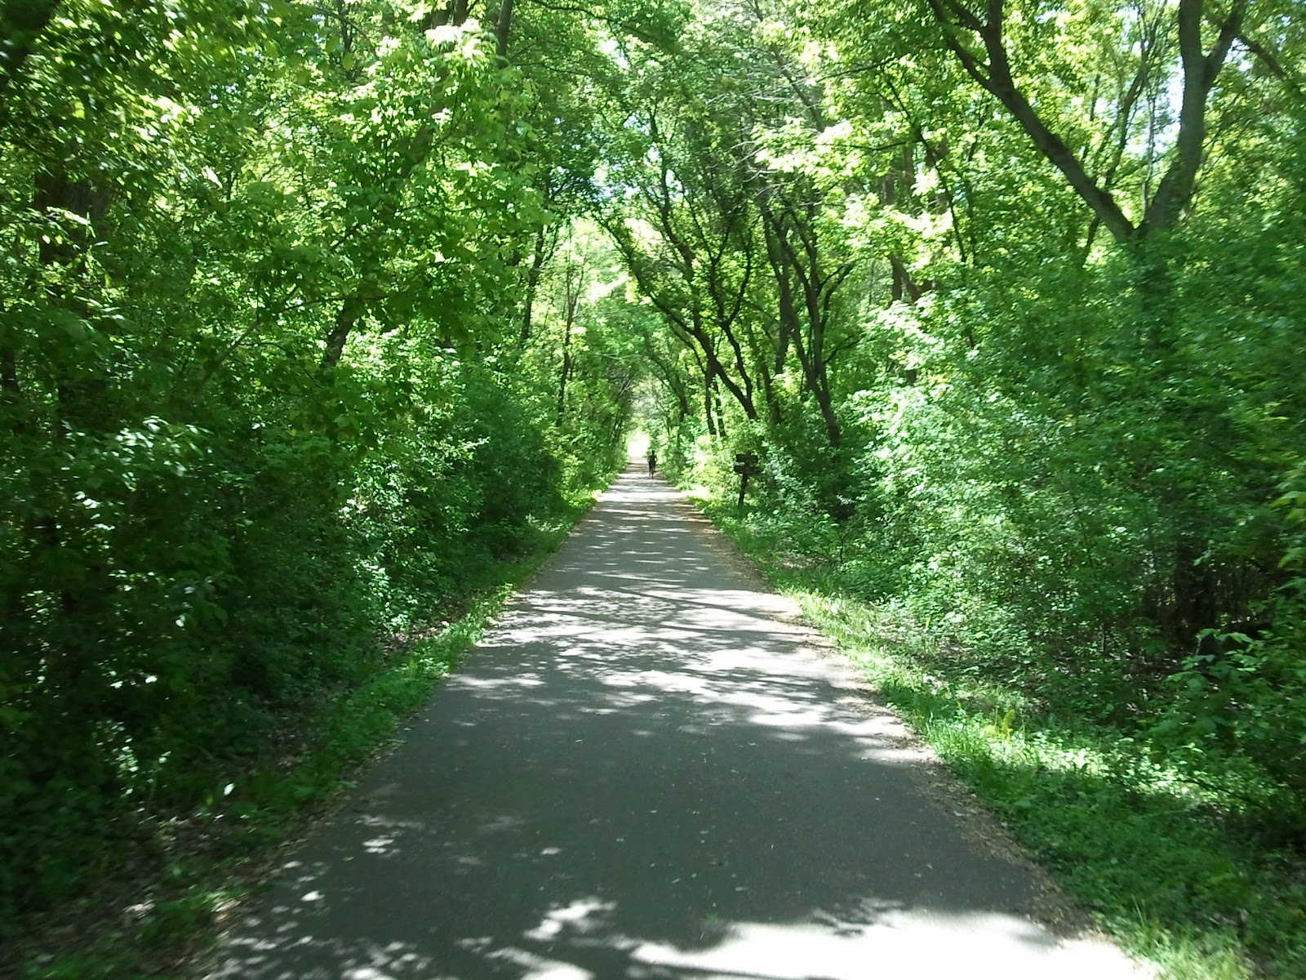

Slide 95
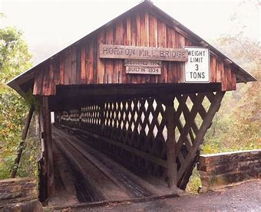
Cycling through Alabama’s Covered Bridges

Slide 96
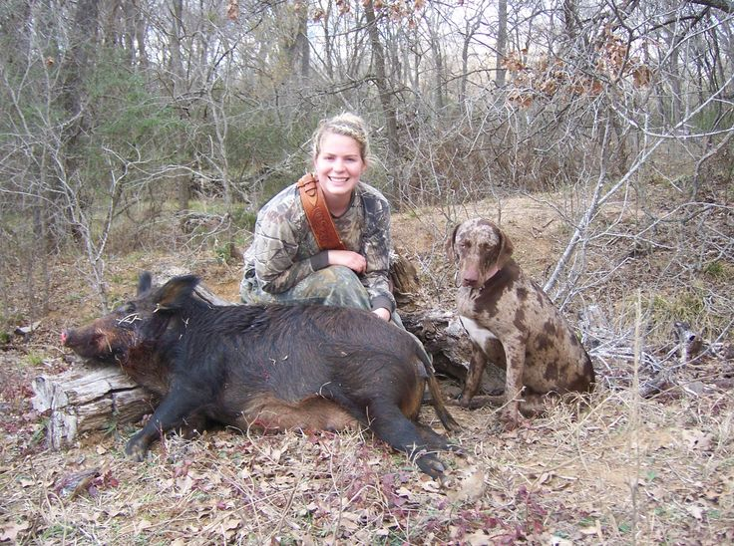

Slide 97
Need
Programs
Outcome data.
Recruiting efforts.

Slide 98
QUESTIONS?

