Slide 1

RURAL TELEHEALTH
Chuck Lail

Slide 2
OVERVIEW
Why Is Telehealth Needed
Telehealth Opportunities
Potential Benefits of Telehealth

Slide 3
Rural Health Landscape
46 of 67 Alabama Counties Are Rural
  As Defined By Federal Office of Rural Health Policy

Slide 4
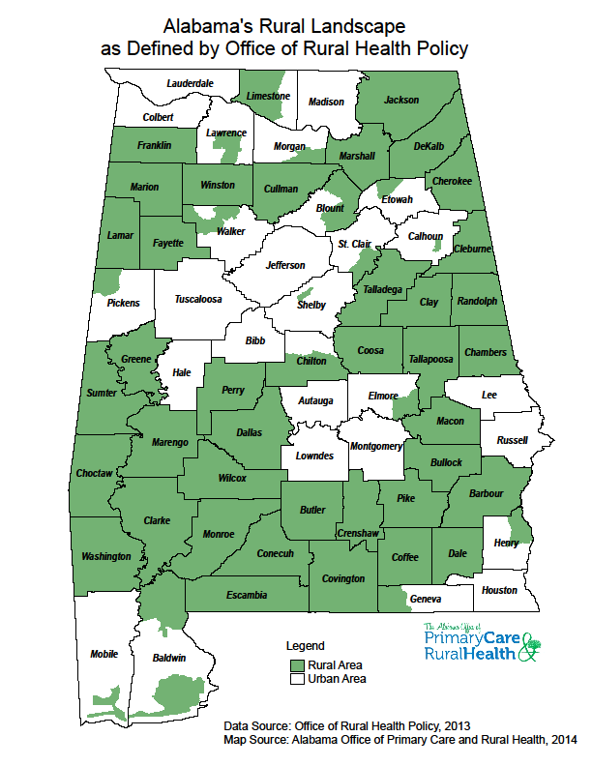

Slide 5
Rural Health Landscape
Rural Demographics
  An Older Population
  Need More Medical Care
  Have Lower Median Incomes
  Limited Access to Health Care

Slide 6
Rural Health Landscape (cont’d)
Shortage of Health Professionals
  Primary Care
  Mental Health
  Dental

Slide 7
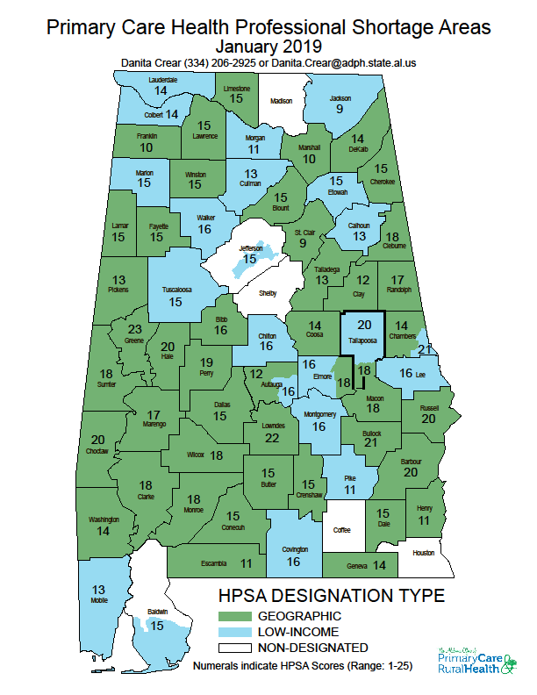

Slide 8
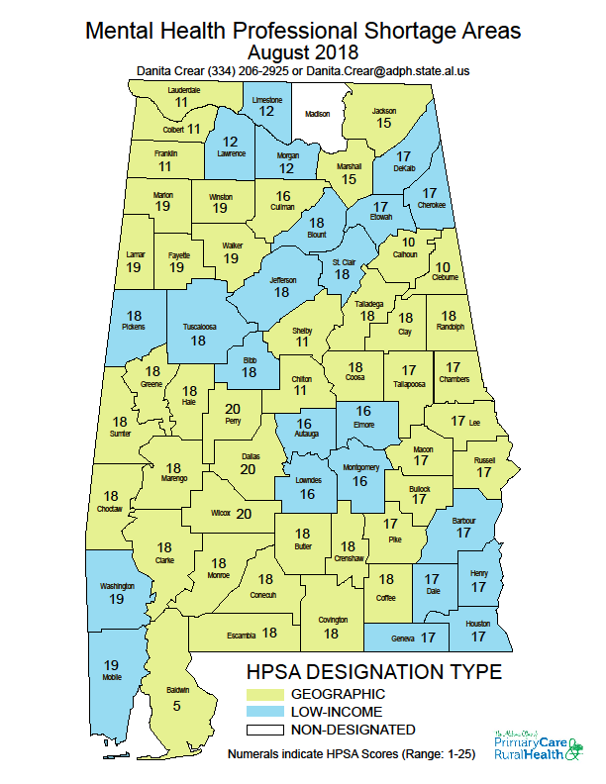

Slide 9
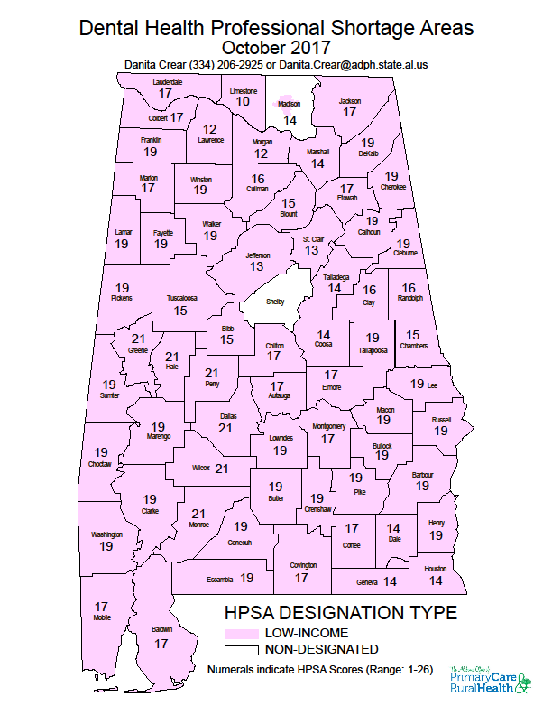

Slide 10
Rural Health Landscape (cont’d)
Rural Hospital Closures
  Seven in last 10 years
Aging Provider Workforce
  Increasing Retirements
Shrinking Services

Slide 11
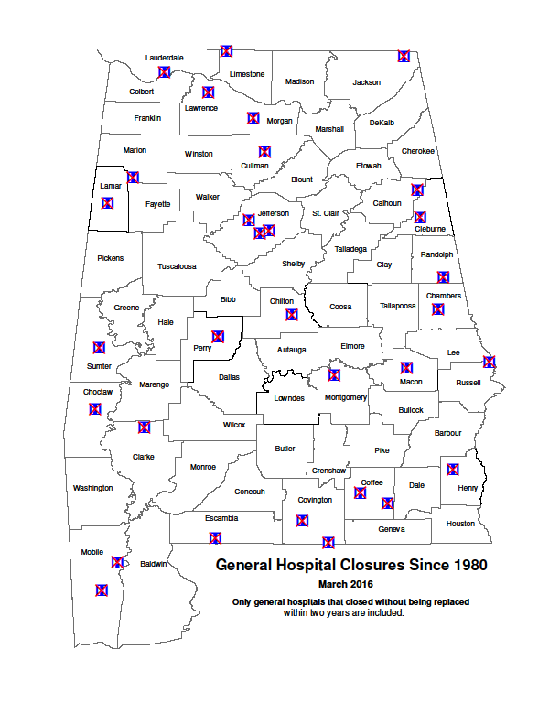

Slide 12
Rural Health Landscape (cont’d)
Rural Hospital Closures
  Seven in last 10 years
Aging Provider Workforce
  Increasing Retirements
Shrinking Services

Slide 13
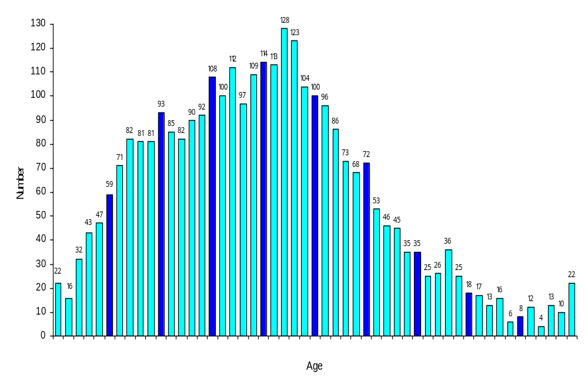
Primary Care Physicians Actively Practicing
In Alabama By Age, 2006
Total = 3,048
Age Not Given = 4
Average Age = 50.1 years
<31
35
40
45
50
55
60
65
70
75
80+
Source: Alabama Medical Licensure Commission Licensed Physician Data Base.

Slide 14
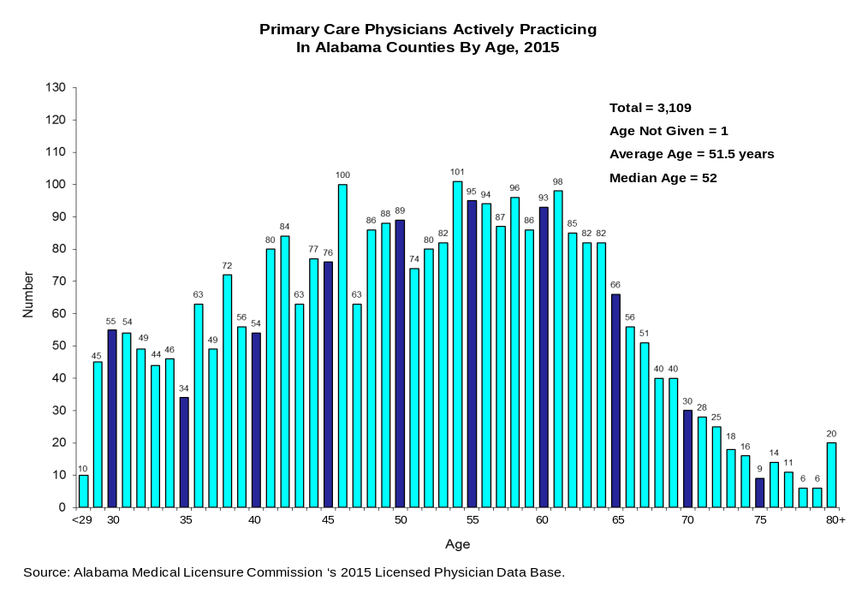

Slide 15
Rural Health Landscape (cont’d)
Rural Hospital Closures
  Seven in last 10 years
Aging Provider Workforce
  Increasing Retirements
Shrinking Services

Slide 16
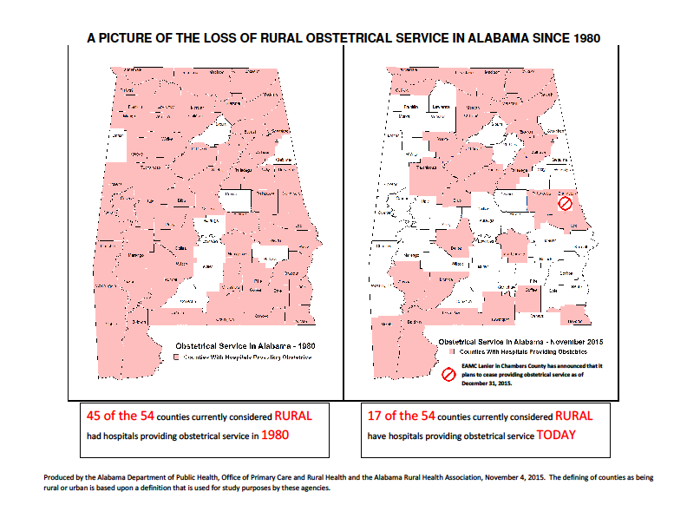

Slide 17
Rural Health Landscape (cont’d)
Rural Transportation Barriers
  Specialty Care in Urban Areas
  Limited Public Transportation
  Cost of Travel
    Lost Health Treatment Time
    Lost Work Time and Wages

Slide 18
Telehealth Opportunities
The Reimbursement Paradigm Has Shifted
  CMS Bringing Telehealth to Medicare Advantage
    Starting in 2020, Patients Can Get Care By Phone or Video (CMS Fact Sheet)
  CMS Expanding Medicare Physician Fee Schedule
  BC/BS Has Begun Paying For Many T/H Services
VA Exceeds One Million Telehealth Visits
VA and Walmart: Transforming Telehealth
    The Rural Connection • Spring 2019

Slide 19
Benefits of Telehealth
Care Closer to Home and Family
Optimizes Health Professionals
Expanded Opportunity For Midlevel Care
Retention of Patients
Recruitment and Retention of Providers
Savings In:
  Golden Minutes
  Travel Time & $$$$$
  Lives
Improved Hospital Sustainability

Slide 20
Summary
Great Need
Potential Benefits
Its Time Has Come

Slide 21
CHARLES (CHUCK) LAIL
Phone: 334-206-5438
Email: Chuck.Lail@adph.state.al.us
Web: www.alabamapublichealth.gov/ruralhealth

Slide 22


Leveraging Telehealth to Solve Alabama’s Rural Health Plight
ADPH Office of Telehealth
Establish Telehealth Clinics at All County Health Departments
Collaborate with Healthcare Providers
Facilitate All Telehealth Services
April 25, 2019

Slide 23
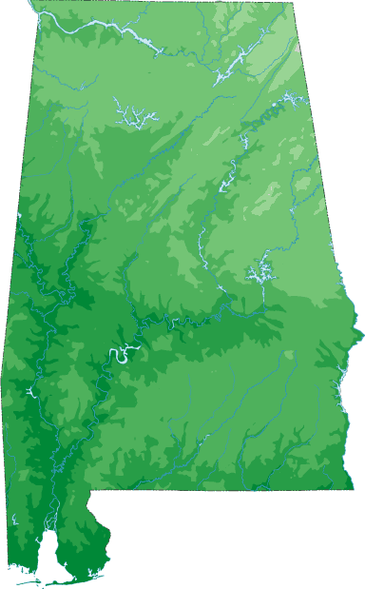
Individual
Telehealth
Networks
Providing
Single Health Care
Service

Slide 24
Components Required to Build 1 Cart
Ergotron SV43-53EO-1 Telepresence Cart 1
JedMed 39-7420 Series 1 Horus Handheld Camera w/3 Lenses 1
Cisco SX-10 Video Conference Cam/Encoder 1
Cisco SX-10 License 1
HP P4K05UT Desk Top Mini Elite PC 1
HP K7X31-6001 P232 Pro Display 23” Monitor 1
LG 24LF4520 24” LCD TV 1
Littman 3200BK27 Electronic Bluetooth Stethoscope 1
Ergotron 97-780-194 Scanner Shelf 1
Startech C6PATCH1BK 1’ Black Cat6 UTP Patch Cable 1
Belkin A3L980-04-BLK-S 4’ Black Cat6 Patch Cable RJ45/RJ45 1
Tripp-Lite P569-003 3’ High Speed HDMI Cable 1
Tripp-Lite P006-003 3’ Power Cord 125V, 10A 1
Tripp-Lite P582-006 6’ Display Port to HDMI 1
Tripp-Lite UL17CB-15 Waber Power Strip, 9 Outlet 1
ADesso AKB-510HB SlimTouch mini keyboard w/USB 1
Cyberdata PMP7793 3 Port Gigabit Ethernet Switch 1
Cables 2 Go 29652 10’ USB 2.0A to Mini-B Cable 1
Fastenal 0163160 M4-.7 x 12 screws to mount monitors 8
Fastenal 29508 10-32 x 5/8 screws to mount plate 4
Fastenal 0146964 10-32 x 9/16 screws to mount shelf 2
Fastenal 1136030 M4-.7 #10 nuts for mounting screws 6
Fastenal 1133735 External tooth lock washers 6
Graybar DT11B 11.25” Black cable ties 10
Graybar DT11 11.25” White cable ties 1
18’ Cat 5E Ethernet Cable for Connection to LAN at Health Depts. 1
Custom made mounting plate for monitors and video camera 1
Cut and bend scanner shelf for JedMed camera 1

Slide 25

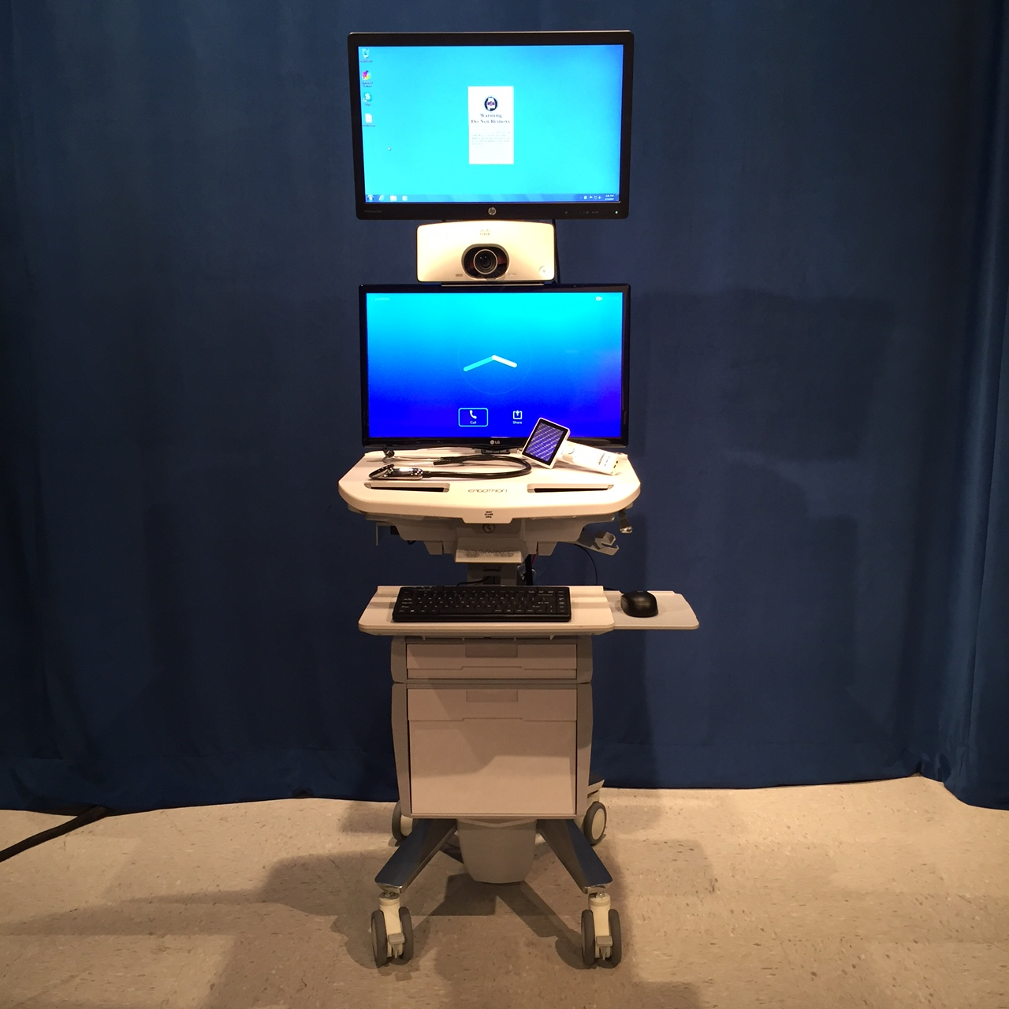
Telehealth Services
ADPH Model:
Custom build Carts
Deploy to Site, Train and Support Staff
Manage Network
$10,000 per Cart
Includes:
Bluetooth Stethoscope
Handheld Exam Camera

Slide 26
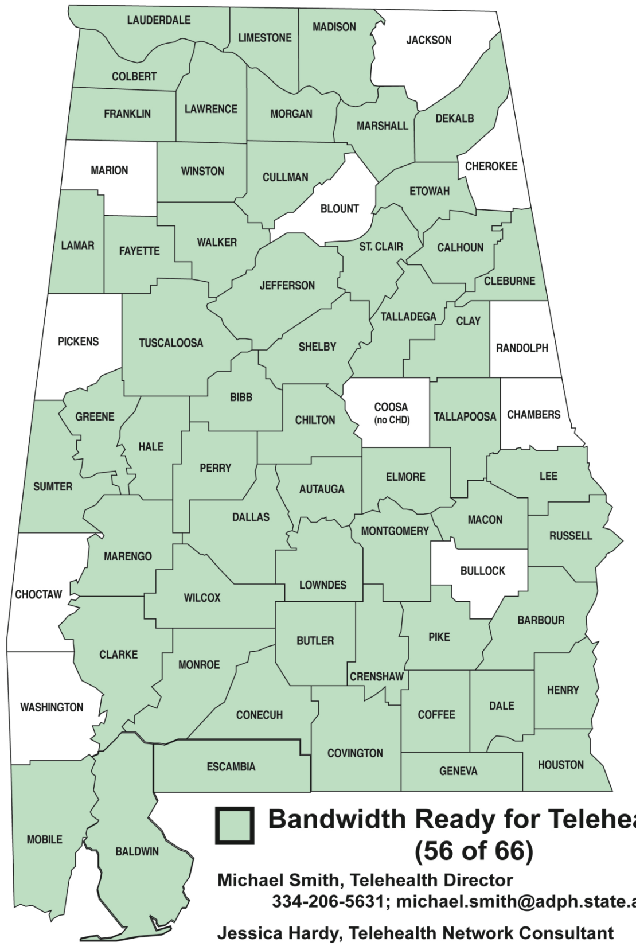
Telehealth at
ADPH County
Health Departments
Medical AIDS Outreach
(HIV/AIDS)
(First telehealth partner)
CHD Telehealth Sites Started February 2015

Slide 27
Telehealth at
ADPH County
Health Departments
Medical AIDS Outreach
UAB School of Medicine
(Monthly appointments for home dialysis patients)

Slide 28
Telehealth at
ADPH County
Health Departments
Medical AIDS Outreach
UAB School of Medicine
AIDS Alabama
(Mental health)

Slide 29
Telehealth at
ADPH County
Health Departments
Medical AIDS Outreach
UAB School of Medicine
AIDS Alabama
ADPH STD Program
(Patient education)

Slide 30
Telehealth at
ADPH County
Health Departments
Medical AIDS Outreach
UAB School of Medicine
AIDS Alabama
ADPH STD Program
University of South Alabama
(Diabetes education)

Slide 31
Telehealth at
ADPH County
Health Departments
Medical AIDS Outreach
UAB School of Medicine
AIDS Alabama
ADPH STD Program
University of South Alabama
Veterans Affairs
31 CHD Telehealth Sites
As of February 2018

Slide 32
Alabama County Health Departments: Single and Neutral Point of Entry for
Telehealth Clinics
For
All Health Care Services
Partnerships and Collaboration

Slide 33
Milestones
2014: Purchase components / build carts
($10,000 vs. $30,000 per cart)
2015: 44 of 66 county health departments have bandwidth for telehealth
  Deployed 6 carts
2016: Deployed 10 carts (16 total)
2017: 60 of 66 county health departments have bandwidth for telehealth
  Deployed 13 carts (29 total)
2018: 54 ADPH County Health Departments have telehealth carts!

Slide 34

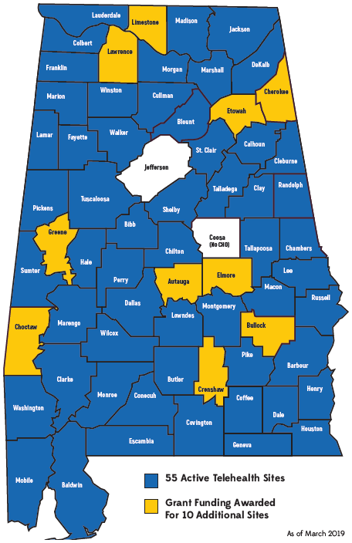
Telehealth
Clinics
at
ADPH
County
Health Departments
55 Active Telehealth Sites
Grant Funding Awarded for 10 Additional Sites
As of March 2019

Slide 35
Alabama Telehealth Champions
ADPH Programs
AIDS Alabama
Alabama Department of Mental Health
Alabama Department of Rehabilitation Services
Alabama Health Action Coalition
Alabama Lions Sight Conservation Association
Auburn University
Birmingham VA Medical Center
Children’s Hospital of Alabama
Five Horizons Health Services
Medical Advocacy and Outreach
UAB Medical Center; UAB Genetics Department
University of South Alabama

Slide 36
Telehealth Services
Behavioral health Cardiology
Diabetes education Family planning
Genetic counseling HIV/AIDS
Maternal fetal medicine Nephrology
Neurology Rheumatology
Surgery Consults Sleep Medicine
Urology Palliative Care
Opioid agonist therapy for pregnant women
Pre/Post procedure consultations
STD education, counseling, partner tracing
Also used for meetings and training

Slide 37
Telehealth Services
Coming Soon:
Bone Marrow Transplant
Physical Medicine and Rehabilitation
Pre Exposure Prophylaxis

Slide 38
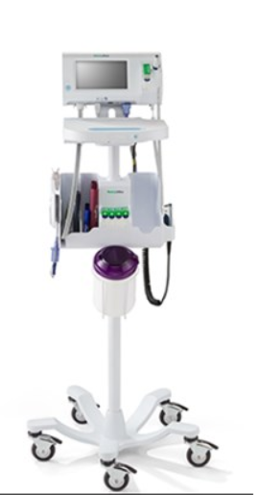
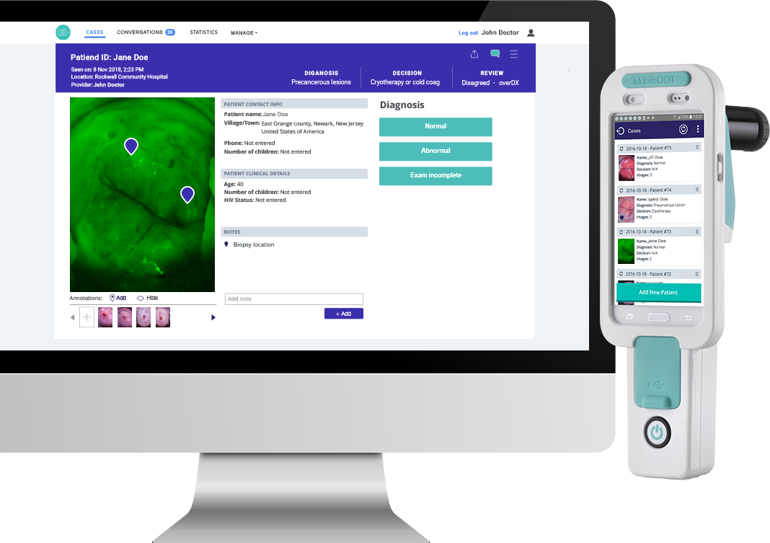
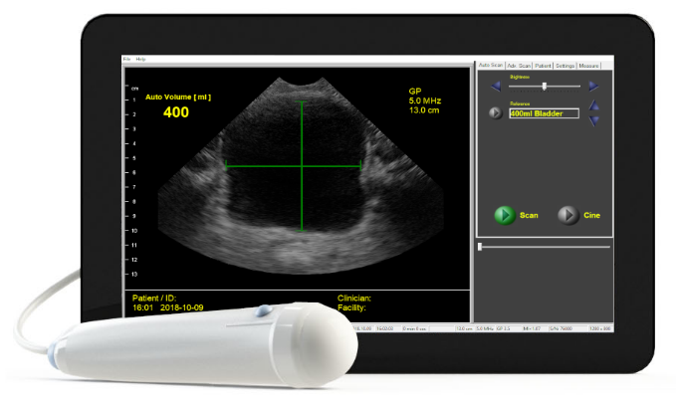
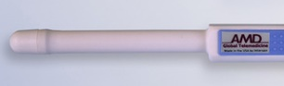
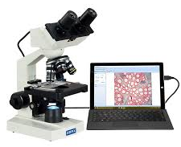
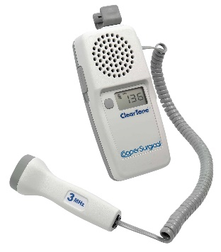

Specialty Peripheral Equipment
Vital Signs Electronic Monitor
Family Planning
Visualization Technology
Ultrasound Probes
Laboratory Training
Maternal Fetal Medicine

Slide 39
Data x Vision x First Steps Resistance
(Obstacles, Challenges, etc)
V

Slide 40
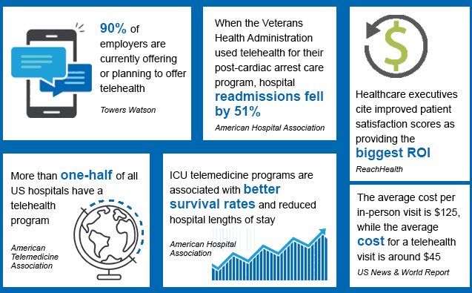

Slide 41
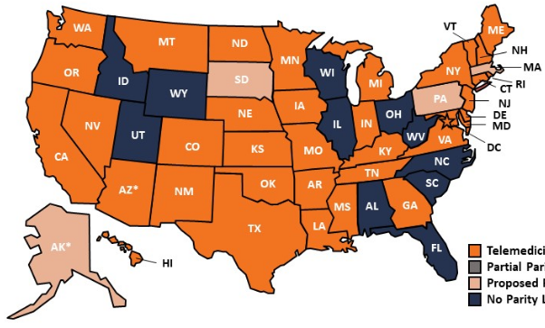
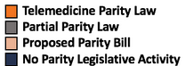
States with Parity Laws for Private Insurance Coverage of Telemedicine
American Telemedicine Association 2018

Slide 42
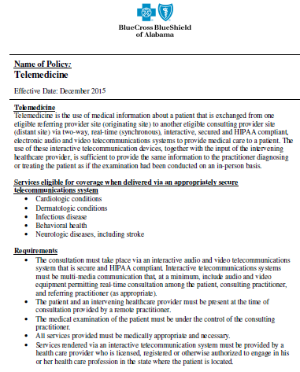
Effective November 1, 2018
BCBS reimburses providers for all telehealth delivered services if they are presently covered under BCBS policy.

Slide 43
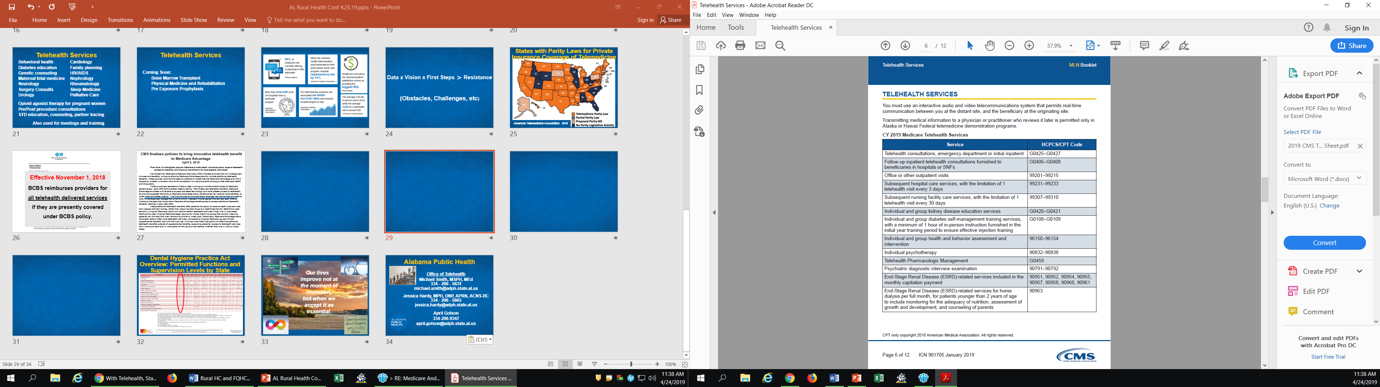

Slide 44
CMS finalizes policies to bring innovative telehealth benefit to Medicare Advantage
April 5, 2019
Final Rule will strengthen popular Medicare private health insurance plans, expand telehealth access for patients, and improve coordination for dual-eligible individuals
The Centers for Medicare & Medicaid Services (CMS) finalized policies that will increase plan choices and benefits, including allowing Medicare Advantage plans to include additional telehealth benefits. These policies continue the agency’s efforts to modernize the Medicare Advantage and Part D programs, unleash innovation and drive competition to improve quality among private Medicare health and drug plans.
“Today’s policies represent a historic step in bringing innovative technology to Medicare beneficiaries,” said CMS Administrator Seema Verma. “With these new telehealth benefits, Medicare Advantage enrollees will be able to access the latest technology and have greater access to telehealth. By providing greater flexibility to Medicare Advantage plans, beneficiaries can receive more benefits, at lower costs and better quality.” The final policies announced today leverage new authorities provided to CMS in the Bipartisan Budget Act of 2018, which President Trump signed into law last year. CMS is finalizing changes that would allow Medicare Advantage beneficiaries to access additional telehealth benefits, starting in plan year 2020.
These additional telehealth benefits offer patients the option to receive health care services from places like their homes, rather than requiring them to go to a healthcare facility. Before this year, seniors in Original Medicare could only receive certain telehealth services if they live in rural areas. Starting this year, Original Medicare began paying for virtual check-ins across the country, meaning patients can connect with their doctors by phone or video chat. Historically, Medicare Advantage plans have been able to offer more telehealth services, compared to Original Medicare, as part of their supplemental benefits. But with the final rule, it will be more likely that plans will offer the additional telehealth benefits outside of supplemental benefits, expanding patients’ access to telehealth services from more providers and in more parts of the country than before, whether they live in rural or urban areas.

Slide 45
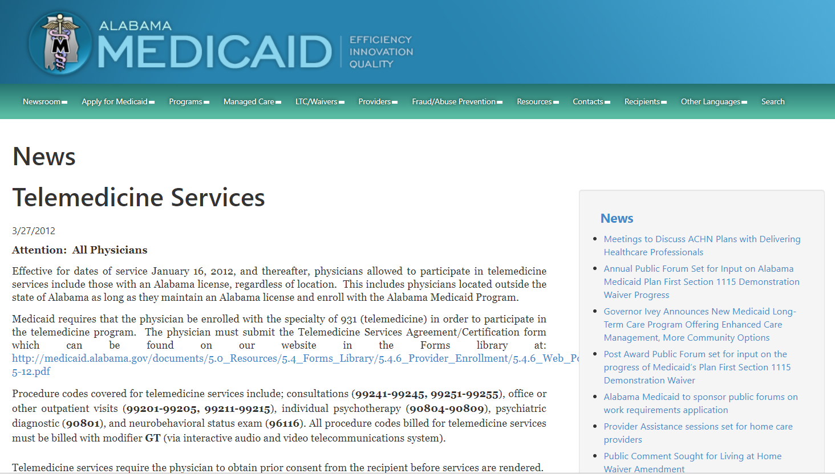

Slide 46
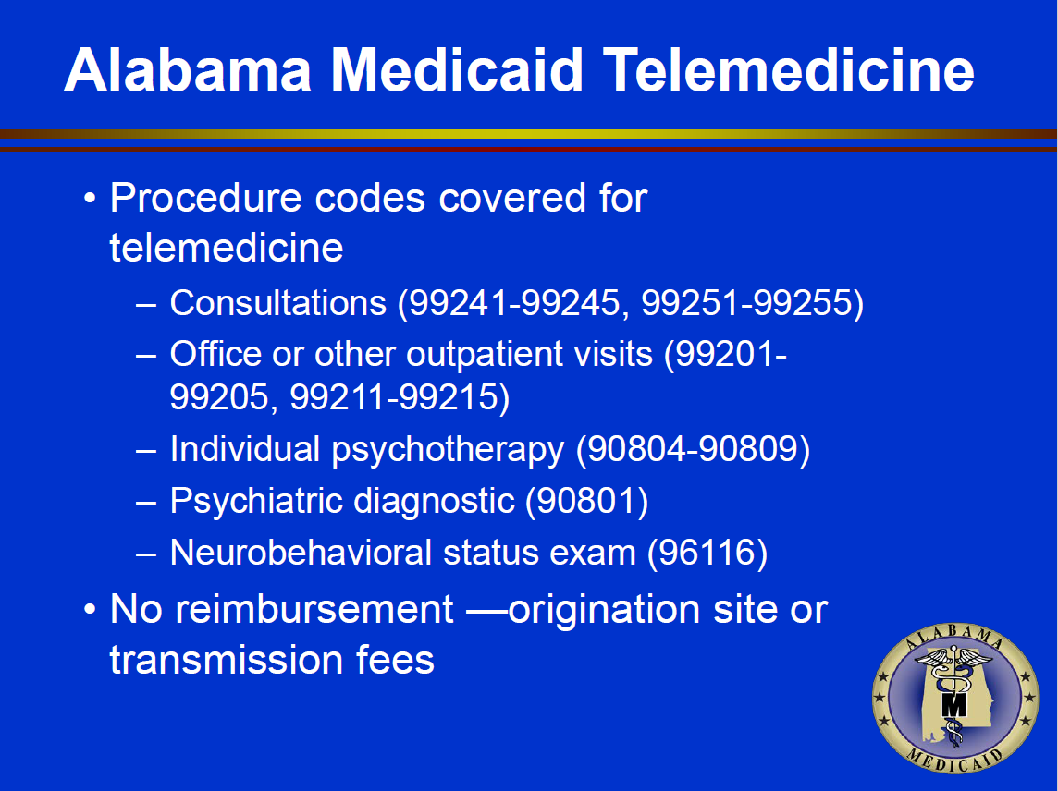

Slide 47
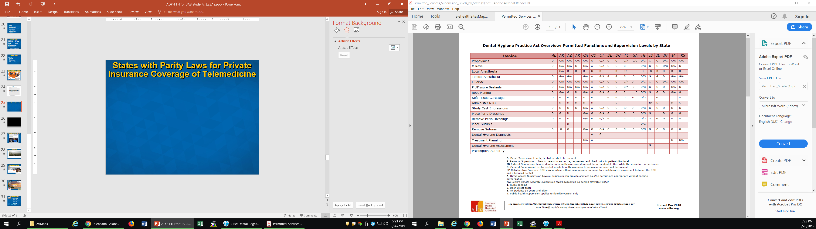
Dental Hygiene Practice Act Overview: Permitted Functions and Supervision Levels by State

Slide 48
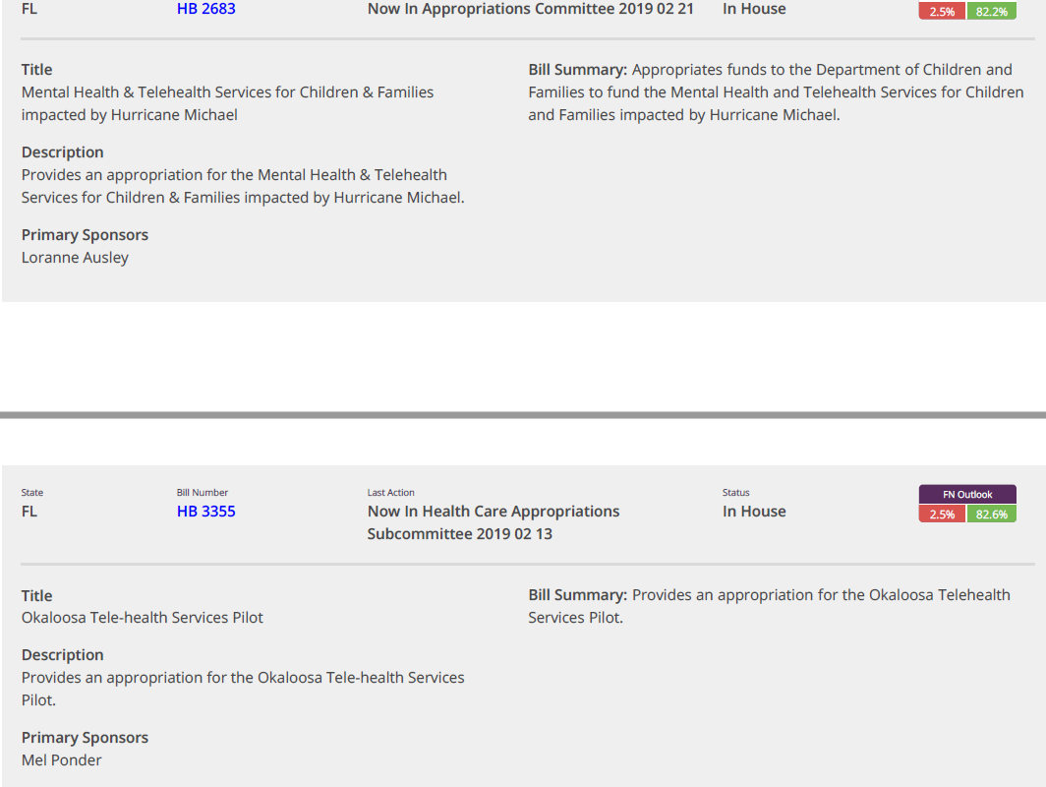

Slide 49





  Our lives improve not at the moment of invention, but when we accept it as essential.
  And
  Adjust our Workplace Culture and Rules and Regulations.

Slide 50

Alabama Public Health
Office of Telehealth
Michael Smith, MSPH, MEd
334 - 206 - 5631
michael.smith@adph.state.al.us
Jessica Hardy, MPH, DNP, APRN, ACNS-BC
334 - 206 - 5665
jessica.hardy@adph.state.al.us
April Golson
334-206-9347
april.golson@adph.state.al.us

Slide 51

Lloyd Sirmons – Director www.setrc.us – 888.738.7210

Slide 52
On August 20, 2010, Georgia Partnership for TeleHealth (GPT, www.gatelehealth.org) was awarded a HRSA grant from the Office for the Advancement of TeleHealth: Southeastern TeleHealth Resource Center.
Grant Re-Awarded 2013, 2016, 2017 (Grant #: G22RH30350)

Slide 53
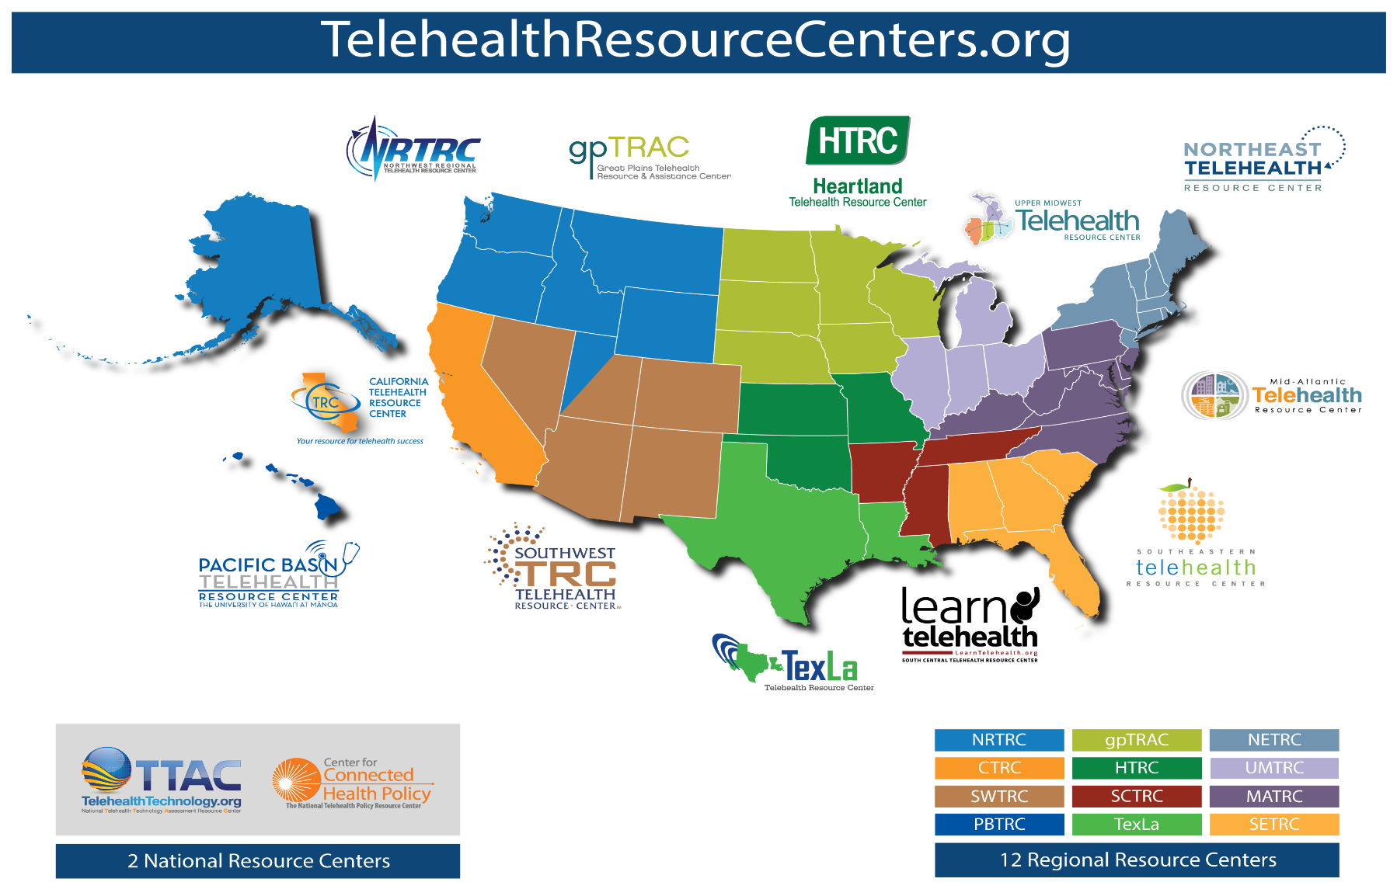

Slide 54

Proud partner of the
National Consortium of Telehealth Resource Centers

Slide 55
SETRC provides an applied approach to telehealth education and technical assistance services in order to streamline implementation and better utilize telehealth applications and technology in the region.
Workgroups
  Provide insight and direction regarding the advancement of telehealth and encourage collaboration among existing telehealth networks and programs.
Education
  Online education through the National School of Applied Telehealth (www.nsat.us)
Awareness
  Present and Exhibit at State, Regional & National Events & Meetings

Slide 56
SETRC Advisory Committee
Dr. Anne Burdick – FL – U of M
Mike Smith – FL – FSU
Ron Sparks – AL
Dr. Eric Wallace – AL - UAB
Jeff Robbins – GA – Tift Regional
Jill Davis – GA – Collaborative Telehealth Consulting
Kathy Schwarting – SC – Palmetto Care Conn
Dr. Katie Cristaldi – SC Center of Excellence

Slide 57

NSAT is the education arm of the SETRC and delivers
standardized, accredited, and affordable online telehealth education.
The online Telemedicine / Telehealth Certification courses instruct on the essentials of telehealth and prepare individuals to become valuable members of a telehealth team. A completion certificate with 0.3 CEU/3 credit hours for this course will be awarded when all Learning Outcomes Conditions have been met.
As an IACET Authorized Provider, HomeTown Health University (NSAT) offers continuing education units (CEUs) for its programs that qualify under IACET guidelines (www.iacet.org)

Slide 58
NSAT – Online TeleHealth Courses
www.nsat.us
Telemedicine Presenter Course
designed so that its graduates will gain insights and skills in order to correctly and confidently present patients during virtual encounters with healthcare providers and a variety of specialists.
Telehealth Coordinator Course
designed so that its graduates will gain insights and skills to successfully implement, coordinate, and manage a telehealth program.
Telehealth Liaison Course
designed so that its graduates will gain insights and confidence to successfully serve as a leader, promoter, and marketer in the telehealth industry.

Slide 59

Why ???
Increased Access to Quality Care
Enhanced support to Patients and Families
Increased Access to Information
Increased Access to Training
Cost Savings

Slide 60
Where???
Large and small hospitals
Private physician offices
Skilled Nursing Facilities (SNFs)
School Based Health Centers
Mental Health Centers
Correctional Institutes
Colleges/Universities
Ambulances

Slide 61
Telemedicine Billing
Bill Insurance
  Modifiers
    CMS & Medicaid
    (POS 02)
    GT – Live video
    GQ – Store and forward
Contract with Providers
Direct-to-Consumer
  Direct Bill patient
Medicaid
CMS (Medicare)
Private Payers

Slide 62
Opioids & SUD
    The SUPPORT for Patient and Communities Act required CMS to adjust their reimbursement policy of telehealth for treating individuals with SUDs or a co-occurring mental health disorder.
    Removed the originating site geographic requirements for telehealth services on or after July 1, 2019 for any existing Medicare telehealth originating site (except for a renal dialysis facility).
    Home was made an eligible originating site for purposes of treating these individuals, however the home would not qualify for the facility fee.
    Within 5 years a report of the impact of telehealth services on SUD must be submitted by the Secretary

Slide 63
Opioids & SUD
    Guidance by CMS given to states regarding options for receipt of federal funds for Medicaid covered treatment of SUD through telehealth
    Guidance by CMS on availability of federal funding in Medicaid coverage for SUD treatment services using telehealth through managed care and school-based health centers
    Within one year the DEA must have final regulations for a special registration to remotely prescribe Suboxone/Buprenorphine through telehealth

Slide 64
Lloyd Sirmons – Director www.setrc.us – 888.738.7210

